Slide 1
IEEE 1914 WG
2017 January Meeting Logistics
Jinri Huang, China Mobile

Slide 2
Basic information
Date:
17-19, Jan, 2017, Tuesday to Thursday
9AM – 5PM
Venue:
Hotel: Double Tree Hilton Hotel Beijing, 北京希尔顿逸林酒店
Address: 168 Guang'anmen Wai Main Street Xicheng District, Beijing, 100055, China
http://doubletree3.hilton.com/en/hotels/china/doubletree-by-hilton-hotel-beijing-BJSDTDI/index.html
Major airport：
Beijing Capital International Airport
Registration fee
300USD by Sunday, Jan. 8th, 2017
400USD after Jan. 8th.
Lunch and snacks included
Gluten free and vegetarian food provided on request

Slide 3
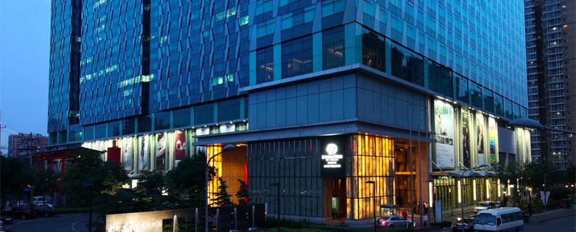
Double Tree Hilton Hotel Beijing, 北京希尔顿逸林酒店
Only 85 meters away from Exit C, Daguanying Station, Subway Line 7

Slide 4
How to get to the hotel from airport?
38 km (about 1h), cost around RMB 130. Please show the following card to the taxi driver.
请带我去北京希尔顿逸林酒店
Please take me to …
地址：北京市西城区广安门外大街168号
Address: No. 168, GuangAnMen Wai Street, Xicheng District, Beijing

Slide 5
For more information, refer to:
http://doubletree3.hilton.com/en/hotels/china/doubletree-by-hilton-hotel-beijing-BJSDTDI/index.html
Or email to: Annie.zhang3@hilton.com
Or call: 0086-10-6338-1888
（Front desk Ext.1666, Reservation:Ext.1831/1832/1833/1834, Sales persons: ext.1821 ）

Slide 6
Room reservation
CMCC has reserved blocks of rooms for the meeting
Group rate is: CNY 580net/nights, include tax, service charge, 1 breakfast and internet.
To reserve the room:
Please email to:Annie.zhang3@hilton.com,
CC: reservation.dtbeijing@hilton.com; huangjinri@chinamobile.com;
Need to remark company name and meeting name
Note: the cut-off date for the group price is 10th Jan 2017
Cancellation policy:
Free for cancellation 24 hours before the day of arrival

Slide 7
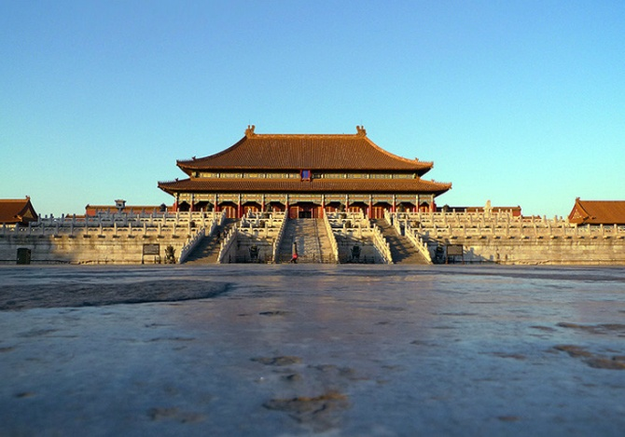
Most famous tourist attractions in Beijing
Imperial Palace
Great Wall
Summer Palace

Slide 8
Need more help?
To reach
Jinri Huang at 0086-1391049-0429, huangjinri@chinamobile.com, or
For hotel issues: Annie.zhang3@hilton.com

Slide 9
Visa information
For invitation letter, please contact with IEEE staff Soo Kim at s.h.kim@ieee.org and provide the following information:
First Name, Last Name:
Company Name:
Company Address:
Company Phone:
Company E-mail:
Mobile Phone (If possible):
Date of Birth:
Place of Birth:
Passport ID Number:
Passport Expiration Date:
Passport Nationality:

