Slide 1
IEEE 1914 NGFI Working Group
June 2017 Meeting Logistics
Hosted by Sarokal Test Systems

Slide 2
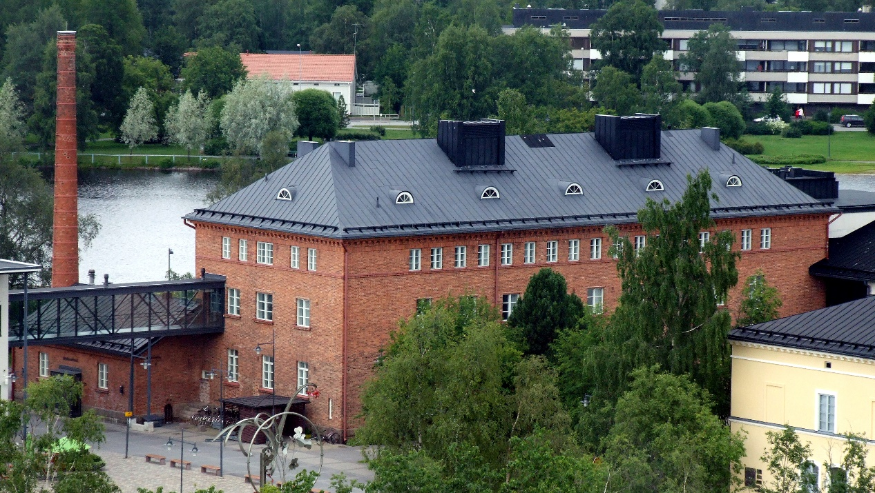
Top Level Summary
Meeting Dates
June 28-30, 2017
9:00 AM – 5:00 PM
Location
https://lasaretti.com/en/
Kasarmintie 13b, FIN-90130 Oulu tel. +358 20 757 4700
Major Airports
Transfer from Helsinki (HEL)
to Kemi-Tornio Airport (KEM)
Registration Fee:
$400 before June 12th
$500 after June 12th
Breakfast, lunch and snacks included
Gluten free and vegetarian food provided on request

Slide 3
Getting from Helsinki to Oulu
Oulu airport will be closed for renovation during 26. June -31. July 2017.
Attendees are adviced to fly from Helsinki to Kemi-Tornio airport from where there will be a bus transportation to Oulu bus station (111km / estimated travel time 1h 20min). The coach/bus transportation from Kemi airport to Oulu is free. However, attendees have to register online for the transportation prior to their arrival (see below).
Attendees can also take the train from Helsinki to Oulu (minimum travel time 5h 30min)
Train schedules: https://www.vr.fi/cs/vr/en/frontpage
Schedules for airport bus transportations (Kemi-Tornio – Oulu – Kemi-Tornio): https://www.finavia.fi/en/oulu/oulu-airport-air-traffic-in-the-summer-2017/transportations/
Registration to airport bus transportation: https://www.finavia.fi/en/oulu/oulu-airport-air-traffic-in-the-summer-2017/registration-to-transportation/
Car rentals:
https://www.sixt.fi/en/
https://secure.avis.fi/en/?

Slide 4
Getting from Helsinki to Oulu (2)
The coach/bus from Kemi airport arrives at Oulu bus station, which is located in Oulu city centre. The distance from the station to the hotel is only 1,5 kilometers. However, there are no convenient public transportation options from the bus station to the hotel available, so the easiest way is to take a taxi to the hotel. There is a taxi pole on one side of the bus station. There are no subways or trams in Oulu.
Oulu taxi service in English: http://www.oulunaluetaksi.fi/sivu/fi/in_english/
To call a taxi:
- When in Finland: 0600-30081 (1,59 € + 0,48€/min + local network charge)
- Calling from abroad: +358 600 30081

Slide 5
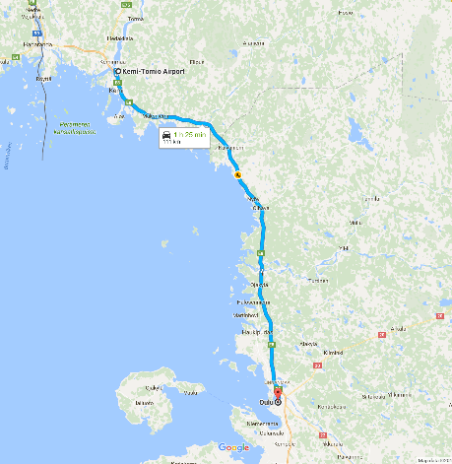
Getting to Oulu via Kemi-Tornio airport

Slide 6
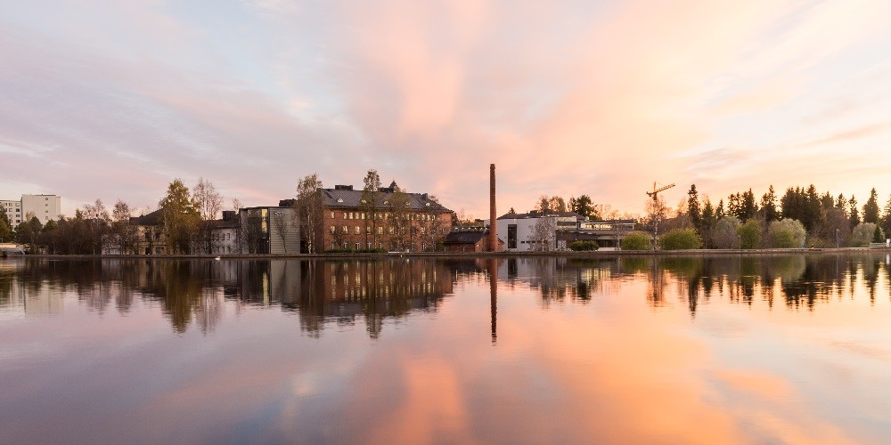
Lodging option
Hotel Lasaretti
Address: Kasarmintie 13b, FIN-90130 Oulu
Prices on Hotel Lasaretti: 93 €/night/single room, 110 €/night/double room.
Reservations: lasaretti@lasaretti.com or tel. +358 20 757 4700.
Block code: “Sarokal”. Room block is valid until 14th June 2017.
More information: http://lasaretti.com/en/rooms/ ”
Parking included
Breakfast included
https://lasaretti.com/en/

Slide 7
Meeting venue
Hotel Lasaretti, MERIKOSKI HALL
https://lasaretti.com/en/meetings-parties/venues/merikoskihall/

Slide 8
Visa Information
For invitation letter, please contact with Mikko Karppinen (mikko.karppinen@sarokal.fi) and provide the following information:
First Name, Last Name:
Company Name:
Company Address:
Company Phone:
Company E-mail:
Mobile Phone (If possible):
Date of Birth:
Place of Birth:
Passport ID Number:
Passport Expiration Date:
Passport Nationality:

Slide 9
About Oulu
A short scenery video made by the City of Oulu (Youtube): https://www.youtube.com/watch?v=I-67WDpMdvg

Slide 10
Need more help?
Please contact:
Mikko Karppinen (mikko.karppinen@sarokal.fi) from Sarokal, or
Jinri Huang (huangjinri@chinamobile.com), WG chair

