Slide 1
IEEE 1914 NGFI WG
March 2018 Meeting Logistics
Hosted by SM Optics

Slide 2
Top Level Summary
Meeting Dates
March 5th-7th, 2018
9:00 AM – 5:30 PM
Meeting venue
Politecnico di Milano
Piazza Leonardo da Vinci 32
20133 Milano (MI) - Italy
Airports
Malpensa (MXP)
Linate (LIN)
Orio al Serio (BGY)
Registration Fee:
USD 200 before/on Feb. 23
USD 300 after Feb. 23.
Coffee breaks and lunch included - REMARK: Gluten free and vegetarian food provided on request

Slide 3
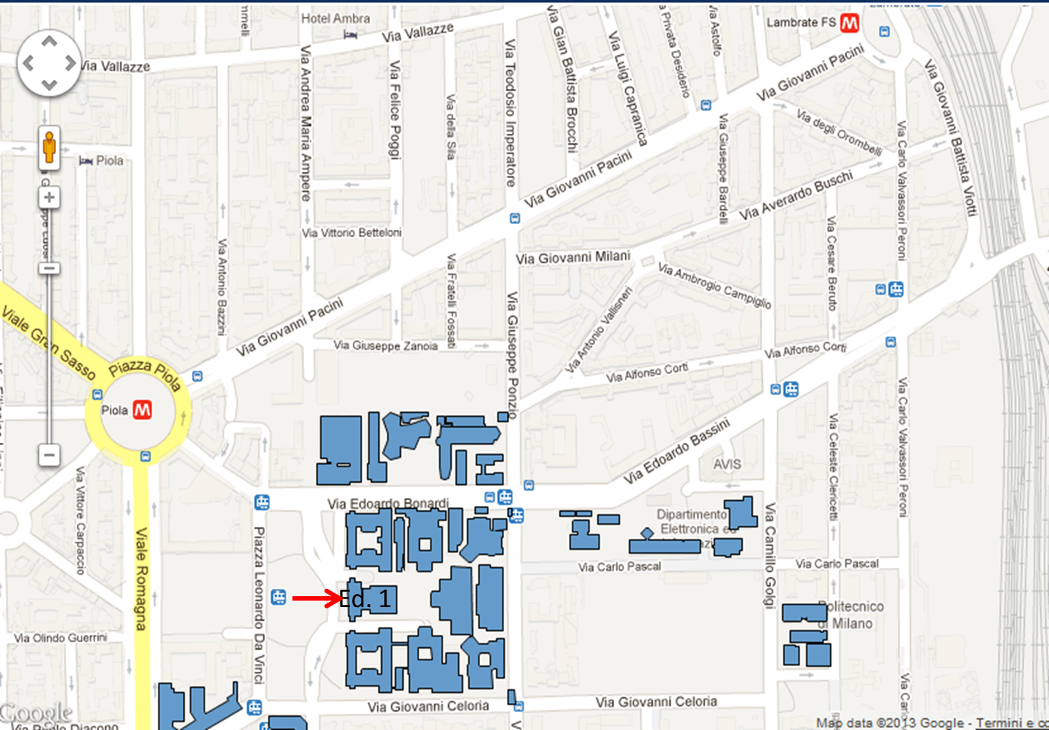
Meeting venue
The 1914 WG meeting will be held at the premises of Fondazione Politecnico di Milano (FPM).
FPM is located at the ground floor of the “Politecnico di Milano”, Building 1 (see Ed.1 ),
(right side with respect to the stairs).

Slide 4
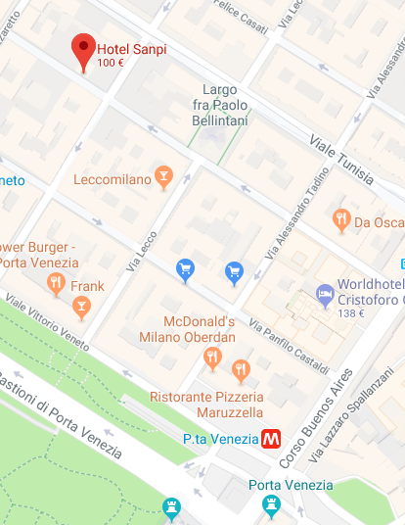
Recommended lodging option
Hotel Sanpi – Via Lazzaro Palazzi, 18 – 20124 – Milano
Price (breakfast included):
March 3rd
  Single room: 169 €;
  Double room (used as single room): 180 €;
  Double room: 199 €
March 4th to 8th
  Single room: 110 €;
  Double room (used as single room): 115 €;
  Double room: 129 €
Cancellation policy：
  Free of charge up to 24h before scheduled arrival
Block code:
  “IEEE” or “meeting Politecnico” to be mentioned
    upon reservation.
Reservation and info:
  Tel: +39 02 29513341 - Fax: +39 02 29402451
  Email: info@hotelsanpimilano.it
  http://www.hotelsanpimilano.it/
REMARK – No time limit applies to the ”block code” usage. Just, due to the high request, room availability is expected to decrease over time.
Metro - “Porta Venezia” station
(M1 line underground) is 5/8 min walking from hotel

Slide 5
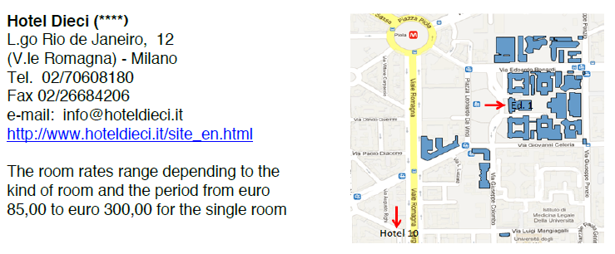
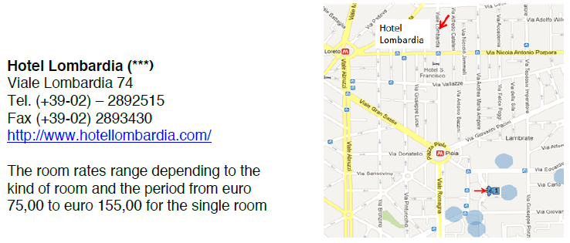
Alternative lodging options (no special rate agreed)

Slide 6
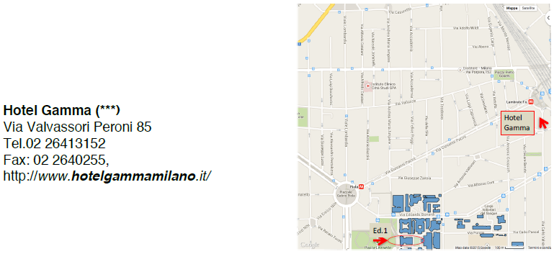
Alternative lodging options (no special rate agreed)

Slide 7
How to reach meeting venue...
From Malpensa Airport
Option 1 - “Malpensa Express” train, connecting every 30 minutes, both T1 and T2 terminals, to “Milano Centrale” or “Milano Cadorna” railway stations (depending on the races). Both destinations are served by (underground green line): get train to “Gobba/Gessate/Cologno Nord” direction and get off at “Piola” stop.
See map in slide 3 to walk to POLIMI (5 min)
Estimated trip time and cost (Malpensa to POLIMI): ~ 1h10-20min / 13 eu (train) + 1.5 eu (underground).
REMARK - “Malpensa Express” ticket locally bought (at airport or railway station desk) has to be stamped at the proper machine before accessing platforms. No need for ticket bought on-line.
Option 2 – “Terravision” or “Malpensa Shuttle” bus service, connecting every 20 minutes Malpensa Airport to “Milano Centrale” railway station. Once in “Milano Centrale”, get again
to “Gobba/Gessate/ Cologno Nord” direction and get off at “Piola” stop.
Then walk to POLIMI.
Estimated trip time and cost: ~ 1h10-20min / 8 eu (Terravision bus) or 10 eu (Malpensa Shuttle bus) + 1.5 eu (underground).
Option 3 - Taxi service, directly from Malpensa Airport to POLIMI.
Estimated trip time and cost: ~ 1h10-20min / 95 eu.
REMARK – Only white cabs (with small “Taxi” light panel on the roof) are regulated/ authorized by Municipality of Milan (Comune di Milano). Taxi parking in Malpensa Airport is showed by dedicated signs

Slide 8
How to reach meeting venue...
From Linate Airport
Option 1 – “Linate Shuttle” or “Starfly” bus service, connecting every 30 minutes Linate to “Milano Centrale” railway station. Once in “Milano Centrale”, get - “Gobba/Gessate /Cologno Nord” direction and get off at “Piola” stop.
Then 5 min walking to POLIMI (see map in slide 3).
REMARK – “Starfly” bus service has an intermediate stop in “Milano Lambrate” railway station, before arriving to “Milano Centrale”; the same M2 line going to Piola may be taken there (see also Milan metro network map in slide 10).
Estimated trip time and cost: ~ 45min / 5 eu (both Linate Shuttle and Starfly bus) + 1.5 eu (underground).
Option 2 - Taxi service, directly from Linate Airport to POLIMI.
Estimated trip time and cost: ~ 20min / 20 eu .
REMARK – Only white cabs (with small “Taxi” light panel on the roof) are regulated/ authorized by Municipality of Milan (Comune di Milano). Taxi parking in Linate Airport is showed by dedicated signs.

Slide 9
How to reach meeting venue...
From Orio al Serio Airport
Option 1 – “Terravision” or “Orio Shuttle” or “Autostradale” bus service, connecting every 30 minutes Orio al Serio Airport to “Milano Centrale” railway station.
Once in “Milano Centrale”, get - “Gobba/Gessate/Cologno Nord” direction and get off at “Piola” stop.
Then walk to POLIMI (see also map in slide 3)
Estimated trip time and cost: ~ 1h / 5 eu (Terravision and Autostradale) or 4 eu (min) (Orio Shuttle bus) + 1.5 eu (underground).
Option 2 - Taxi service, directly from Orio al Serio to POLIMI.
Estimated trip time and cost: ~ 1h / cost depending on the taxi company, roughly around 80 eu.

Slide 10
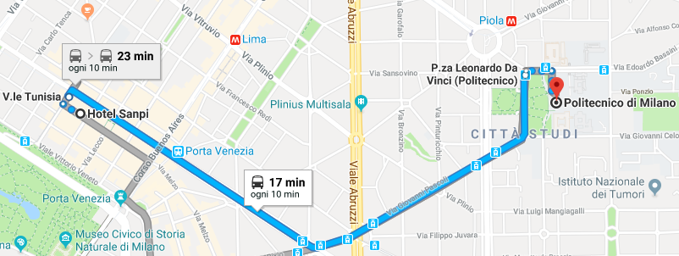
How to reach meeting venue...
From Hotel Sanpi
Option 1 – Walk 2 min to Viale Tunisia (see map below) to get 33 tram (streetcar).
9th stop is Piazza Leonardo Da Vinci (FPM site).
Option 2 - Walk 5 min to – “Porta Venezia” stop and get the train to “Sesto FS” direction (see also map in slide 4).
At “Loreto” stop (2nd stop from Porta Venezia) switch to , get train directed to “Gobba” or “Gessate” or “Cologno Nord” and get off at “Piola” stop (1 stop ahead).
Then walk 5 min to POLIMI (see map in slide 4).
Both options - Estimated trip time and cost: ~ 15/20 min / 1.5 eu (metro/streetcar ticket)

Slide 11
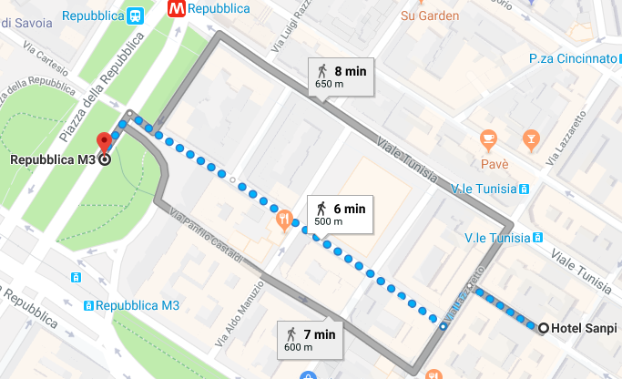
How to reach Hotel Sanpi
From any airport
Option 1 – Reach “Milano Centrale” railway station, via bus connection or “Malpensa Express” connection (as described in slides 5, 6, 7).
Get train (yellow line) to “S.Donato” and get off at “Repubblica” stop
(1 stop ahead).
Then walk ~ 6 min to Hotel Sanpi (see map below).
Estimated trip time and cost: ~ 1h10/20 min /
Connection from airport ticket
(Bus, Malpensa express) + 1.5 eu
(underground).
Option 2 – Taxi service, directly
from (any) airport to the hotel.
estimated trip time and cost as
showed in slides 5, 6, 7.

Slide 12
Public transport tickets
Urban single ticket
Price: € 1.50
Validity: 90 minutes after stamping on any surface transport mean in the urban area with no limitation. Valid for a single journey on the underground (or rail) network.
Urban day ticket
Price: € 4.50
Validity: 24 hours after stamping on any surface mean and underground network in the urban area with no limitation.
Two days urban ticket
Price: 8,25 €
Validity: 48 hours after stamping on any surface mean and underground network in the urban area with no limitation.
REMARK 1 – «Urban area» covers the whole city map except some suburbs zones: urban ticket fits all expected trips related to the meeting
REMARK 2 – Ticket needs to be stamped at the beginning of the trip (both in surface means and in underground lines). When travelling via underground, ticket has to be kept and validated at the exit of the station, as well.

Slide 13
Where buying tickets
Option1 - You can buy tickets at all underground stations from ticket machines selling various types of tickets; these machines accept both coins and bank notes, credits cards and bank cards.
Option 2 - You can buy ATM tickets at any of the around 2.200 authorized outlets (bars, tobacconists, stationers, newspaper stands) found throughout the Milan area and on intercity routes.
Option 3 - The following tickets are available via the ATM MILANO app (Google Play): urban single ticket for 1.50€, urban day ticket for 4,50€ (a QR code will be provided to the smartphone)

Slide 14
Visa Information
For invitation letter, please contact with Nicholas Orlando <n.orlando@ieee.org> and provide the following information:
  First Name, Last Name:
  Company Name:
  Company Address:
  Company Phone:
  Company E-mail:
  Mobile Phone (If possible):
  Date of Birth:
  Place of Birth:
  Passport ID Number:
  Passport Expiration Date:
  Passport Nationality:

Slide 15
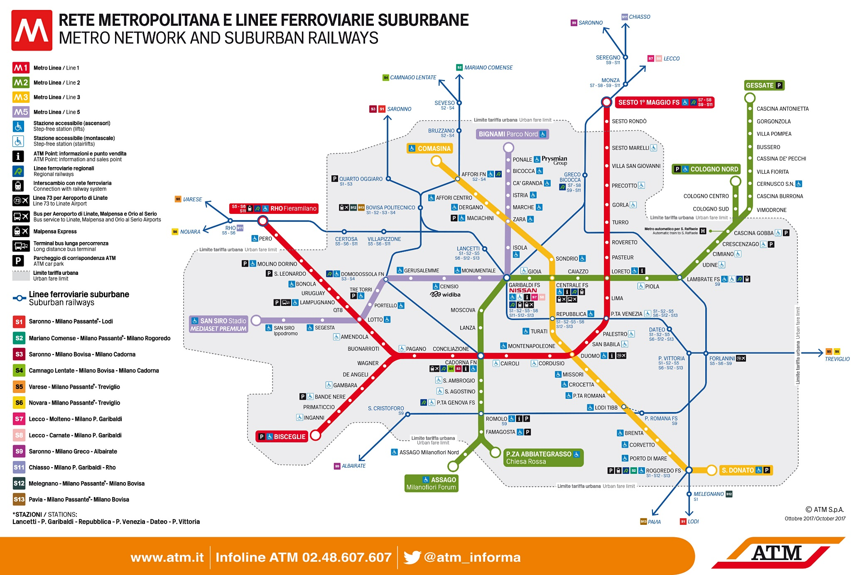
Milan Metro (underground) network

Slide 16
Nice to see in Milan
Many touristic attractions are located in the center of the city, reachable from both Hotel Sanpi or from meeting venue, by M1 line – underground.
«S.Babila», «Duomo», «Cordusio», «Cairoli» stops, all do.
Attractions include also:
Duomo (Milan Cathedral – free and guided tours are available)
Galleria Vittorio Emanuele II (access from Piazza Duomo)
Teatro alla Scala (guided tour only are available)
Piazza Mercanti & Loggia dei Mercanti (middle age attractions, close to Piazza Duomo)
Chiesa di S. Satiro (small and interesting church painted by Bramante around 1500, located in Via Torino 17, close to Piazza Duomo)
Chiesa di S. Maurizio (Leonardo’s school painted church, located in Corso Magenta 15 – free and guided tours available)
Chiesa di S. Maria delle Grazie (located in Piazza S. Maria delle Grazie, free and guided tours of church are available – Visit to «The Last Supper» by Da Vinci are guided only and need to be booked in advance)
Castello Sforzesco (located in Largo Cairoli – free and guided tours available).
Museums include:
Palazzo Reale (old royal palace hosting today arts exhibitions - access from Piazza Duomo)
Museo del Novecento (modern art museum – access from Piazza Duomo)
Gallerie d’Italia (hosting arts exhibitions – located in Piazza della Scala, 6)
Castello Sforzesco (hosting several museums in its premises – see «milanocastello» link in next slide)

Slide 17
Useful touristic references
The following links may provide useful information on attractions,
organized tours/visits and intineraries.
www.turismo.milano.it/wps/portal/tur/en
www.visitacity.com
www.tripadvisor.com
www.musement.com/us/
www.milanocastello.it
milanostyle.com
delightfullyitaly.com
www.viator.com

Slide 18
Need more help?
Please contact:
  Vincenzo Sestito (vincenzo.sestito@sm-optics.com) from SM Optics, or
  Jinri Huang (huangjinri@chinamobile.com), WG chair; 0086-13910490429

