Slide 1
IEEE 1914 NGFI WG
June 2018 Meeting Logistics v2.0
Hosted by CommScope

Slide 2
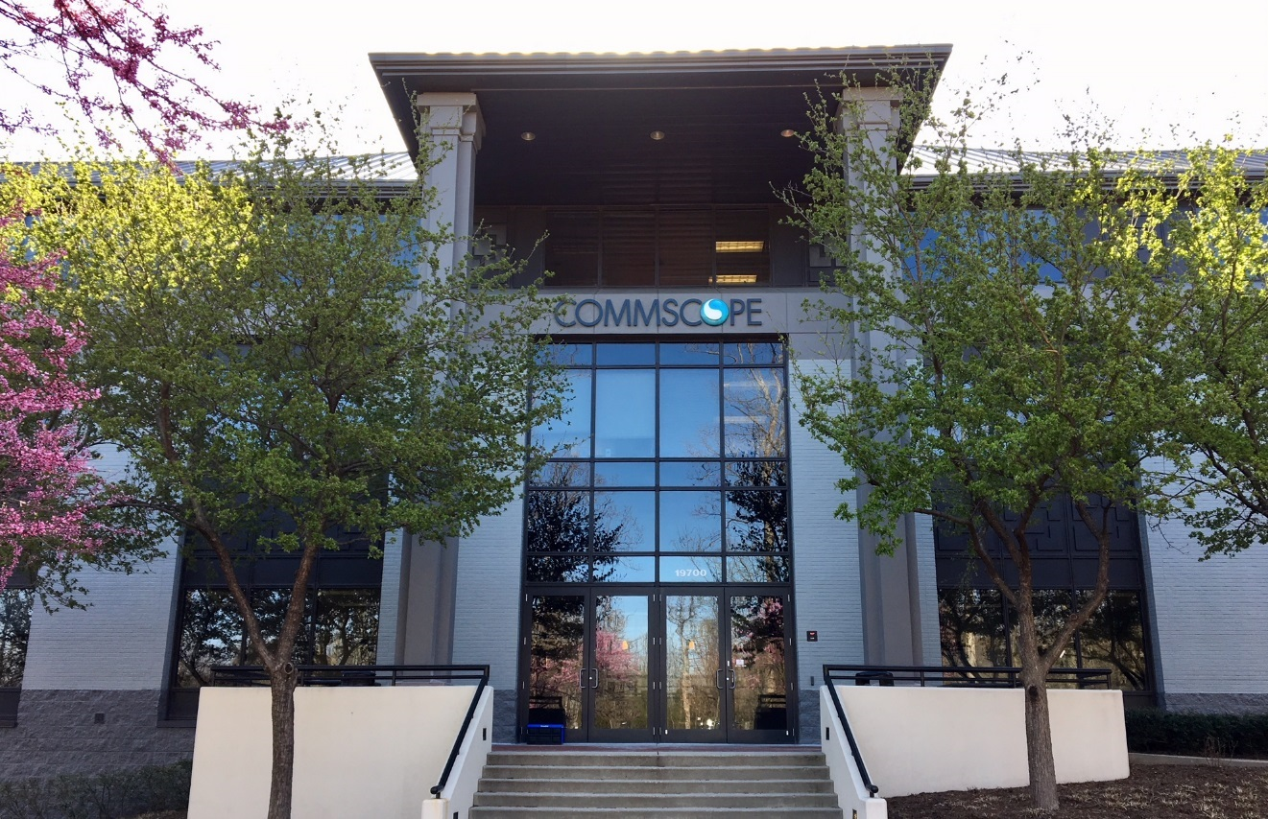
Top Level Summary
Meeting Dates:
June 6-8, 2018
9:00 AM – 5:30 PM
Location:
CommScope
19700 Janelia Farm Blvd.
Ashburn, Virginia 20147
USA
Tel: 703-726-5500
Major Airports:
Washington Dulles International Airport
Ronal Reagan National Airport
Registration Fee:
$100 before May 30th.
$150 after May 30th.
Lunch and snacks included
Gluten free and vegetarian food provided on request. Please email Khalid.al-mufti@commscope.com with your request after you register

Slide 3
Top 2 Lodging options
Option 1:
SpringHill Suites by Hilton
20065 Lakeview Center Plaza, Ashburn, VA 20147
Block reserved under IEEE 1914.
Use this link for online reservation: Book your group rate for IEEE 1914
For reservation by phone call: 703-723-9300 or 1-888-287-9400
Reference code: IEEE 1914
Rate $149 + Tax, rate valid through May 18th. Breakfast included.
Block of 15 rooms has been reserved. Hotel can add 5 more room if block fills a week from the 18th, so we are covered for 20 people.
Cancelation policy: 100% refund if canceled at least 48 hours prior to check in date, otherwise will be charged for 1st night.
Click here for Hotel website
Option 2:
Double Tree by Hilton Hotel Sterling
21611 Atlantic Blvd, Sterling, VA 20166
No block reserved.
Hotel website
Additonal options shown on next slide

Slide 4
Additional hotel options within 10 miles of CommScope
Hotel name | Phone
Lansdown Resort and Spa | (703) 729-8400
Homewood Suites by Hilton Dulles-North/Loudoun | (703) 723-7500
Courtyard by Marriott | (571) 434-6400
Candelwood Suites Washington Dulles sterling | (703) 674-2288
Emabssy Suites Dulles -North/Loudoun | (703) 723-5300
Double Tree by Hilton Sterling - Dulles Airport | (703) 230-0077
Residence Inn Dulles Airport at Dulles 28 Centre | (703) 421-2000
Hyatt Place Sterling/Dulles Airport-North | (703) 444-3909
Hampton Inn Dulles/Cascades | (703) 450-9595
SpringHill Suites by Marriott Dulles Airport (*) | (703) 444-3944
Fairfield Inn & Suites by Marriott at Dulles Airport | (703) 435-5300
Best Western Dulles Airport Inn | (703) 471-8300
Hyatt House Sterling/Dulles Airport-North | (703) 435-9002

Slide 5
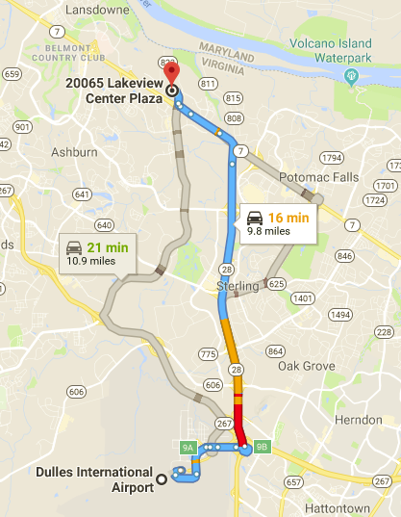
Transportation from Airports to SpringHill Suites Hotel
From Dulles International Airport (IAD):
Dulles Airport shuttle service Super Shuttle Airport Shuttle https://www.shuttlefare.com/washington_dulles_airport_shuttle_iad
Alternatively, SpringHill Suites provides free shuttle to/from IAD. Contact hotel and arrange based on your travel itinerary (16minutes).
To/from IAD to most hotels Uber is $20 to $30 (25 minutes).
Taxi to/from IAD fair ~$25.

Slide 6
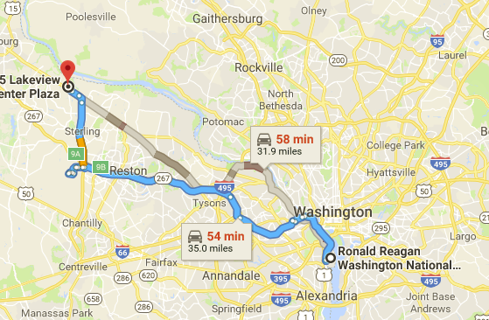
Transportation from Airports continued:
From Ronald Reagan Washington National Airport (DCA):
Metro + Uber/Taxi Option:
Take Metro’s Blue line from DCA to Largo Town Center
Exit at Rosslyn Metro Station
From Rosslyn Metro Station take Silver Line to Wiele Reston East station
Take Uber/Taxi to hotel ($25 to $35).
Duration is 1hr 20min (57mins metro + 20min Uber)
Uber/Taxi or rental car directly from DCA
1hr approximate drive time

Slide 7
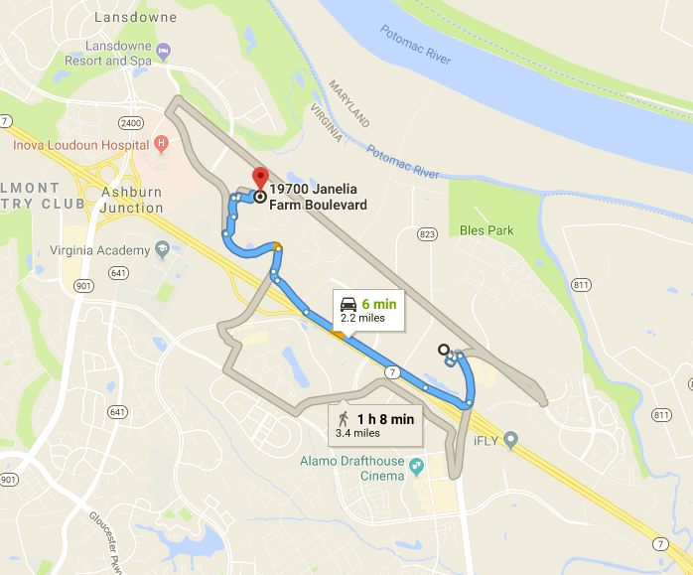
Directions from SpringHill Suites Hotel to CommScope
From SpringHill Suites Hotel:
Free shuttle, 2.2miles 6min
From other Hotels
Check with Hotel as a shuttle may be provided, otherwise, Uber or taxi is suggested.

Slide 8
Visa Information
For invitation letter, please contact with Nicholas Orlando <n.orlando@ieee.org> and provide the following information:
First Name, Last Name:
Company Name:
Company Address:
Company Phone:
Company E-mail:
Mobile Phone (If possible):
Date of Birth:
Place of Birth:
Passport ID Number:
Passport Expiration Date:
Passport Nationality:

Slide 9
Using Metro in Virginia and Washington DC
- Ashburn is approximately 40 minutes from the Nation’s Capital by car.
- Wiehle-Reston East Metro Station is closest Metro Stop to CommScope
Address:
1862 Wiehle Avenue
Reston, VA 20190
It is 20-30 minutes drive from CommScope/SpringHill-Hotel
Approx. $12 round trip cost from Wiehle-Reston to Washington DC.
Visit metro website https://www.wmata.com/ to plan your travel

Slide 10
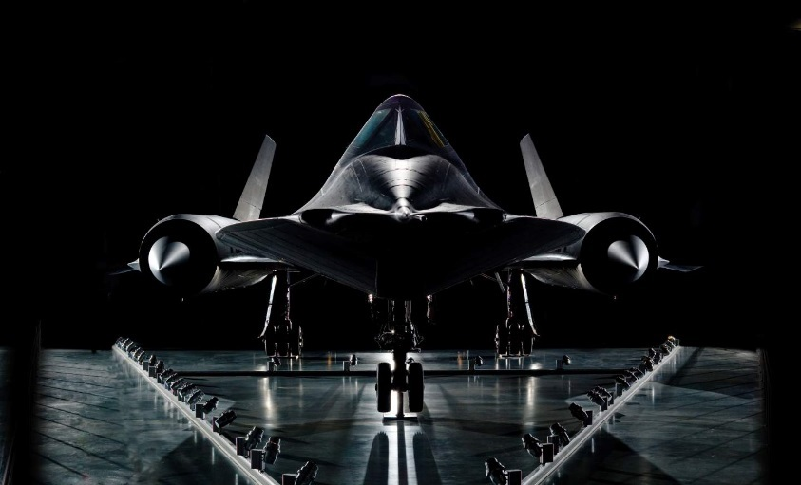
Virginia nearby attractions
National Air and Space Museum annex at Dulles Airport, 14390 Air and Space Museum Pkwy, Chantilly, VA 20151
Great Falls Park, 9200 Old Dominion Drive, McLean, VA 22102

Slide 11
Top attractions in Washington DC
National Mall: https://www.nps.gov/nama/index.htm
Lincoln Memorial: https://www.nps.gov/linc/index.htm
United States Capital: https://www.visitthecapitol.gov/
Smithsonian Institute: https://www.si.edu/
National Air and Space Museum: https://airandspace.si.edu/
National Gallery of Art: https://www.nga.gov/
National Zoological Park: https://nationalzoo.si.edu/
National Museum of Natural History: https://naturalhistory.si.edu/
All national museums and parks free to the public.

Slide 12
Need more help?
Updated
Please contact:
Khalid Al-Mufti
Khalid.al-mufti@commscope.com
1-703-980-0870
Jinri Huang (huangjinri@chinamobile.com), WG chair; 0086-13910490429

