Slide 1
IEEE 1914 NGFI WG
September 2018 Meeting Logistics v1.0
Hosted by AT&T

Slide 2
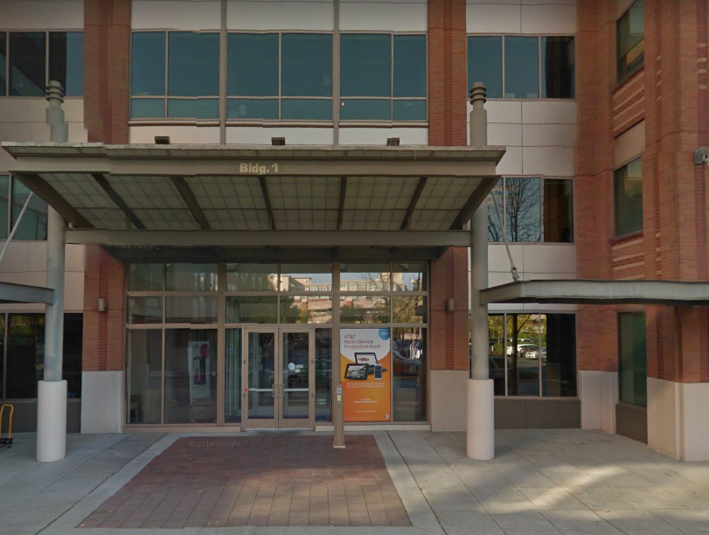
Top Level Summary
Meeting Dates:
September 17-20, 2018
9:00 AM – 5:30 PM
Location:
AT&T
Conference room: 03-3057B
16331 NE 72ND WAY
Redmond, WA 98052
USA
Major Airports:
Seattle-Tacoma International Airport (SEA)
Registration Fee:
$150 before September 10th.
$200 after September 10th.
Lunch and snacks included.
???Gluten free and vegetarian food provided on request. Please email lc779g@att.com with your request after you register

Slide 3
Top 2 Lodging options
Option 1:
Redmond Inn
17601 Redmond Way Redmond, WA 98052
Phone: (425) 883-4900 Fax: (425) 869-5838
Block reserved under AT&T
Call in and supply reference code: AT&T Room Block for reservation
Rate $122 + Tax, rate valid through Sept 5th. Breakfast included.
Block of 15 rooms has been reserved.
Cancelation policy: 24 Hour before the check in date
Hotel Website: http://www.redmondinn.com/
Option 2:
Seattle Marriott Redmond
7401 164TH AVE NE REDMOND
Redmond, WA 98052, USA
Tel: 425-498-4000.
No block reserved
Hotel Website: https://www.marriott.com/hotels/travel/seamc-seattle-marriott-redmond/

Slide 4
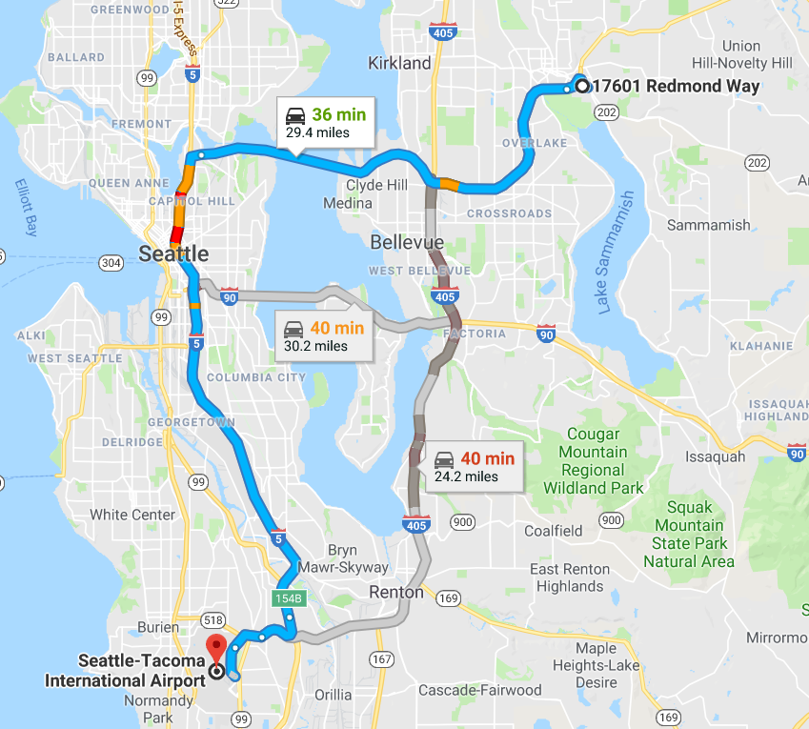
Transportation from Airports to Redmond Inn
From Seattle-Tacoma International Airport (SEA)
Eastside Town Car & Limousine Service
http://www.eastsidetowncars.com/ $60-85, reservation needed
Shuttle Express, call 1-800-487-7433 for reservation, ~$55
To/from SEA to the hotel Uber is ~$45, Taxi ~65$, (~35 minutes).
Driving: 23miles, ~35min

Slide 5
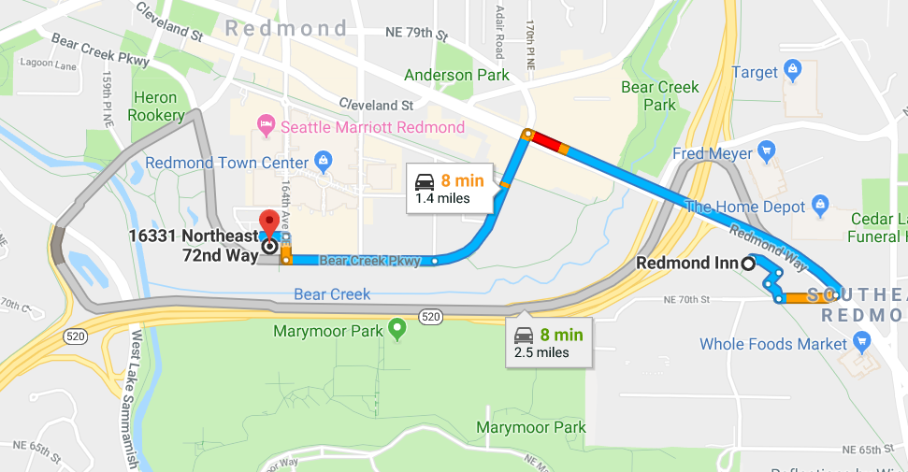
Directions from Hotel to AT&T meeting room
From Redmond Inn:
Free hotel shuttle, 2.5miles 8min
From other Hotels
Check with Hotel as a shuttle may be provided, otherwise, Uber or taxi is suggested.

Slide 6
Visa Information
For invitation letter, please contact with Nicholas Orlando <n.orlando@ieee.org> and provide the following information:
First Name, Last Name:
Company Name:
Company Address:
Company Phone:
Company E-mail:
Mobile Phone (If possible):
Date of Birth:
Place of Birth:
Passport ID Number:
Passport Expiration Date:
Passport Nationality:

Slide 7
Need more help?
Please contact:
Lujing Cai
lc779g@att.com
1-732-772-5717
Jinri Huang (huangjinri@chinamobile.com), WG chair; 0086-13910490429

Slide 8
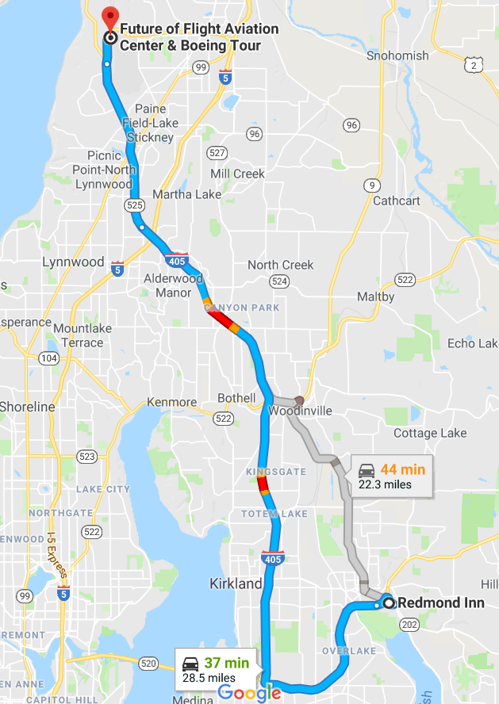
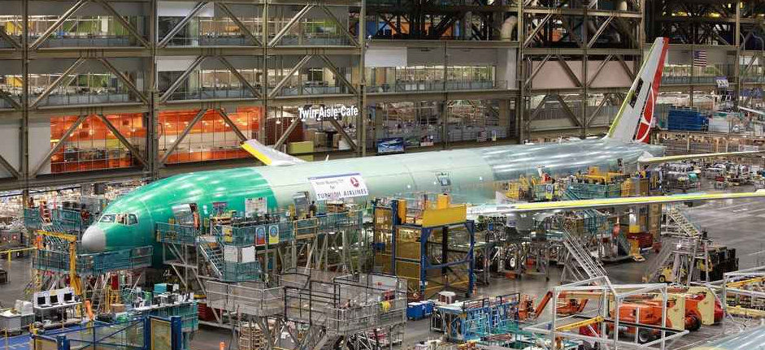
Attraction: Future of Flight, Boeing Tour
What to see: view 747, 767, 777, and 787 Dreamliners on the assembly line before they take to the sky
Web: https://www.futureofflight.org/boeing-tour-seattle
Address: 8415 Paine Field Blvd, Mukilteo, WA 98275
Aviation Center Hours: 8:30AM-5:30:AM
Boeing Tour Hours: 9:00AM-3:00PM, every 30min apart
Tour duration: 90min
Tour admission: 25$
Distance to the hotel: ~40mins driving
Online reservation needed ASAP to avoid unavailability

Slide 9
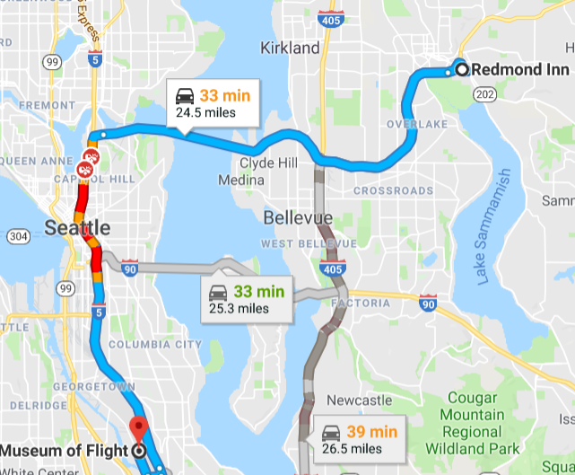
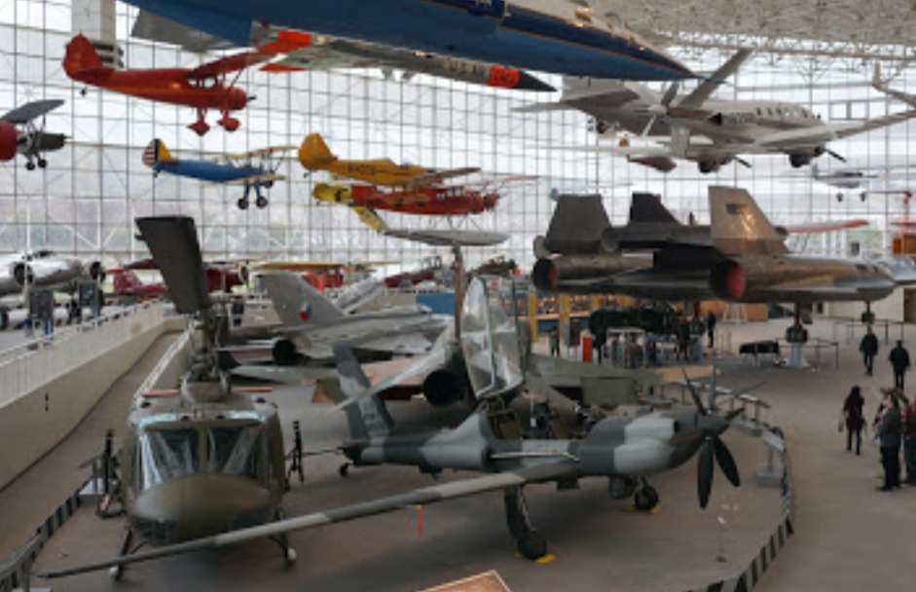
Attraction: The Museum of Flight
What to see: Hundreds of air crafts
Address: 9404 E Marginal Way S, Seattle, WA 98108
Distance to the hotel: ~40mins driving
Hours: 10AM-5PM
Admission:22$
Web: www.museumofflight.org

Slide 10
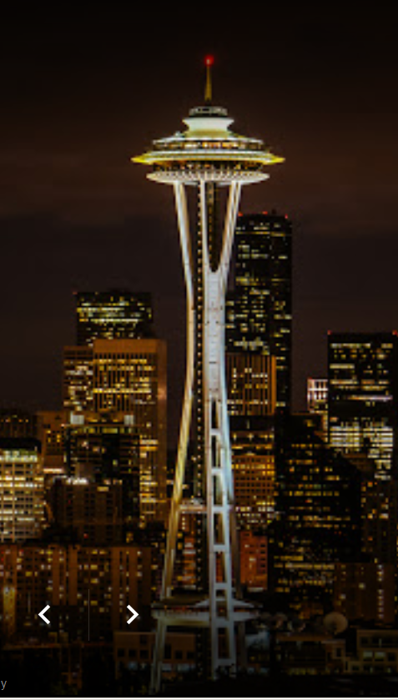
Attraction: Space Needle
What to see: landmark of Seattle, an observation tower
Address: 400 Broad St, Seattle, WA 98109
Hours: 8AM-12AM
General admission: 32$-37$
Web: http://www.spaceneedle.com/
Would be a nice night visit after work hous

Slide 11
Restaurants near AT&T office building
Within 15min walk:
American: BJ's Restaurant & Brewhouse, (425) 376-1560
American: Woodblock, (425) 285-9458
Italian: Sages Restaurant, (425) 881-5004
Japanese: Oto Sushi, (425) 558-5888
Mexican: El Toreador, (425) 883-7570
Thai: Noodle Land, (425) 869-4451
French: Creperie de Paris, (425) 882-4700
Mediterranean: Gyros 2 Go, (425) 885-0605
Coffee: Victor's Celtic Coffee Co, (425) 881-6451
Burger place: Tipsy Cow, (425) 896-8716

Slide 12
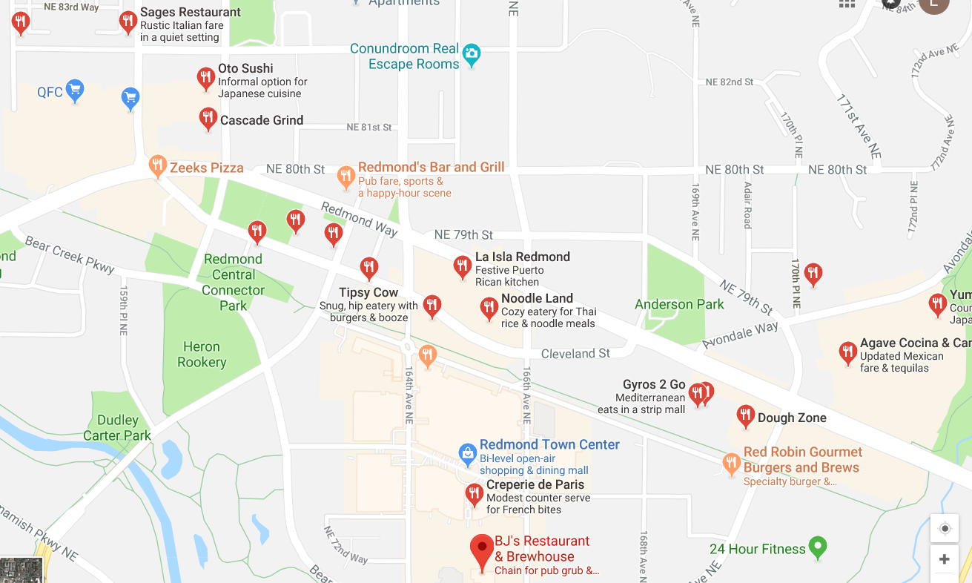
Restaurants near AT&T office building
15min walk
AT&T

Slide 13
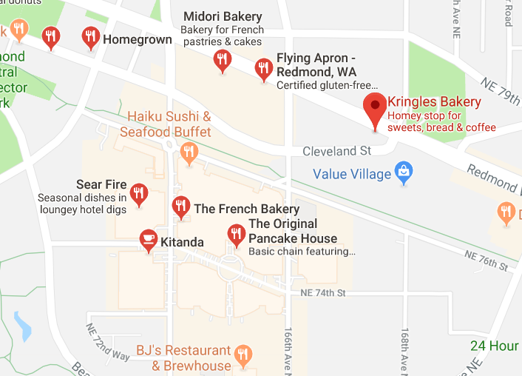
Breakfast places to take order
The French Bakery: (425) 522-4931
Kitanda:(425) 820-4381
The Original Pancake House:(425) 827-7575
Kringles Bakery:(425) 558-3688
AT&T

