Slide 1
IEEE 1914 NGFI WG
December Meeting Logistics v2.0
Hosted by Fiberhome

Slide 2
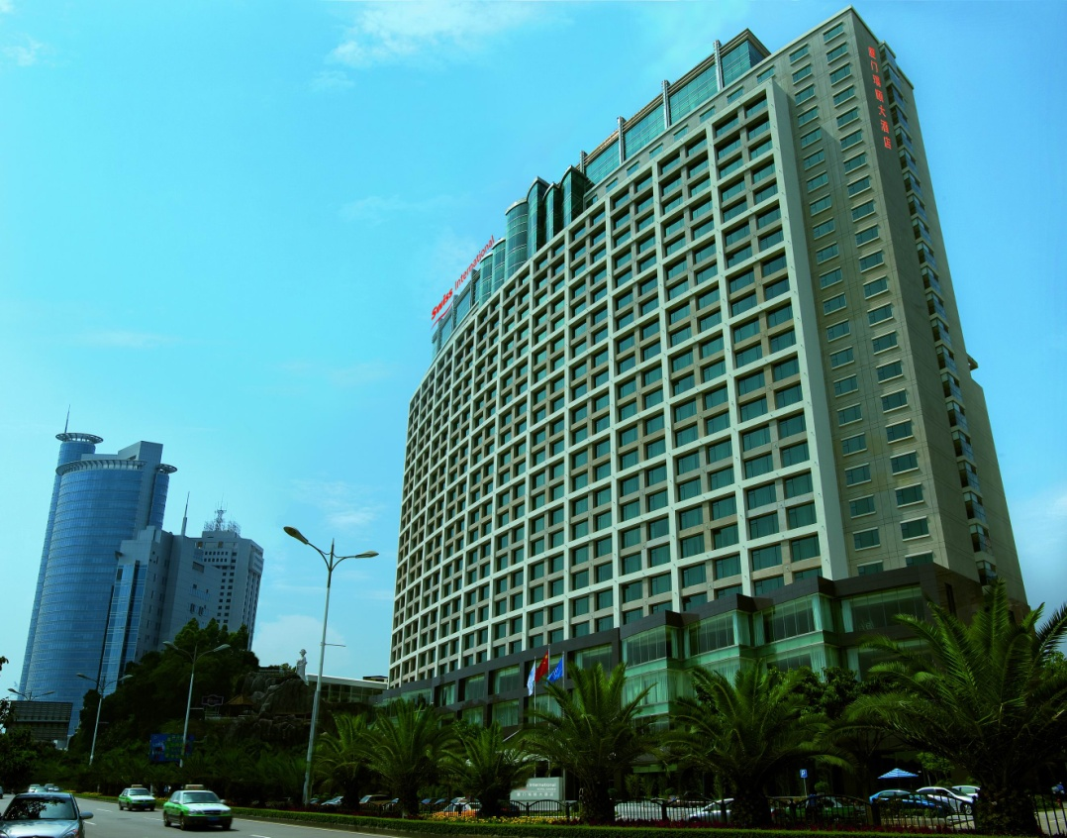
Top Level Summary
Meeting Dates:
December 04-06, 2018
9:00 AM – 5:30 PM
Location:
Swiss Grand Xiamen
Conference room: Lily Room
12 Lujiang Dao, Xiamen, Fujian, China 361001
Major Airports:
Xiamen Gaoqi International Airport (XMN)
Registration Fee:
$200 before November 24th.
$300 after November 24th.
Lunch and snacks included.
Gluten free and vegetarian food provided on request. Please email zzhou@fiberhome.com with your request after you register.

Slide 3
Lodging option: Swiss Grand Hotel
12 Lujiang Dao, Xiamen, Fujian, China 361001
Phone: (86) 592-6366666 Fax: (86) 592-2971918
Hotel Website: http://www.swissinternationalxiamen.com.cn/
For room reservation, please email to
Tracy.yang@swissgrandxiamen.com.cn and copy
huangjinri@chinamobile.com and
zzhou@fiberhome.com
indicating the code of ”IEEE 1914” and the information of your name, check- in and check-out date, type of room
No guaranteed blocks of room, thus, it is encouraged to make the reservation ASAP (see the cancellation policy below)
Price: 880rmb (around 130USD), including:
Tax and service rate;
1 Breakfast;
Wi-Fi connection
Cancellation policy
Free cancellation at least one day before check-in date
Charge applies if cancelled on or after check-in date;

Slide 4
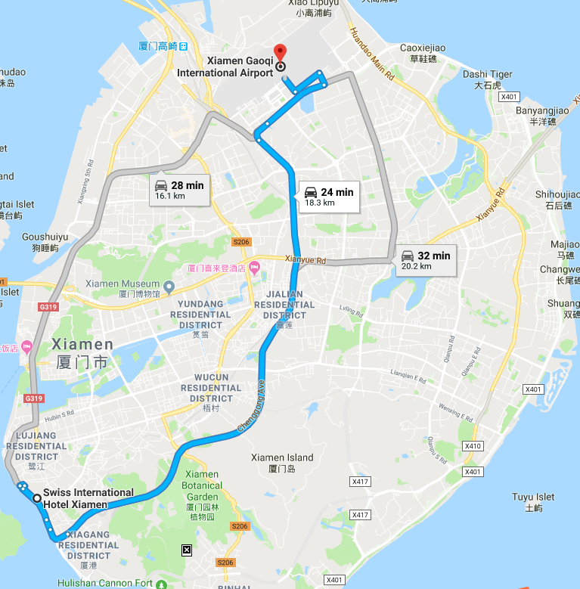
Transportation from (to) Airports to (from) Swiss Grand Xiamen
Either Terminal 3 or Terminal 4
8miles, ~35min
Hotel car Airport pick-up service ,CNY280, reservation needed
Taxi ~CNY45(~35 minutes).
Show a card with the following to drivers:
---Please take me to
Swiss Grand Hotel
12 Lujiang Dao, Xiamen, Fujian, China
---请带我到
厦门瑞颐大酒店，鹭江道12号，中国厦门

Slide 5
Visa Information
For invitation letter, please contact with Zhen Zhou <zzhou@fiberhome.com> and provide the following information:
— First Name, Last Name:
— Date of Birth: (MM/DD/YYYY):
— Passport ID Number:
— Passport Expiration Date:
— Passport Nationality:
— Company Name:
— Company Address:
— Job Title:
— Date planned to enter China:
— Date planned to leave China:
— Country/Area & City to apply your visa:
And you need to provide the copy of your passport, with the name, date of birth, nationality, passport number, valid date of passport, etc. which must be seen clearly.

Slide 6
Need more help?
Please contact:
Jinri Huang (huangjinri@chinamobile.com), WG chair; 0086-13910490429
Zhen Zhou
zzhou@fiberhome.com, 0086-15927521668
Tracy Yang
Tracy.yang@swissgrandxiamen.com.cn
0086-15280213647

Slide 7
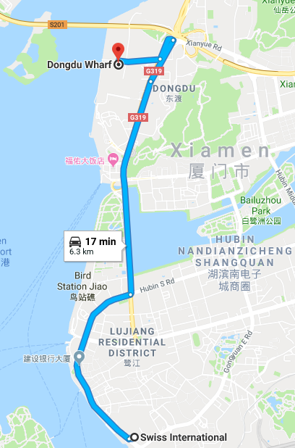
Attraction: Kulangsu (Gulangyu) Island
What to see:Shuzhuang Garden, Gulangyu Organ Museum,
Zheng Chenggong Memorial Hall
How to go: take taxi to Dongdu Whart and go on boarding to Gulangyu island
Web: http://www.glyylq.com/
Address: Gulangyu,Siming District, Xiamen
Ferry Ticket:RMB35 per person

Slide 8
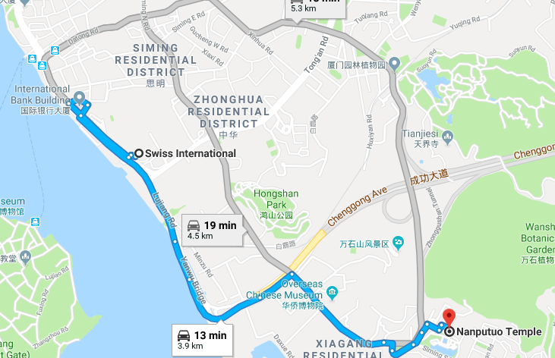
Attraction: Nanputuo Temple
What to see: Chinese Traditional Temple
Address: 515 Siming Nan Road,Siming Qu, Xiamen, Fujian, 361005
Distance to the hotel: ~11mins driving
Hours: 09AM-16:30PM
Admission: Free
Web: http://nanputuo.com/

