Slide 1
IEEE 1914 NGFI WG
October 2019 Meeting Logistics

Slide 2
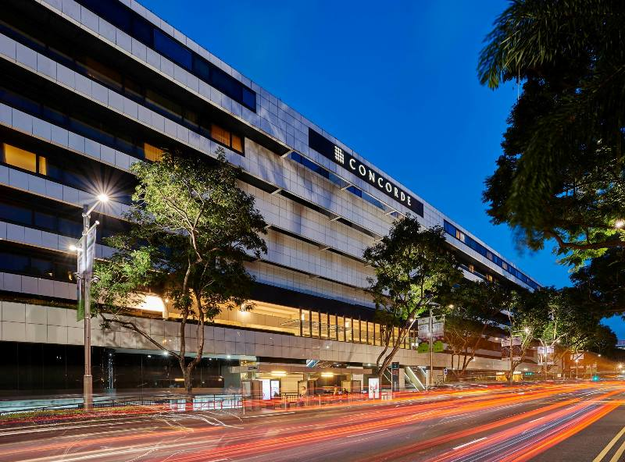
Top Level Summary
Meeting Dates
October 8th-10th, 2019
9:00 AM – 5:00 PM
Meeting venue
Concorde hotel Singapore
100 ORCHARD ROAD
SINGAPORE 238840
Airports
Singapore Changi Airport (SIN)
Registration Fee:
150 USD before and on Oct. 1
200 USD after Oct. 1
Coffee breaks and lunch included - REMARK: Gluten free food provided on request

Slide 3
Lodging option with special rate agreed
Concorde hotel Singapore, 100 ORCHARD ROAD, SINGAPORE 238840, TEL +65 6733 8855, FAX +65 6732 7886
Special rates agreed with the hotel:
Note: ”++” is 10% service charge and 7% tax (goods tax)
Reservation and info:
All room reservations via the completed form or emails to be sent to Concorde Hotel Singapore by 27th September 2019. Rooms are subject to availability upon reservation.
Email: reservations.chs@concorde.net or Momoko Sumiya :Momoko.Sumiya@concorde.net
Fax: +65-6732-0540 Contact Number:+65-6733-8855
Payment and cancellation policies:
Check the form
Room Type (Refurbished) | Rates (Single) | Rates (Double)
Deluxe Plus Room | S$218.00++ per room per night Daily breakfast for 1 persons Free Wi-Fi connectivity for multiple devices | S$233.00++ per room per night Daily breakfast for 2 persons Free Wi-Fi connectivity for multiple devices
Premier Club Room | S$258.00++ per room per night (inclusive of club benefits) See list below | S$278.00++ per room per night (inclusive of club benefits) See list below

Slide 4
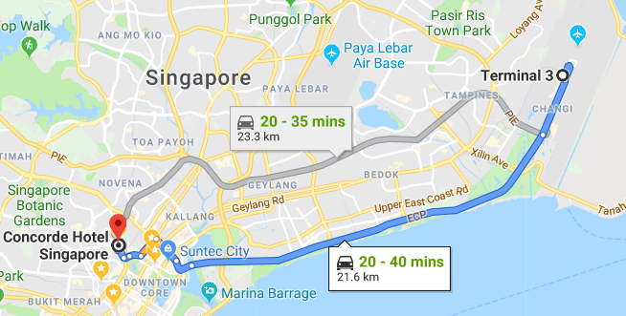
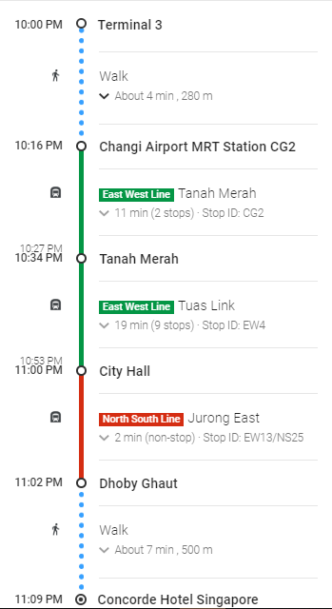
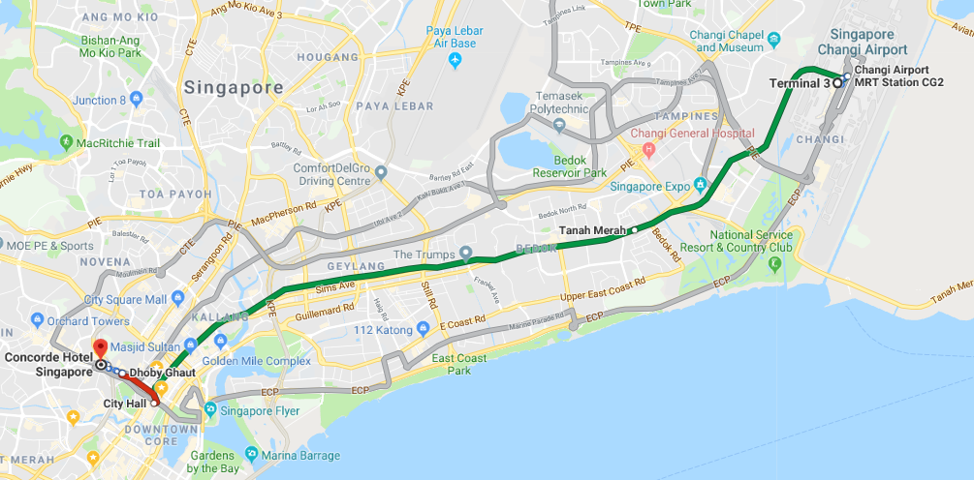
How to reach meeting venue
Recommended (follow the Taxi sign at the airport)
Taxi service from Singapore Changi airport (~30 min, S$25 ~ 30)
Including S$3- or S$5- (airport change depending On time) and late night charge
Second option
The train from “Changi airport station” to “Dhoby Ghaut station” and then a 5+min walk. (MRT = Mass Rail Transport)
This is quite straight forward and will cost about S$2-
But as it’s your first time to the hotel it’s simply easer to get a taxi.

Slide 5
Visa Information
For invitation letter, please contact with Jennifer Santulli <j.santulli@ieee.org> and provide the following information:
First Name, Last Name:
Company Name:
Company Address:
Company Phone:
Company E-mail:
Mobile Phone (If possible):
Date of Birth:
Place of Birth:
Passport ID Number:
Passport Expiration Date:
Passport Nationality:

Slide 6
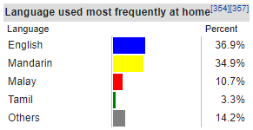
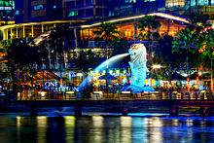
Visit Singapore
In-case you have never heard of singapore
Founded (by the the English) in 1819 as a trading hub for the spice route from China and India to England, later became independent of Malyaisa in 1965.
It’s an island state ~45km*25km (size of many inner cities), known for being very clean with a low crime rate.
Education and business (daily) language is English but in school all must have a scond language (mother tounge). Chinese (Manderin) being the most common followed by Malay (Bahasa) then Tamil (Indian).
https://en.wikipedia.org/wiki/Singapore
A major business hub with most international companies having their regional head office located here.
Basically located on the equator thus ~32degC all year with high humidity.

Slide 7
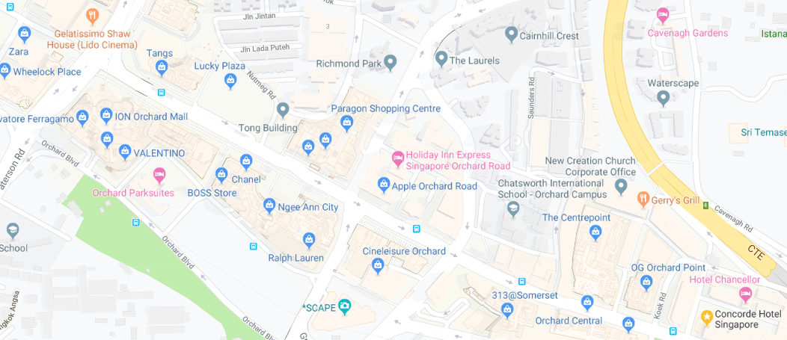
Visit Singapore
Concorde hotel is at one end of Orchard Rd, very famous shopping area.
ION is one of the newest and most luxurious ~20min walk, passed about 10 other shopping centers (Marina Bay Sand also an iconic shopping center).
If you are into high end shopping you could spend a week here (maybe don’t tell your better half)…

Slide 8
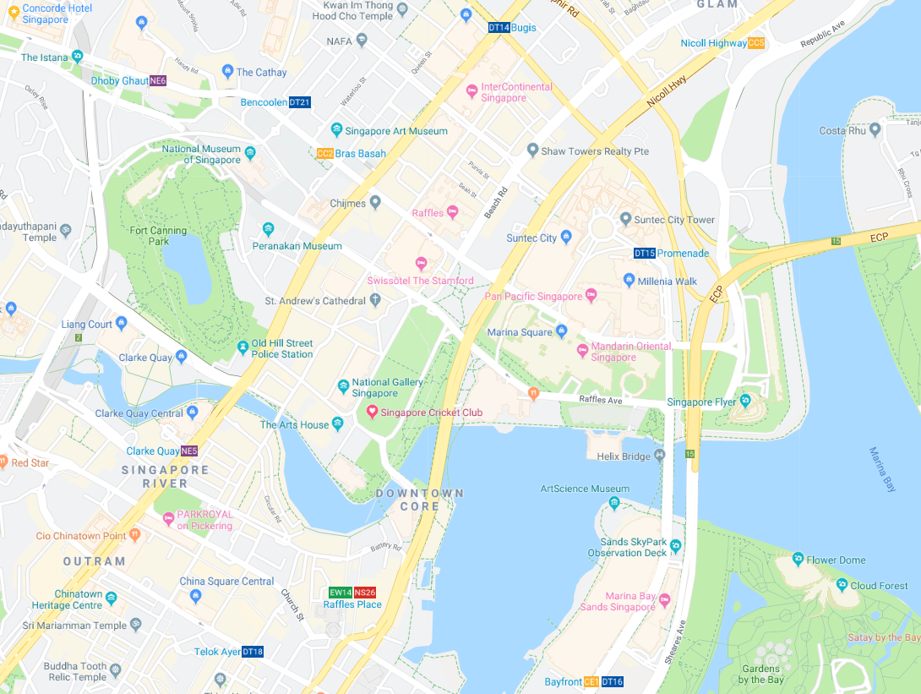
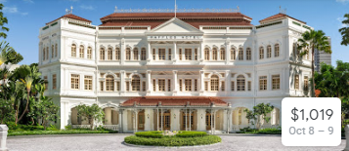
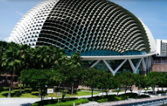
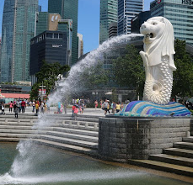
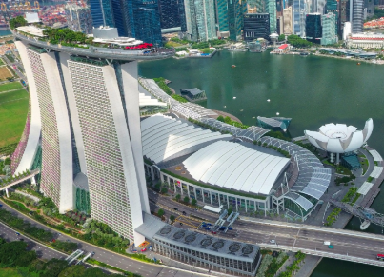
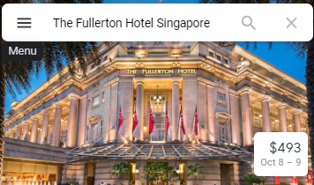
Visit Singapore
Away from the shopping street (the other direction) your in the center of town, art and museums,
Fort Canning
National Gallery
Asian Civilization
And iconic places to visit around the bay,
Raffles hotel
Esplanade Theatre
Merlion
Fullerton hotel
Marina Bay Sands (shopping and iconic building)
Gardens by the bay

Slide 9
Need more help?
Please contact:
Jinri Huang (huangjinri@chinamobile.com), WG chair; 0086-13910490429
Questions on Singapore,
Stuart Whitehead
Stuart.Whitehead@Anritsu.com
+65 98190326

