Slide 1
IEEE P2938 draft 2.5 WG technique meeting
Pan Hu, WG Chair (acting)*
Vice-Chair(s): Ying Wang.
Secretary: Ke Zhou.
Conference Call
November 21, 2021
Working group PE/T&D/PQ/Economic Evaluation of Voltage Sags Working Group

Slide 2
Welcome Speech
IEEE P2938 WG
Host by Pan Hu
Notes:
IEEE Standards Association has 2 types of Standards Development process, Individual and Entity corporate process.
The individual process allows for 1 individual 1 vote whereas the Entity process allows for One company one vote methods.
According to the IEEE-SA Bylaws, Participants in the IEEE standards development individual process shall act based on their qualifications and experience.
In the Individual Process while participants may represent the interests of their employers, individual members participate in the process and ballot as individuals, rather than as a corporate entity. Individual process actions are based on their experience and qualifications and only represent themselves.
Entity representative participants in the IEEE standards development entity process are appointed by an entity to represent that entity and act on its behalf.
Such representatives may participate in IEEE standards development activities and take action based upon the instruction from the entity for which they have been appointed as an entity representative. lt enables organizations to contribute and define market-relevant technology standards. IEEE-SA corporate membership allows companies and entities to engage in the standards development process to ensure their business interests are heard and represented. Participants of the corporate model process are representatives of “entities,” (universities, government bodies, etc). IEEE-SA corporate membership consists of two types of membership; basic and advanced, where both can send member representative(s) to observe any entity-based standards Working Group meetings Only Advanced Corporate Membership holders are eligible to drive the initiation and creation of entity-based standards by participating, voting and submitting technical contributions to the Working Group for consideration.

Slide 3
Methods for Standards Development
Individual Method
Each individual participant has 1 vote
Entity (Corporate) Method (e.g., IEEE P2938)
Ballot groups are made up of a minimum of 10 individuals
Ballot group participants must be IEEE-SA individual members
Individuals represent themselves
Participants are individual technical experts
Participants are “entities,” i.e., companies, universities, government bodies, etc.
Designated representative and alternate represent the entity
Each entity has 1 vote
Requires 3 entities to commit to participation at project initiation
Entity sends representatives to meetings
Notes:
IEEE Standards Association has 2 types of Standards Development process, Individual and Entity corporate process.
The individual process allows for 1 individual 1 vote whereas the Entity process allows for One company one vote methods.
According to the IEEE-SA Bylaws, Participants in the IEEE standards development individual process shall act based on their qualifications and experience.
In the Individual Process while participants may represent the interests of their employers, individual members participate in the process and ballot as individuals, rather than as a corporate entity. Individual process actions are based on their experience and qualifications and only represent themselves.
Entity representative participants in the IEEE standards development entity process are appointed by an entity to represent that entity and act on its behalf.
Such representatives may participate in IEEE standards development activities and take action based upon the instruction from the entity for which they have been appointed as an entity representative. lt enables organizations to contribute and define market-relevant technology standards. IEEE-SA corporate membership allows companies and entities to engage in the standards development process to ensure their business interests are heard and represented. Participants of the corporate model process are representatives of “entities,” (universities, government bodies, etc). IEEE-SA corporate membership consists of two types of membership; basic and advanced, where both can send member representative(s) to observe any entity-based standards Working Group meetings Only Advanced Corporate Membership holders are eligible to drive the initiation and creation of entity-based standards by participating, voting and submitting technical contributions to the Working Group for consideration.

Slide 4
Roll call of Entities for P2938
Working Group member
State Grid Corporation of China (DR: Pan Hu)
China Southern Power Grid Company (DR: Ke Zhou)
Schneider Electric(DR: Daniel Sabin)
US-based Electric Power Research Institute(DR: Mark Stephens)
Sichuan University(DR: Ying Wang)
Huazhong University of Science and Technology(DR: Yan Li)
Ceiec Electric Technology Inc(DR: Xin Wang)
North China Electric Power University(DR: Shun Tao)

Slide 5
Agenda
IEEE Patent Policy and Copyright Policy
WG Policies and Procedures (P&P) Review
Introductions of standard background and outline
Technique Discussion
Consolidated comments discussion on P2938
Introduction of P2938 draft 2.5
Next steps/ web or in-person meeting
Adjournment

Slide 6
Approval of the agenda
Motion:
Approve the agenda of P2938 draft 2.5 WG Meeting.
Moved: xxx, entity name
Seconded: xxx, entity name
(Procedural, required ≥ 50%)

Slide 7
Guidelines for IEEE WG meetings
All IEEE-SA standards meetings shall be conducted in compliance with all applicable laws, including antitrust and competition laws.
Don’t discuss the interpretation, validity, or essentiality of patents/patent claims.
Don’t discuss specific license rates, terms, or conditions.
Relative costs of different technical approaches that include relative costs of patent licensing terms may be discussed in standards development meetings.
Technical considerations remain the primary focus
Don’t discuss or engage in the fixing of product prices, allocation of customers, or division of sales markets.
Don’t discuss the status or substance of ongoing or threatened litigation.
Don’t be silent if inappropriate topics are discussed … do formally object.
For more details, see IEEE-SA Standards Board Operations Manual, clause 5.3.10 and Antitrust and Competition Policy: What You Need to Know at http://standards.ieee.org/develop/policies/antitrust.pdf

Slide 8
Patent Policy-Participants have a duty to inform the IEEE
Participants shall inform the IEEE (or cause the IEEE to be informed) of the identity of each holder of any potential Essential Patent Claims
that are potentially essential to implementation of the proposed standard(s)
of which they are personally aware if the claims are owned or controlled by the participant or the entity the participant is from, employed by, or otherwise represents
Participants should inform the IEEE (or cause the IEEE to be informed) of the identity of any other holders of potential Essential Patent Claims
Early identification of holders of potential Essential Patent Claims is encouraged
Notes:
New Patent Slides

Slide 9
Patent Policy-Ways to inform IEEE
Cause an LOA to be submitted to the IEEE-SA (patcom@ieee.org); or
Provide the chair of this group with the identity of the holder(s) of any and all such claims as soon as possible; or
Speak up now and respond to this Call for Potentially Essential Patents
If anyone in this meeting is personally aware of the holder of any patent claims that are potentially essential to implementation of the proposed standard(s) under consideration by this group and that are not already the subject of an Accepted Letter of Assurance, please respond at this time by providing relevant information to the WG Chair

Slide 10
Patent-related information
The patent policy and the procedures used to execute that policy are documented in the:
IEEE-SA Standards Board Bylaws (http://standards.ieee.org/develop/policies/bylaws/sect6-7.html#6)
IEEE-SA Standards Board Operations Manual (http://standards.ieee.org/develop/policies/opman/sect6.html#6.3)
Material about the patent policy is available at
http://standards.ieee.org/about/sasb/patcom/materials.html
If you have questions, contact the IEEE-SA Standards Board Patent Committee Administrator at patcom@ieee.org

Slide 11
IEEE SA Copyright Policy
By participating in this activity, you agree to comply with the IEEE Code of Ethics, all applicable laws, and all IEEE policies and procedures including, but not limited to, the IEEE SA Copyright Policy.
Previously Published material (copyright assertion indicated) shall not be presented/submitted to the Working Group nor incorporated into a Working Group draft unless permission is granted.
Prior to presentation or submission, you shall notify the Working Group Chair of previously Published material and should assist the Chair in obtaining copyright permission acceptable to IEEE SA.
For material that is not previously Published, IEEE is automatically granted a license to use any material that is presented or submitted.

Slide 12
Copyright-related information
The IEEE SA Copyright Policy is described as:
IEEE SA Copyright Policy, Clause 7 of the IEEE SA Standards Board Bylaws https://standards.ieee.org/about/policies/bylaws/sect6-7.html#7 Clause 6 of the IEEE SA Standards Board Operations Manual https://standards.ieee.org/about/policies/opman/sect6.html
IEEE SA Copyright Permission（letter template）
https://standards.ieee.org/content/dam/ieee-standards/standards/web/documents/other/permissionltrs.zip
IEEE SA Best Practices for IEEE Standards Development
http://standards.ieee.org/develop/policies/best_practices_for_ieee_standards_development_051215.pdf
Distribution of Draft Standards (see 6.1.3 of the SASB Operations Manual)
https://standards.ieee.org/about/policies/opman/sect6.html
IEEE SA Copyright FAQs
http://standards.ieee.org/faqs/copyrights.html/

Slide 13
Resources
Training Videos
How to Run an Individual Working Group
How to Run an Entity Working Group
Bylaws and Procedures
IEEE-SA Standards Board Bylaws
http://standards.ieee.org/develop/policies/bylaws/
IEEE-SA Standards Board Operations Manual
http://standards.ieee.org/develop/policies/opman/
IEEE Baseline Operational Procedures
http://standards.ieee.org/about/sasb/audcom/bops.html

Slide 14
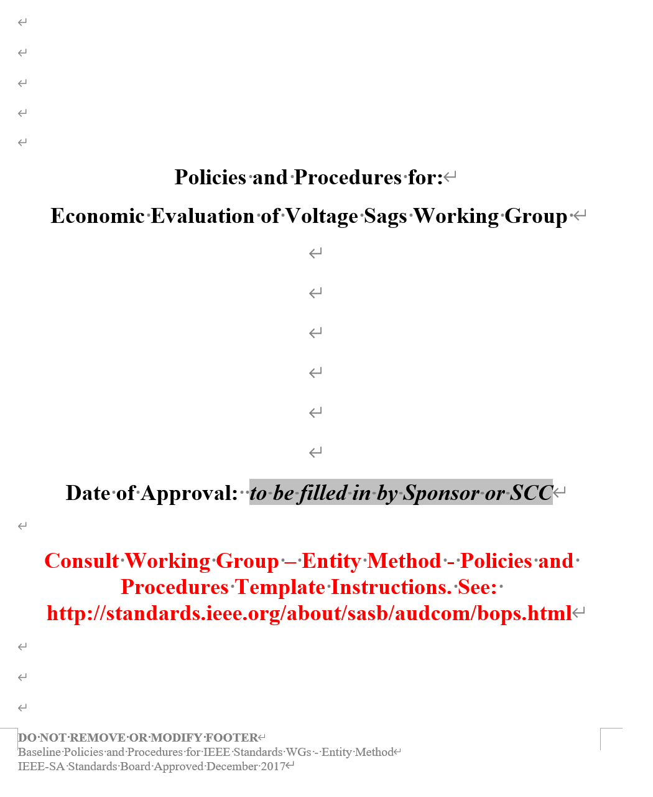
WG Policies and Procedure

Slide 15
Agenda
IEEE Patent Policy and Copyright Policy
WG Policies and Procedures (P&P) Review
Introductions of standard background and outline
Technique Discussion
Consolidated comments discussion on P2938
Introduction of P2938 draft 2.5
Next steps/ web or in-person meeting
Adjournment

Slide 16
New IEEE Project Authorization Requests
Project | Scope | Status | Lead | Joint Sponsors / Liaisons | Next Steps
P2938 - Guide for Economic Loss Evaluation of Sensitive Industrial Customers Caused by Voltage Sags Link on myProject | Guide on Economic Evaluating and Testing (Entity Project) | Approved by NESCOM/SASB on 9/24/2020. | c/o China State Grid Dr. Pan Hu Hubei Electric Power Company Limited Research Institute +86 15629060628 hup21@hb.sgcc.com.cn hupanwin@whu.edu.cn | T&D-Sponsor | Convene four WG meetings at 2021

Slide 17
IEEE P2938: Guide for Economic Loss Evaluation of Sensitive Industrial Customers Caused by Voltage Sags
Scope:
This guide provides a method to evaluate the economic loss impact of voltage sags on sensitive industrial customers. It describes how to carry out cost and loss economic-assessment of voltage sags, what economic indexes and assessment flowcharts can be considered, how to efficiently collect useful data for evaluation, and recommended experimental method for testing users’ equipment and production line.
Related activities: IEC TR 63222-100 (Impact of poor power quality on electrical equipment and power system), Contact: Kai ding, Dingkay@sina.com, TC 8.

Slide 18
Outline of P2938
1. Overview
Scope--This guide provides a method to evaluate the economic loss impact of voltage sags on sensitive industrial customers. It describes how to carry out cost and loss economic-assessment of voltage sags, what economic indexes and assessment flowcharts can be considered, how to efficiently collect useful data for evaluation, etc..
Purpose--This guide provides a method to evaluate the economic loss impact of voltage sags on sensitive industrial customers.
2. Normative References
IEEE Std. 1564-2014
IEEE Std. 1159-2019
IEEE Std. 1366-2012
3. Definitions
Technical terms used in this guide
Financial terms used in this guide

Slide 19
Outline of P2938
4. Principles and process of economic loss evaluation for voltage sag management
This section shows the procedures for the economic loss evaluation.
4.1 General
4.2 Process of economic loss evaluation for voltage sag management
This section presents the data and the information which may be useful for economic evaluation.
5.1 General database for economic loss evaluation
5.2 The information and data collection from user side
5. Method of data and information collection

Slide 20
Outline of P2938
6. The items of costs for voltage sag management of economic loss evaluation
The indices of costs for sensitive industrial customers are listed
6.1 General
6.2 Cost of power quality monitoring
6.3 Cost of voltage sag mitigation

Slide 21
Outline of P2938
7. The indexes of the cost and economic loss of voltage sag management
Proposes the indices of economic loss of the sensitive industrial customers.
7.1 General
7.2 Annual cost of the monitor project
7.3 Annual cost of the mitigation project
7.4 Severity of single industrial process consequence
7.5 Economic loss for single trip of industry process
7.6 Annual economic loss for industry process
7.7 User annual total cost
7.8 Unit output cost
7.9 Unit electricity cost

Slide 22
Outline of P2938
8. Economy of cost-investment evaluation methods for voltage sag management
The evaluation methods for economic loss are in Clause 8.
8.1 General
8.2 Equipment life cycle cost analysis (LCC)
8.3 Net present value method (NPV)
8.4 Payback period method (PP)
Annex A :SIC code list
Annex B :Typical test results of sensitive equipment tolerance against voltage sag
Annex C :Example of data collection
Annex D :Example of information of voltage sag
Annex E :Calculation equation of capital equivalent
Annex F :Example of evaluating the trip probability of industry process
Annex G :Trip probability of sensitive equipment under different sag characteristics
Annex H :Example of evaluating the economic loss
Annex I :Example of economic evaluation of the mitigation for voltage sag
Annex J :Bibliography

Slide 23
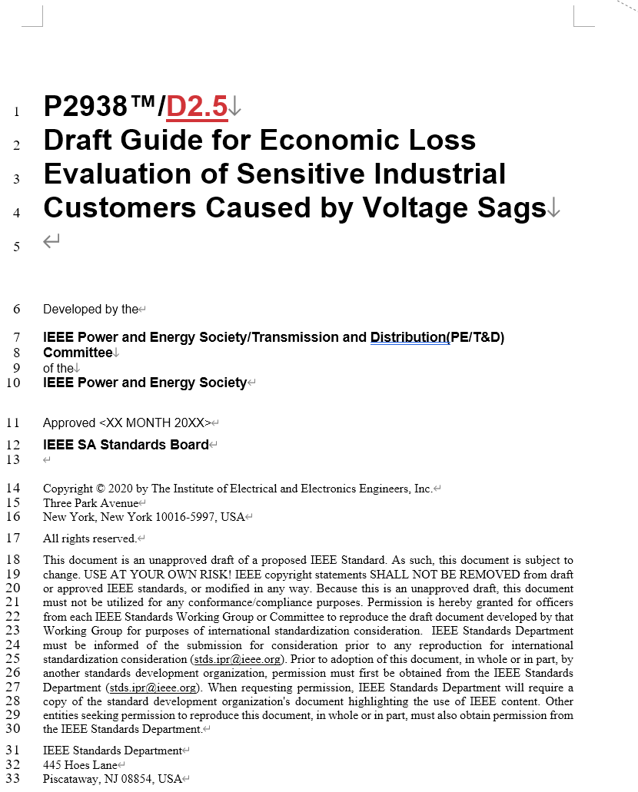
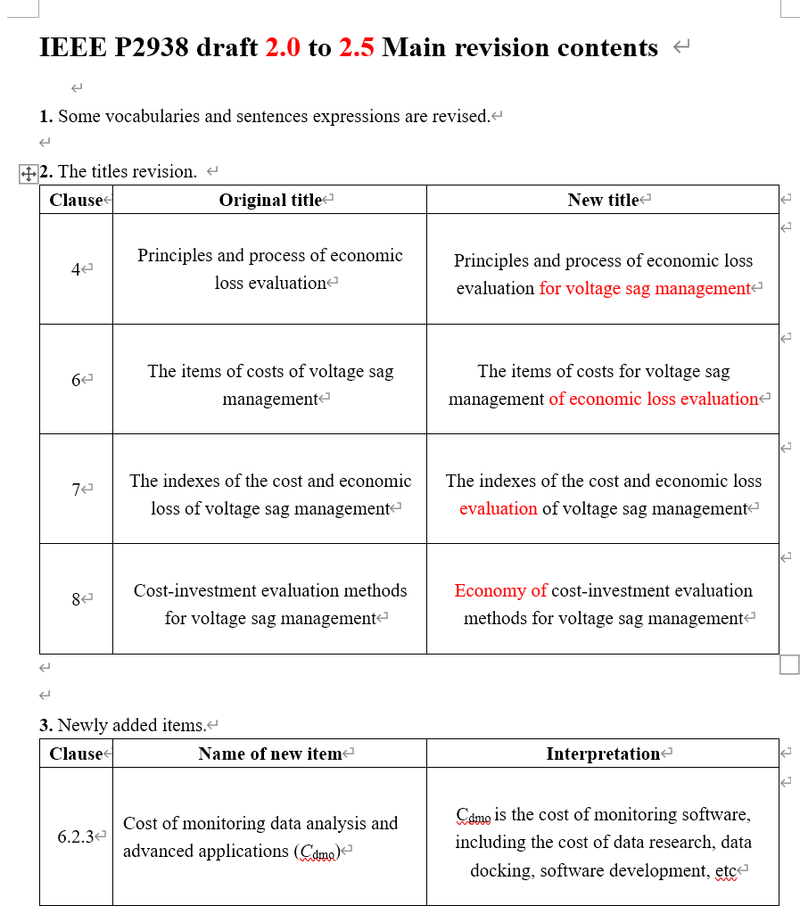
Introduction of main revision of P2938 draft 2.5
Introduced by Ying Wang from Sichuan University

Slide 24
Introduction of main revision of P2938 draft 2.5
1. The revision of titles.
Clause | Version 2.0 | Version 2.5
4 | Principles and process of economic loss evaluation | Principles and process of economic loss evaluation for voltage sag management
6 | The items of costs of voltage sag management | The items of costs for voltage sag management of economic loss evaluation
7 | The indexes of the cost and economic loss of voltage sag management | The indexes of the cost and economic loss evaluation of voltage sag management
8 | Cost-investment evaluation methods for voltage sag management | Economy of cost-investment evaluation methods for voltage sag management

Slide 25
Introduction of main revision of P2938 draft 2.5
2. Newly added items.
Clause | Name of new item | Interpretation
6.2.3 | Cost of monitoring data analysis and advanced applications (C_{dmo}) | C_{dmo} is the cost of monitoring software, including the cost of data research, data docking, software development, etc
6.3.5 | Profit from peak load shifting of mitigation equipment (I_{pmi}) | The mitigation equipment with energy storage device can be used not only for voltage sag management, but also for peak load shifting of electric energy to obtain the profit of electricity price difference. The profit can reduce the total cost of voltage sag mitigation project.

Slide 26
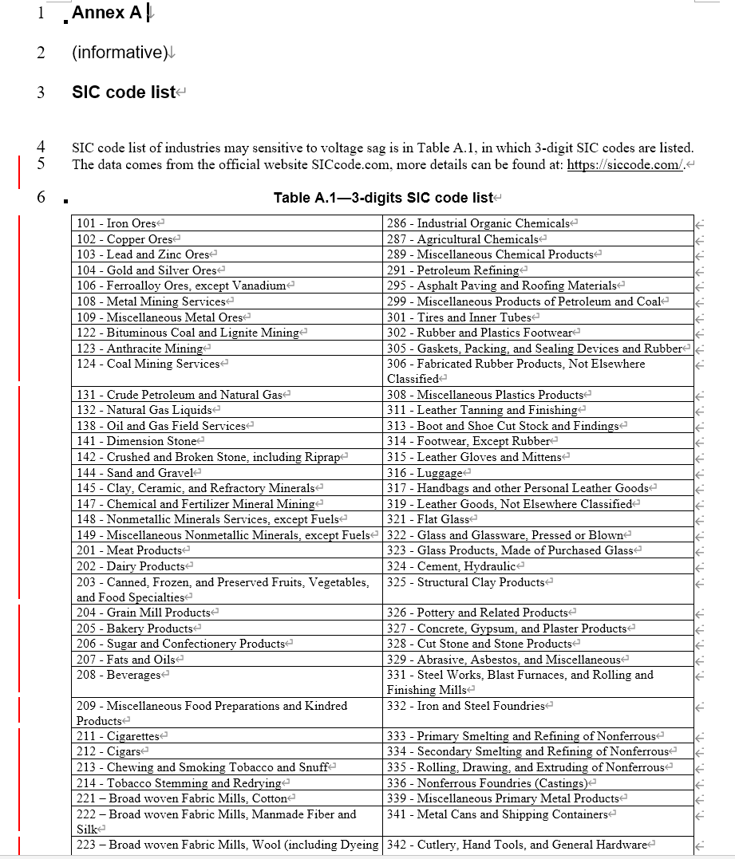
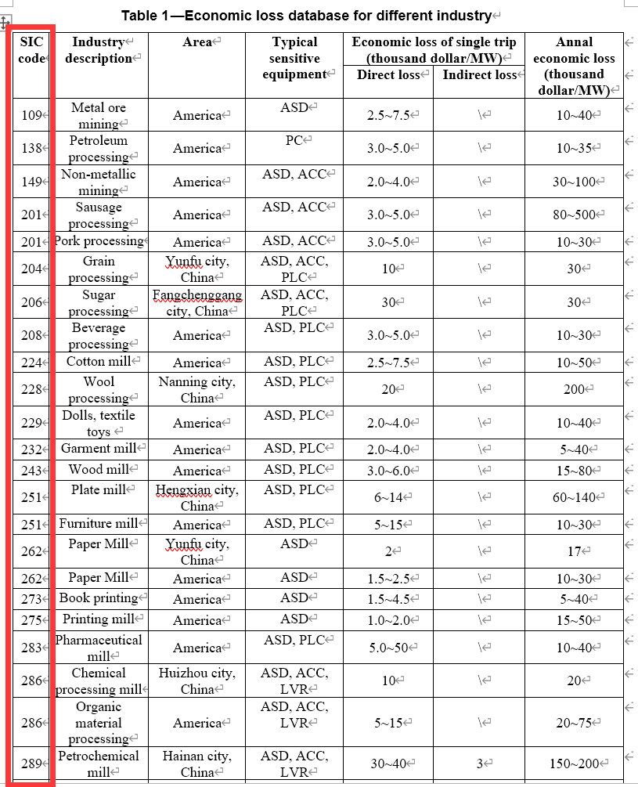
Introduction of main revision of P2938 draft 2.5
3. Clause 5. The SIC code of some industries in Table 1 is revised. Now the SIC code corresponding to sensitive industries is more accurate.
4. Appendix A. The SIC codes of non-sensitive industries in Table A.1 are deleted. Now the industries listed in Table A1 are all sensitive industries which are vulnerable to voltage sag.

Slide 27
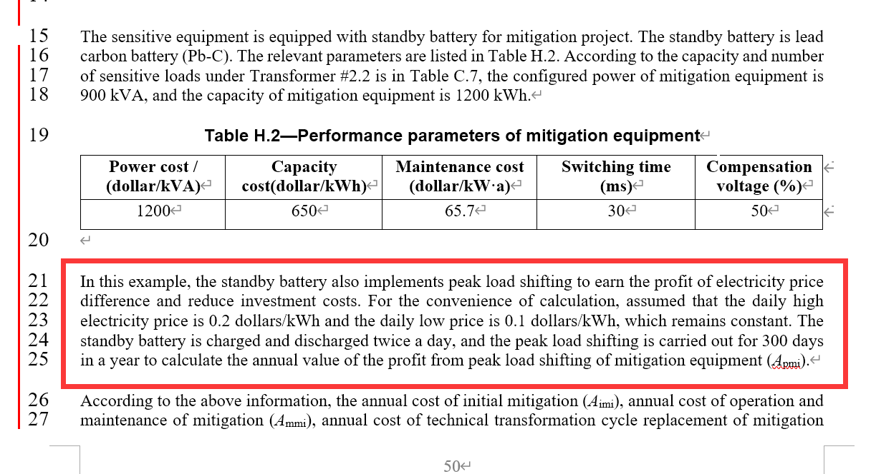
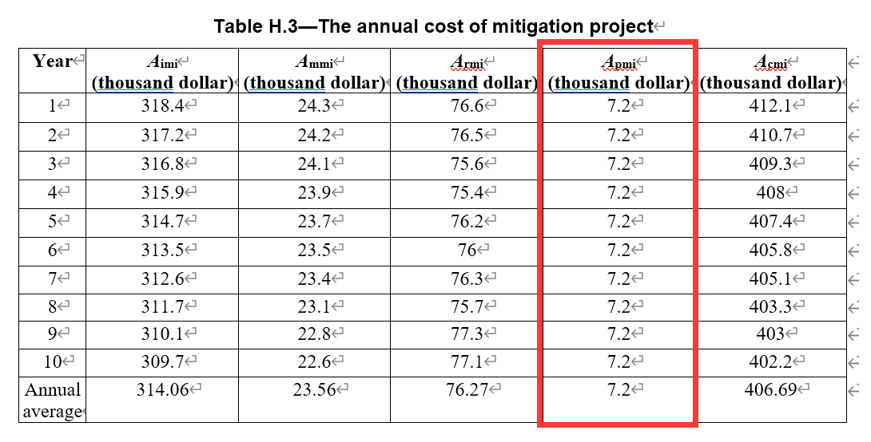
Introduction of main revision of P2938 draft 2.5
5. Appendix H. The annual value of profit for peak load shifting of mitigation equipment A_{pmi} are added.

Slide 28
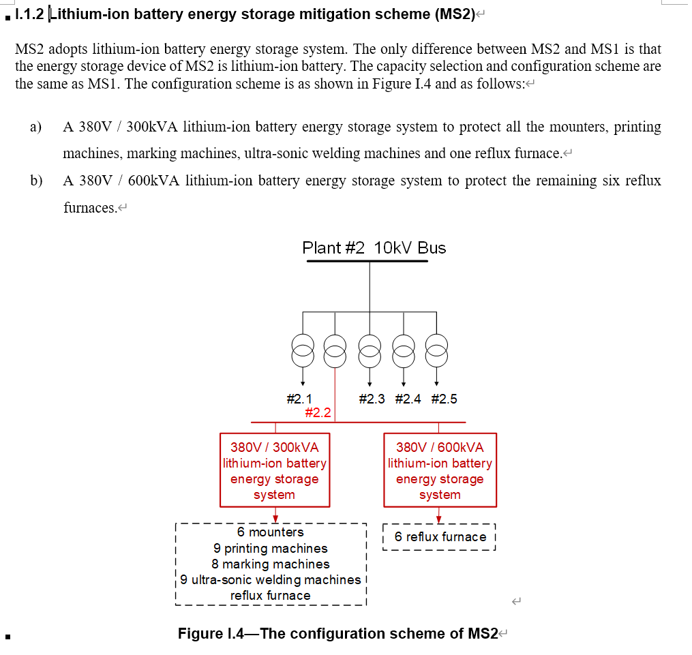
Introduction of main revision of P2938 draft 2.5
6. Appendix I. In the case of Appendix I, the energy storage mitigation scheme of lithium-ion battery (MS2) is added. Now there are four mitigation schemes, namely the flywheel energy storage mitigation scheme, lithium-ion battery energy storage mitigation scheme, DVR compensation mitigation scheme and UPS compensation mitigation scheme.

Slide 29
Discussion of tentative timeline
P2938
Kick-Off
WG Drafting
Initial Sponsor Ballot**
…
Recirculation
Publication
Submit to RevCom**
Dec 2020
2021-2022
2022
Dec 2022
Aug 2023
Dec 2023
2023

Slide 30
Agenda
IEEE Patent Policy and Copyright Policy
WG Policies and Procedures (P&P) Review
Introductions of standard background and outline
Technique Discussion
Consolidated comments discussion on P2938
Introduction of P2938 draft 2.5
Next steps/ web or in-person meeting
Adjournment

Slide 31
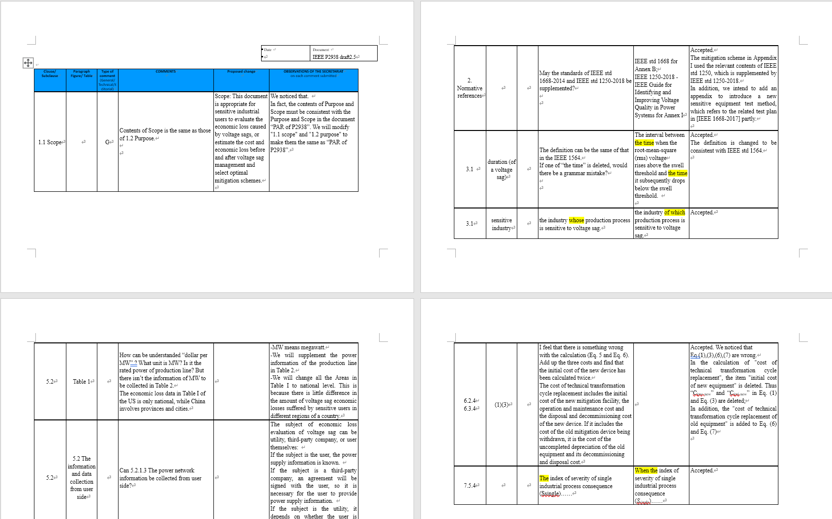
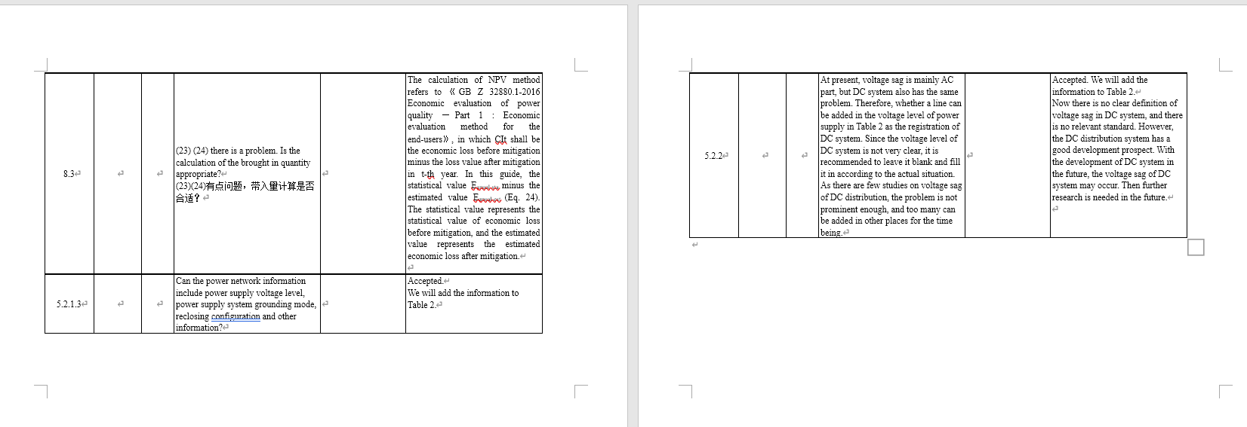
Consolidated comments discussion on P2938
Number of total comments | Number of general comments | Number of technical comments | Number of editorial comments | Comments we accepted | Comments we explained
10 | 1 | 6 | 3 | 9 | 2

Slide 32
Consolidated comments discussion on P2938
Number | Clause/ Subclause | Type of comment (General/ Technical/Editorial) | Comments | Proposed change | Reply
1 | 1.1 Scope | G | Contents of Scope is the same as those of 1.2 Purpose. | Scope: This document is appropriate for sensitive industrial users to evaluate the economic loss caused by voltage sags, or estimate the cost and economic loss before and after voltage sag management and select optimal mitigation schemes. | We noticed that. In fact, the contents of Purpose and Scope must be consistent with the Purpose and Scope in the document “PAR of P2938”. We will modify "1.1 scope" and "1.2 purpose" to make them the same as “PAR of P2938”.

Slide 33
Consolidated comments discussion on P2938
Number | Clause/ Subclause | Type of comment (General/ Technical/Editorial) | Comments | Proposed change | Reply
2 | Normative references | T | May the standards of IEEE std 1668-2014 and IEEE std 1250-2018 be supplemented? | IEEE std 1668 for Annex B; IEEE 1250-2018 - IEEE Guide for Identifying and Improving Voltage Quality in Power Systems for Annex I | Accepted. The mitigation scheme in Appendix I used the relevant contents of IEEE std 1250, which is supplemented by IEEE std 1250-2018. In addition, we intend to add an appendix to introduce a new sensitive equipment test method, which refers to the related test plan in [IEEE 1668-2017] partly.

Slide 34
Consolidated comments discussion on P2938
Number | Clause/ Subclause | Type of comment (General/ Technical/Editorial) | Comments | Proposed change | Reply
3 | 3.1 | E | The definition can be the same of that in the IEEE 1564. If one of “the time” is deleted, would there be a grammar mistake? | The interval between the time when the root-mean-square (rms) voltage rises above the swell threshold and the time it subsequently drops below the swell threshold. | Accepted. The definition is changed to be consistent with IEEE std 1564.
4 | 3.1 | E | the industry whose production process is sensitive to voltage sag. | the industry of which production process is sensitive to voltage sag. | Accepted.

Slide 35
Consolidated comments discussion on P2938
Number | Clause/ Subclause | Type of comment (General/ Technical/Editorial) | Comments | Proposed change | Reply
5 | 5.2 Table 1 | T | How can be understanded “dollar per MW” ? What unit is MW? Is it the rated power of production line? But there isn’t the information of MW to be collected in Table 2. The economic loss data in Table I of the US is only national, while China involves provinces and cities. | IEEE std 1668 for Annex B; IEEE 1250-2018 - IEEE Guide for Identifying and Improving Voltage Quality in Power Systems for Annex I | - MW means megawatt. - We will supplement the power information of the production line in Table 2. - We will change all the Areas in Table I to national level. This is because there is little difference in the amount of voltage sag economic losses suffered by sensitive users in different regions of a country.

Slide 36
Consolidated comments discussion on P2938
Number | Clause/ Subclause | Type of comment (General/ Technical/Editorial) | Comments | Proposed change | Reply
6 | 5.2 The information and data collection from user side | T | Can 5.2.1.3 The power network information be collected from user side? |  | The subject of economic loss evaluation of voltage sag can be utility, third-party company, or user themselves: - If the subject is the user, the power supply information is known. - If the subject is a third-party company, an agreement will be signed with the user, so it is necessary for the user to provide power supply information. - If the subject is the utility, it depends on whether the user is willing to sign an agreement and provide power supply information.

Slide 37
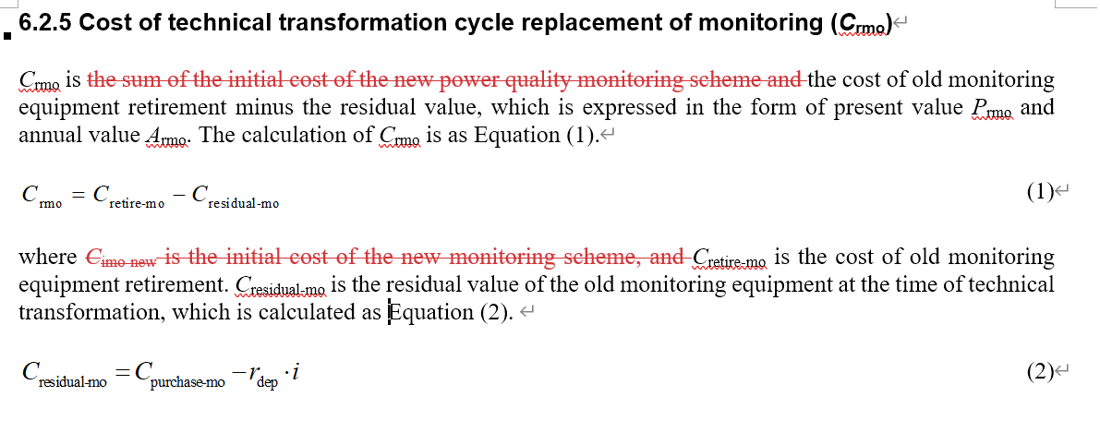
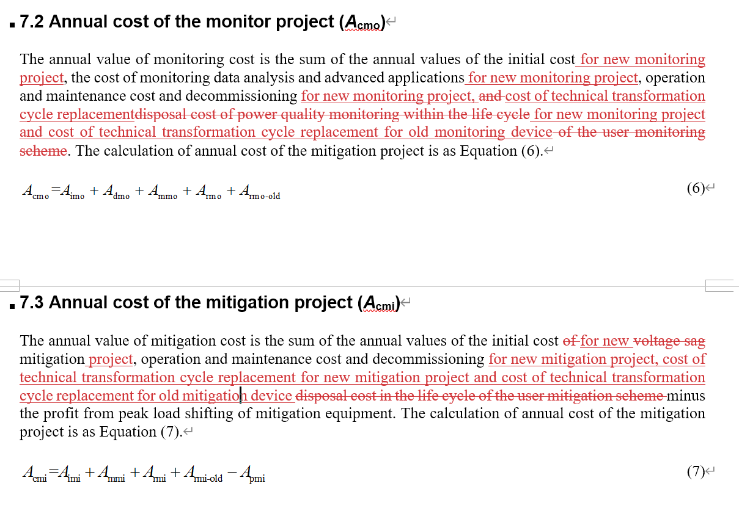
Consolidated comments discussion on P2938
Number | Clause/ Subclause | Type of comment (General/ Technical/Editorial) | Comments | Proposed change | Reply
7 | 6.2.4 6.3.4 | T | I feel that there is something wrong with the calculation (Eq. 5 and Eq. 6). Add up the three costs and find that the initial cost of the new device has been calculated twice. The cost of technical transformation cycle replacement includes the initial cost of the new mitigation facility, the operation and maintenance cost and the disposal and decommissioning cost of the new device. If it includes the cost of the old mitigation device being withdrawn, it is the cost of the uncompleted depreciation of the old equipment and its decommissioning and disposal cost. |  | Accepted. We noticed that Eq.(1),(3),(6),(7) are wrong. In the calculation of "cost of technical transformation cycle replacement", the item "initial cost of new equipment" is considered to be deleted. Thus “C_{imo-new}” and “C_{imi-new}” in Eq. (1) and Eq. (3) will be deleted; In addition, the "cost of technical transformation cycle replacement of old equipment" will be added to Eq. (6) and Eq. (7)

Slide 38
Consolidated comments discussion on P2938
Number | Clause/ Subclause | Type of comment (General/ Technical/Editorial) | Comments | Proposed change | Reply
8 | 7.5.4 | E | The index of severity of single industrial process consequence (Ssingle)…… | When the index of severity of single industrial process consequence (S_{single})…… | Accepted.
9 | 8.3 | T | (23) (24) there is a problem. Is the calculation of the brought in quantity appropriate? |  | The calculation of NPV method refers to 《GB Z 32880.1-2016 Economic evaluation of power quality —Part 1 : Economic evaluation method for the end-users》, in which CIt shall be the economic loss before mitigation minus the loss value after mitigation in t-th year. In this guide, the statistical value E_{anual-sta} minus the estimated value E_{anual-est} (Eq. 24). The statistical value represents the statistical value of economic loss before mitigation, and the estimated value represents the estimated economic loss after mitigation.

Slide 39
Consolidated comments discussion on P2938
Number | Clause/ Subclause | Type of comment (General/ Technical/Editorial) | Comments | Proposed change | Reply
10 | 5.2.2 | T | At present, voltage sag is mainly AC part, but DC system also has the same problem. Therefore, whether a line can be added in the voltage level of power supply in Table 2 as the registration of DC system. Since the voltage level of DC system is not very clear, it is recommended to leave it blank and fill it in according to the actual situation. As there are few studies on voltage sag of DC distribution, the problem is not prominent enough, and too many can be added in other places for the time being. |  | Accepted. We will add the information to Table 2. Now there is no clear definition of voltage sag in DC system, and there is no relevant standard. However, the DC distribution system has a good development prospect. With the development of DC system in the future, the voltage sag of DC system may occur. Then further research is needed in the future.

Slide 40
Agenda
IEEE Patent Policy and Copyright Policy
WG Policies and Procedures (P&P) Review
Introductions of standard background and outline
Technique Discussion
Consolidated comments discussion on P2938
Introduction of P2938 draft 2.5
Next steps/ web or in-person meeting
Adjournment

Slide 41
Vote for approving of redline working document 2.5
Motion:
Approve of redline working document 2.5 and move forward for the next version.
Moved: xxx, entity name
Seconded: xxx, entity name
(Procedural, required ≥ 50%)

Slide 42
Next steps/ in-person or web meeting in March
IEEE P2928 WG Meeting JANUARY, IEEE JTCM, with IEEE PES T&D meeting
Goals
Progress and summary of P2938 draft
Technique discussion
Vote for approving of redline working document 3.0
Next working group meeting plan

Slide 43
Contacts
IEEE P2938
Pan Hu
hupaninwh@whu.edu.cn
Ying Wang
769429505@qq.com
Zengrui Huang
806129254@qq.com.cn

Slide 44
Agenda
IEEE Patent Policy and Copyright Policy
WG Policies and Procedures (P&P) Review
Introductions of standard background and outline
Technique Discussion
Consolidated comments discussion on P2938
Introduction of P2938 draft 2.5
Next steps/ web or in-person meeting
Adjournment

Slide 45
Approval of the adjournment
Motion:
Approve the adjournment of P2938 draft 2.5 WG Meeting.
Moved: xxx, entity name
Seconded: xxx, entity name
(Procedural, required ≥ 50%)

Slide 46
Thanks

