Slide 1
IEEE 2977: MIPI A-PHY Adoption Working Group
Introduction
Zahy Madgar
March 2021

Slide 2
Compliance with ieee standards policies and procedures
Subclause 5.2.1 of the IEEE-SA Standards Board Bylaws states, "While participating in IEEE standards development activities, all participants...shall act in accordance with all applicable laws (nation-based and international), the IEEE Code of Ethics, and with IEEE Standards policies and procedures.”
The contributor acknowledges and accepts that this contribution is subject to
The IEEE Standards copyright policy as stated in the IEEE-SA Standards Board Bylaws, section 7, http://standards.ieee.org/develop/policies/bylaws/sect6-7.html#7, and the IEEE-SA Standards Board Operations Manual, section 6.1, http://standards.ieee.org/develop/policies/opman/sect6.html
The IEEE Standards patent policy as stated in the IEEE-SA Standards Board Bylaws, section 6, http://standards.ieee.org/guides/bylaws/sect6-7.html#6, and the IEEE-SA Standards Board Operations Manual, section 6.3, http://standards.ieee.org/develop/policies/opman/sect6.html

Slide 3
IEEE P2977 MIPI A-PHY ADOPTION WORKING GROUP
Introduction
Date: 2021-03-09
Author(s):
Name | Affiliation | Phone [optional] | Email [optional]
Zahy Madgar | Valens Semiconductors

Slide 4
Introduction to MIPI A-PHY Adoption Work Group
Purpose
Scope
Stakeholders
Timeline

Slide 5
P2977 Project Purpose
“With in-vehicle connectivity rapidly growing more complex, the automotive industry is seeking streamlined and simplified integration, flexibility and high performance at reduced cost. Development of MIPI A-PHY was predicated on those needs,” said Joel Huloux, chairman of MIPI Alliance. “The IAN program provides an opportunity to offer the A-PHY SerDes specification to a broader ecosystem beyond the MIPI membership. That, in turn, translates into even greater interoperability, product choice and economies of scale for automotive OEMs and their suppliers.”
IEEE SA PR Oct. 2020
https://www.businesswire.com/news/home/20201012005615/en/IEEE-Standards-Association-Launches-Industry-Affiliate-Network-IAN-to-Rapidly-Evolve-Existing-Specifications-into-Global-Standards

Slide 6
MIPI A-PHY ADOPTION WORKING GROUP Scope
Type of Project: Adoption of a Non-IEEE Standard
PAR Request Date: 24 Nov 2020
PAR Approval Date: 10 Feb 2021
The scope of this project is the adoption of: MIPI Alliance - MIPI A-PHY Specification Version 1.0 as an IEEE Standard
P2977 (https://development.standards.ieee.org/myproject-web/app#viewpar/12407/8928)
IEEE, the world's largest technical professional organization dedicated to advancing technology for humanity, and the IEEE Standards Association (IEEE SA) today announced the Industry Affiliate Network (IAN), a new offering designed to assist multi-stakeholder industry organizations in accelerating development and adoption of global standards. Through IAN, industry alliances, associations, consortia and other industry organizations leverage the IEEE brand, policy and global distribution to increase their visibility and value to expanded markets.
IEEE SA PR Oct. 2020
https://www.businesswire.com/news/home/20201012005615/en/IEEE-Standards-Association-Launches-Industry-Affiliate-Network-IAN-to-Rapidly-Evolve-Existing-Specifications-into-Global-Standards

Slide 7
MIPI A-PHY ADOPTION WORKING GROUP Stakeholders
IEEE Standards Association (IAN Program)
Corporate Advisory Group (CAG)
MIPI Alliance
Interested Entity WG Members: Qualcomm, Intel (Mobileye), MIPI Alliance, UNH-IOL, Valens, Synopsys and Aptiv

Slide 8
About the MIPI Alliance
MIPI Alliance (MIPI) develops interface specifications for mobile and mobile-influenced industries. There is at least one MIPI specification in every smartphone manufactured today. Founded in 2003, the organization has over 325 member companies worldwide and 14 active working groups delivering specifications within the mobile ecosystem.
Members of the organization include handset manufacturers, device OEMs, software providers, semiconductor companies, application processor developers, IP tool providers, automotive OEMs and Tier 1 suppliers, and test and test equipment companies, as well as camera, tablet and laptop manufacturers.

Slide 9
About the MIPI Alliance

Slide 10
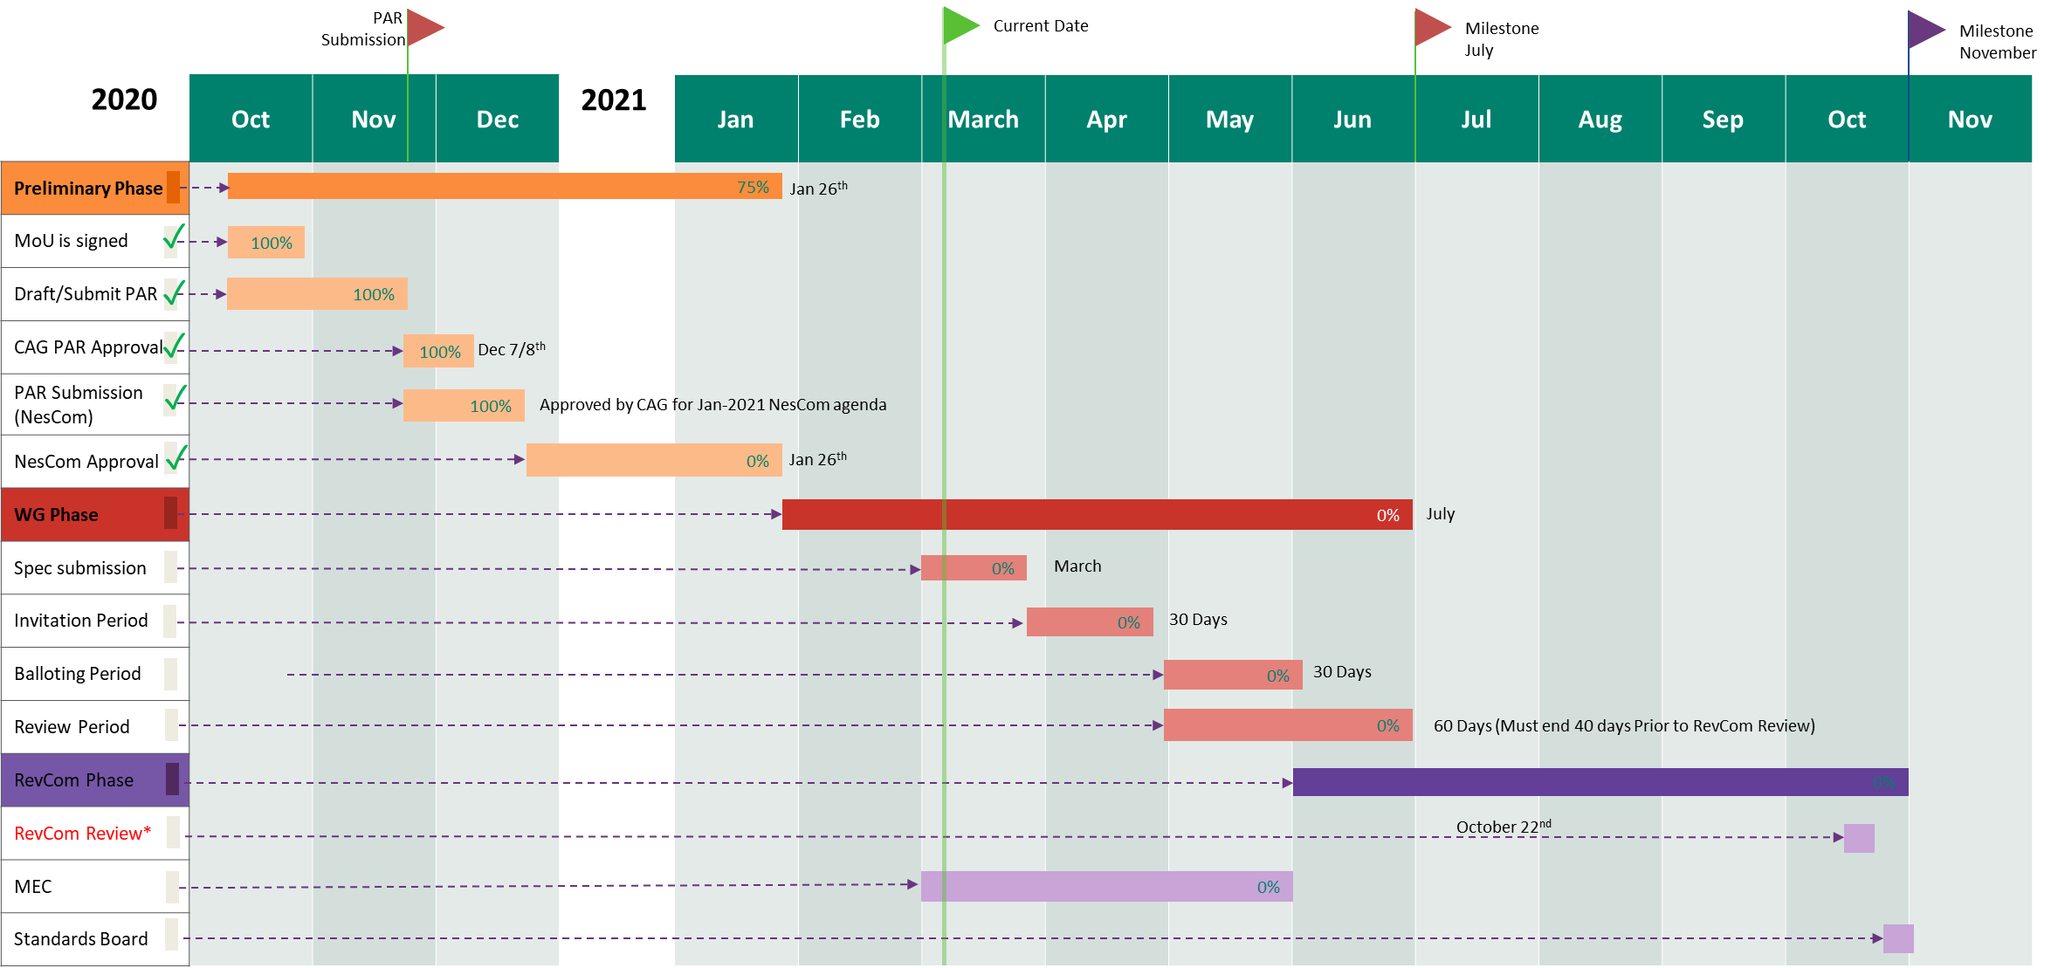
Project Timeline

Slide 11
Thank you
Name
Title
Company
Email
URL
Social Media

