Slide 1
Introducing MIPI A-PHY 1.0
Rick Wietfeldt
Chair
March 9th, 2021

Slide 2
Compliance with ieee standards policies and procedures
  Subclause 5.2.1 of the IEEE-SA Standards Board Bylaws states, "While participating in IEEE standards development activities, all participants...shall act in accordance with all applicable laws (nation-based and international), the IEEE Code of Ethics, and with IEEE Standards policies and procedures.”
  The contributor acknowledges and accepts that this contribution is subject to
    The IEEE Standards copyright policy as stated in the IEEE-SA Standards Board Bylaws, section 7, http://standards.ieee.org/develop/policies/bylaws/sect6-7.html#7, and the IEEE-SA Standards Board Operations Manual, section 6.1, http://standards.ieee.org/develop/policies/opman/sect6.html
    The IEEE Standards patent policy as stated in the IEEE-SA Standards Board Bylaws, section 6, http://standards.ieee.org/guides/bylaws/sect6-7.html#6, and the IEEE-SA Standards Board Operations Manual, section 6.3, http://standards.ieee.org/develop/policies/opman/sect6.html

Slide 3
IEEE P2977
MIPI A-PHY ADOPTION WORKING GROUP
Technical contribution
Date: 2021-03-09
Author(s):
Name | Affiliation | Phone [optional] | Email [optional]
Rick Wietfeldt | Qualcomm
Zahy Madgar | Valens

Slide 4
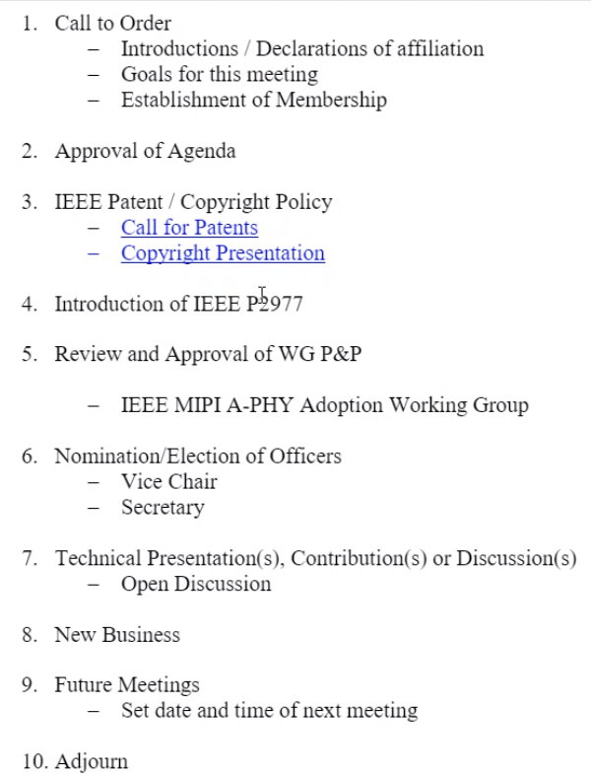
March 9 IEEE P2977 Meeting Agenda
    Background and Motivation
    Key Technical Requirements
    A-PHY Technical Overview
    Summary

Slide 5
Background and Motivation

Slide 6
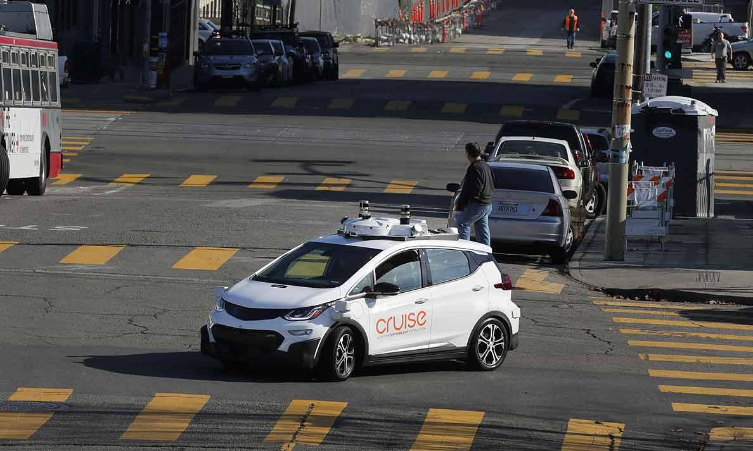
Auto Industry Transformation
CASE:
• Connected • Automated
• Shared • Electrified
Connected: The move to 5G
Automated: The move to L2/L2++
Shared: New OEMs, new business models, new alliances
Electrified: Tesla and others
And . . .
Safety: Improved government safety regulations (FCWS, AEB, RVS, LDWS, etc.)
Fuel economy: Aggressive regulations
Honda and GM Partner to Develop Mass Produced, Driverless Cars
Source: October 4, 2018, Automotive News
MIPI Alliance directly supports CASE via:
Connected (MIPI RFFESM, others)
Automated (MIPI A-PHY, MIPI CSI-2®, others)
FCWS: Forward Collision Warning System
AEB: Autonomous Emergency Breaking
RVS: Rear View System
LDWS: Lane Departure Warning System
RFFE: RF Front End

Slide 7
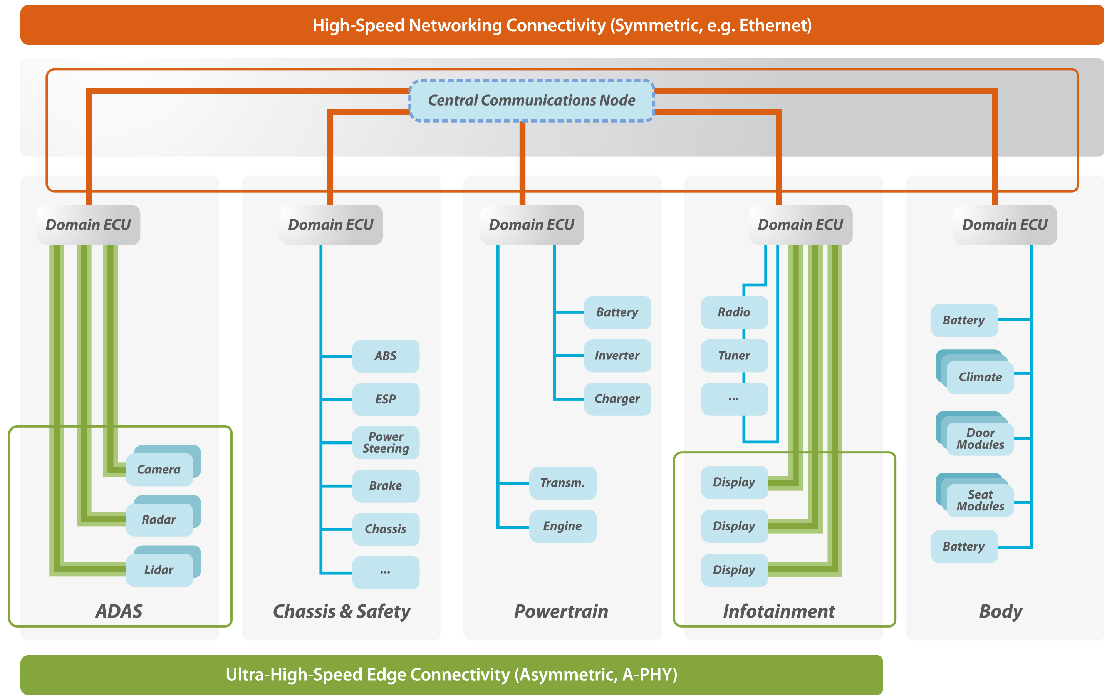
Emerging Standards in High-Speed In-Vehicle Connectivity
Coexistence of Edge and Networking Connectivity
High-speed Edge and Networking connectivity will coexist in automotive architectures
Networking:
  Symmetric comms between ECUs
Edge:
    Asymmetric comms from cameras-to-ECU and ECU-to-displays
Today’s topic is focused on asymmetric communications

Slide 8
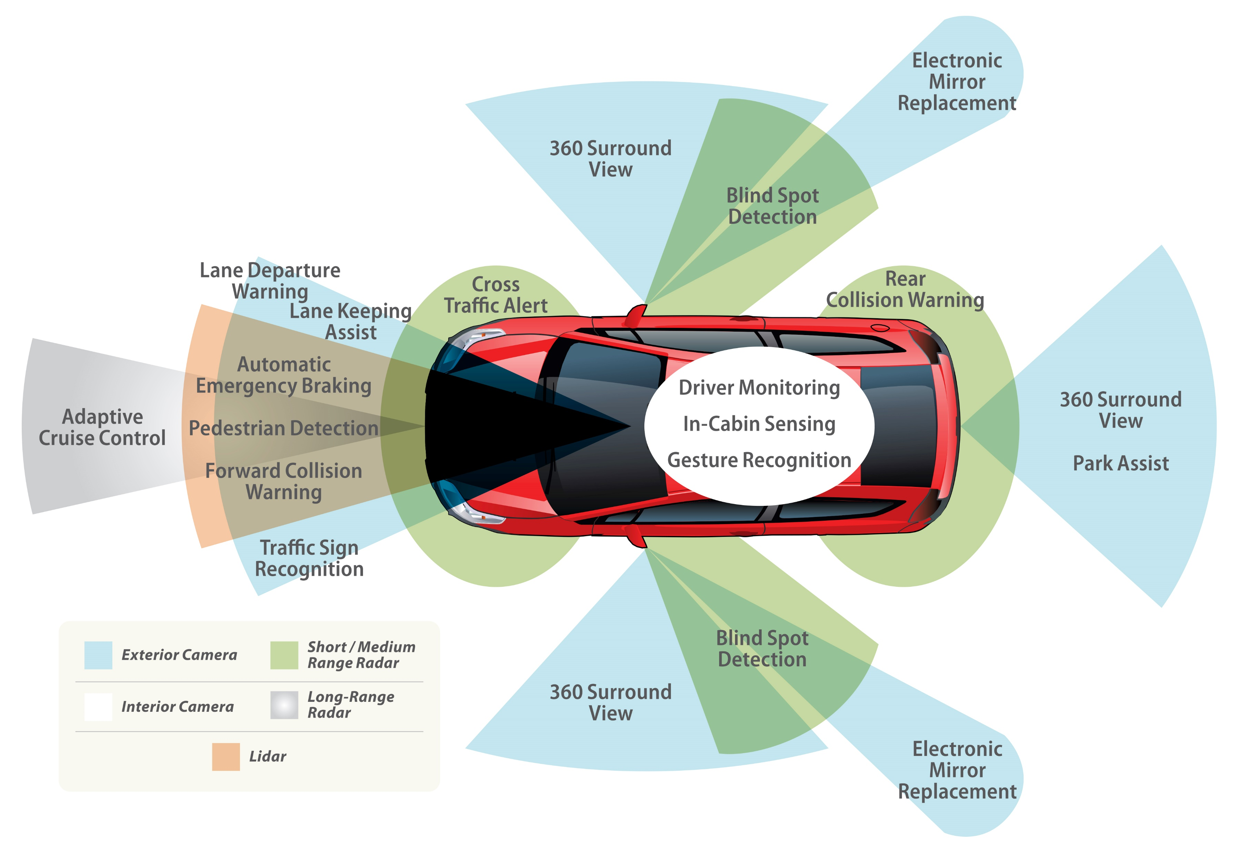
NCAP Regulations Driving Sensor & Display Adoption
Worldwide NCAP ADAS and ADS standards driving adoption of multiple high data rate “surround sensors”
Displays for driver viewing of assistance imaging and information also required
NCAP: New Car Assessment Program
ADAS: Advanced Driver Assistance System
ADS: Autonomous Driving System

Slide 9
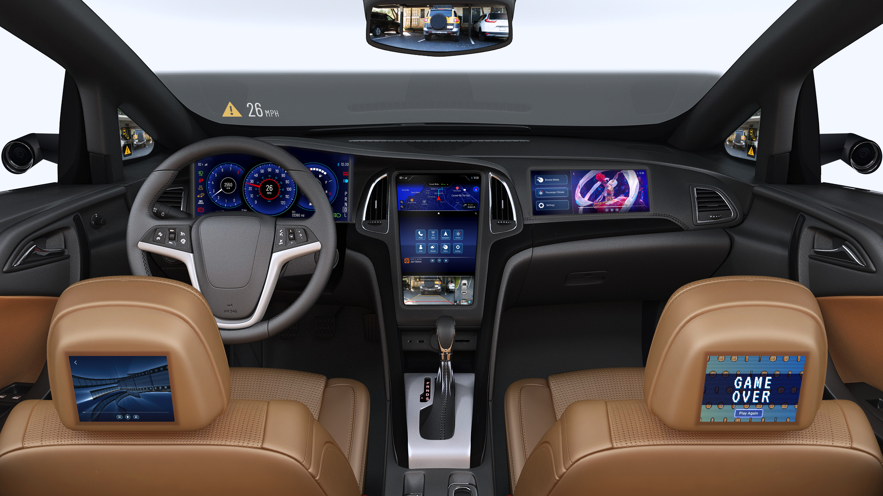
Modern digital Cockpit Displays
Display Type | Resolution Examples | Required NET Throughput [Gbps]
HUD | 850x480 | 0.6
DMD | 1280x720 | 1.5
DID | 3840x1440 | 8.4
CID | 3840x2160 | 12.6
CDD | 3840x2160 | 12.6
LCD | 3840x2160 | 12.6
RSE | 3820x2160 | 12.6
Future 1 | 5120x2160 | 16.6
Future 2 | 7680x2880 | 33.2
Head-Up Display (HUD)
Rear DMD
Left DMD
Co-Driver Display (CDD)
Right DMD
Centre Information Display (CID)
Driver Instrument Display (DID)
Lower Control Display (LCD)
Left RSE
Display
Right RSE Display
DMD: Digital Mirror Display
RSE: Rear Seat Entertainment
Assumptions: 24-bit/pixel, 60fps, CVT-2 Blanking overhead

Slide 10
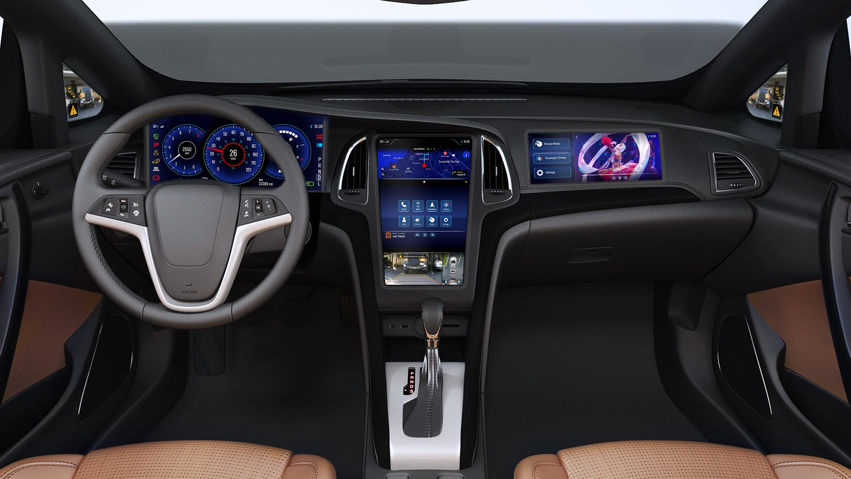
Exemplary Daisy-chain topology

Slide 11
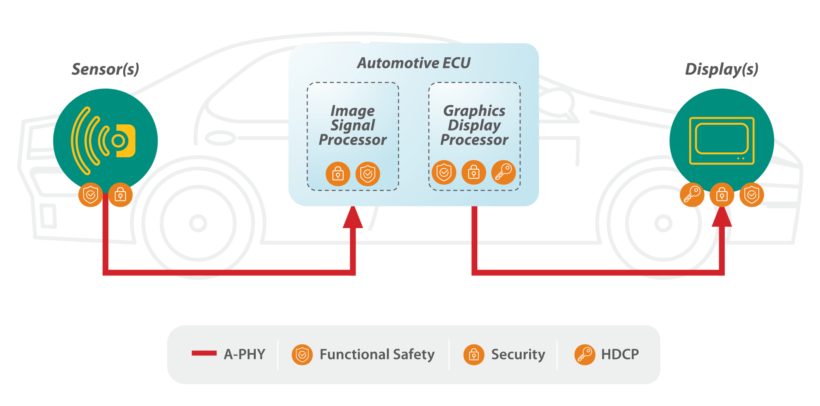
Vision TO Full SerDes Integration
Sensor and display endpoints with integrated long-reach connectivity (integrated SerDes) connect to the ECU without intermediate bridges.
Application-level functional safety and security data protection. HDCP for protecting premium content.
Camera
Radar
Lidar
VESA eDP/DP

Slide 12
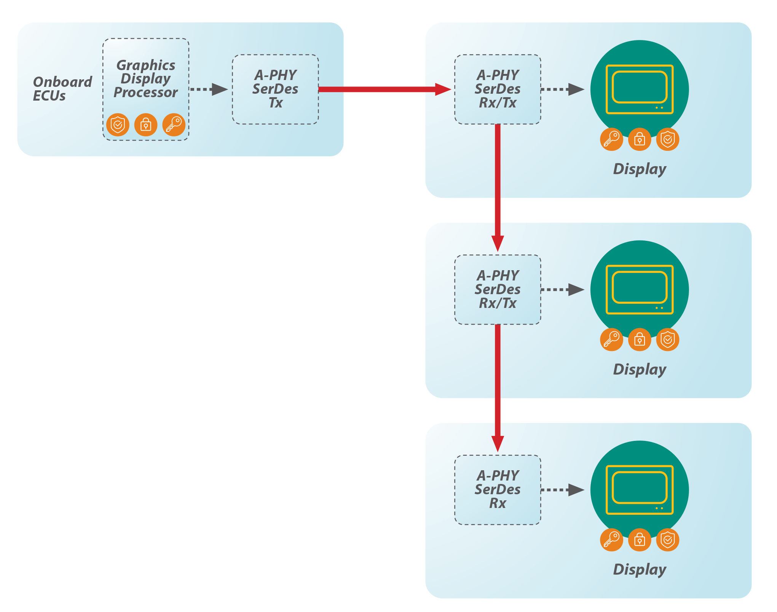
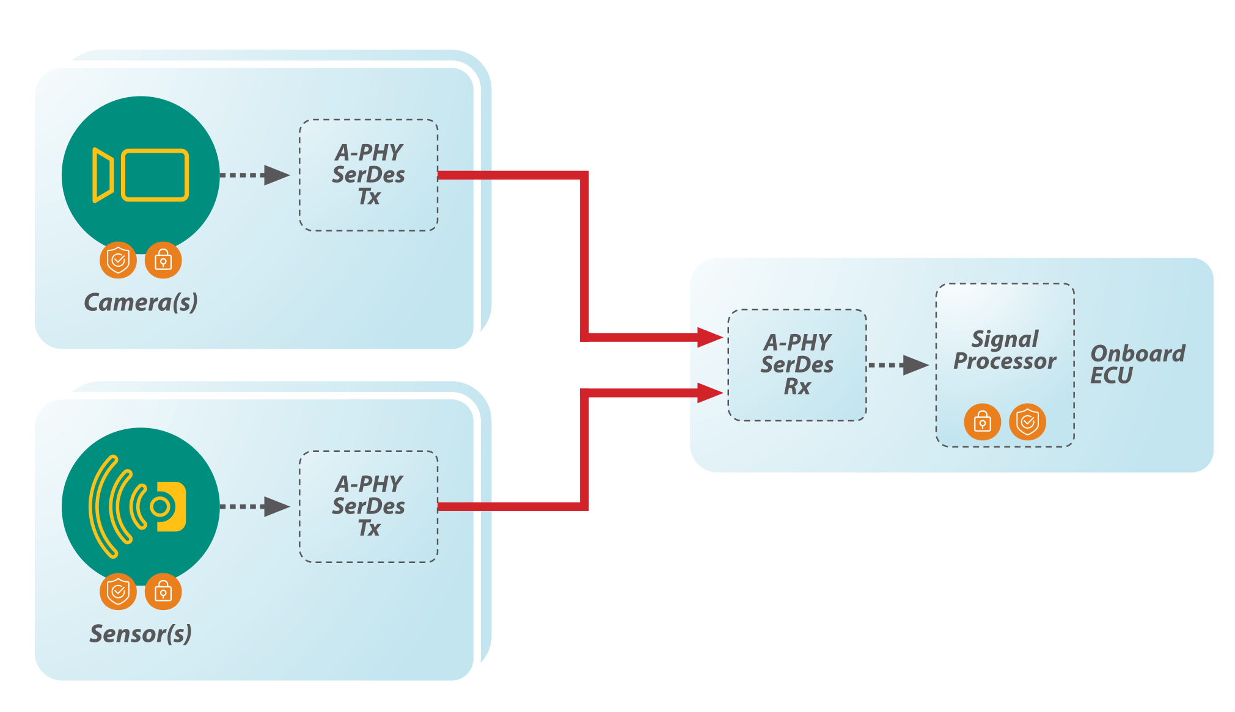
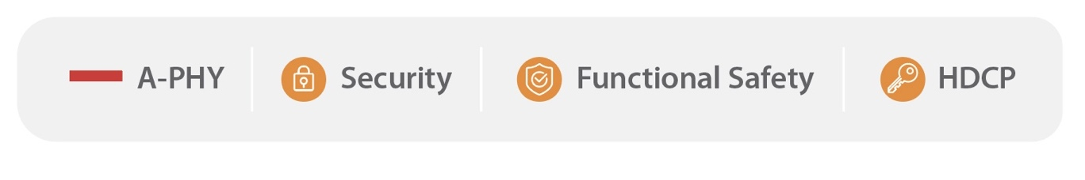


Examples of required Topologies
Camera and Sensor Aggregation
Daisy Chaining of Heterogeneous Displays
Sensors
Multi-port A-PHY RX SerDes with Sensor Aggregator
DID
DSI-2
Display Protocols
over A-PHY
CID
eDP
CDD
eDP
DID: Driver Instrument Display
CID: Central Information Display
CDD: Co-Driver Display

Slide 13
Key technical Requirements

Slide 14
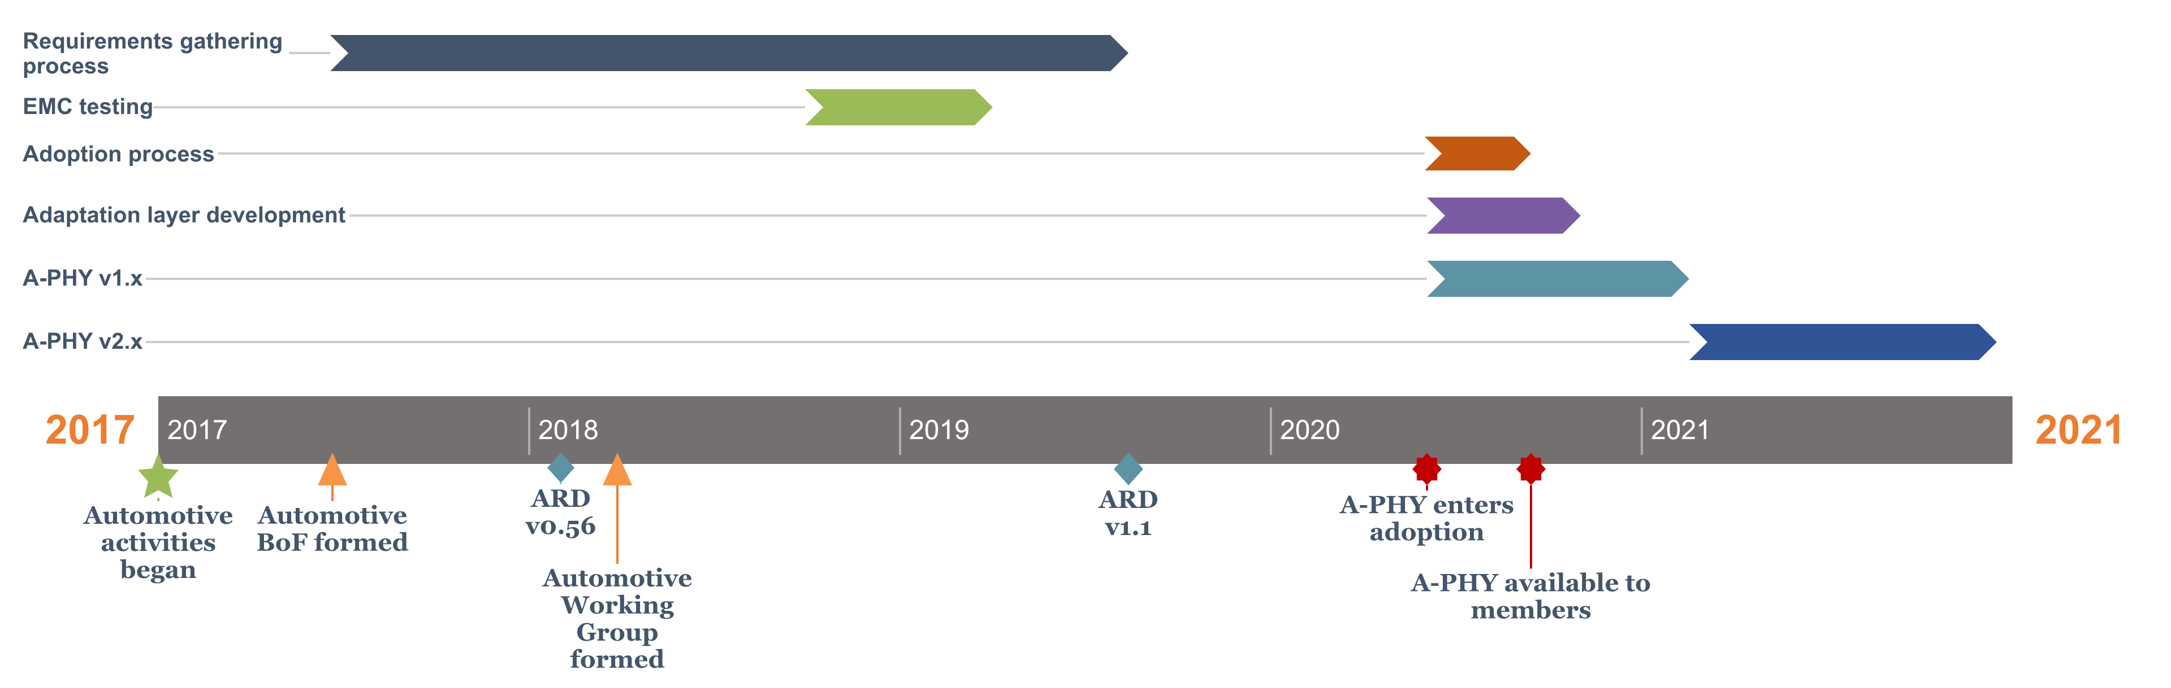
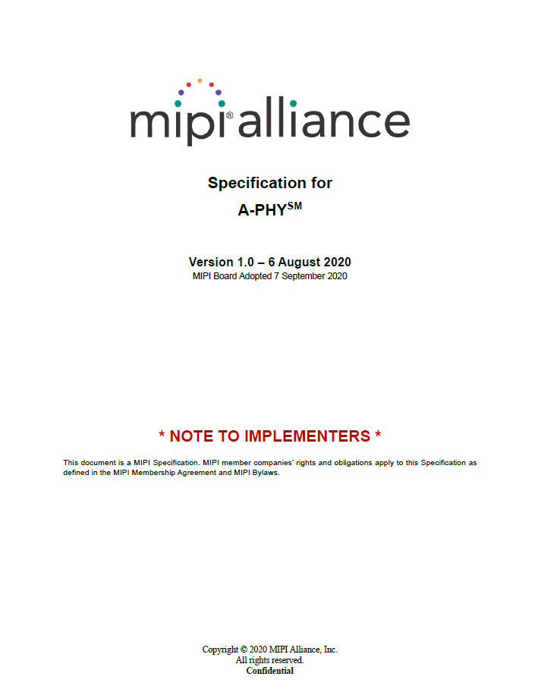
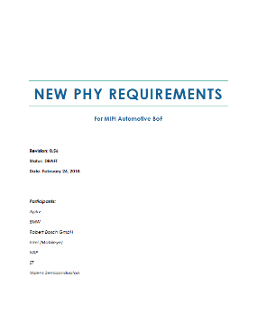
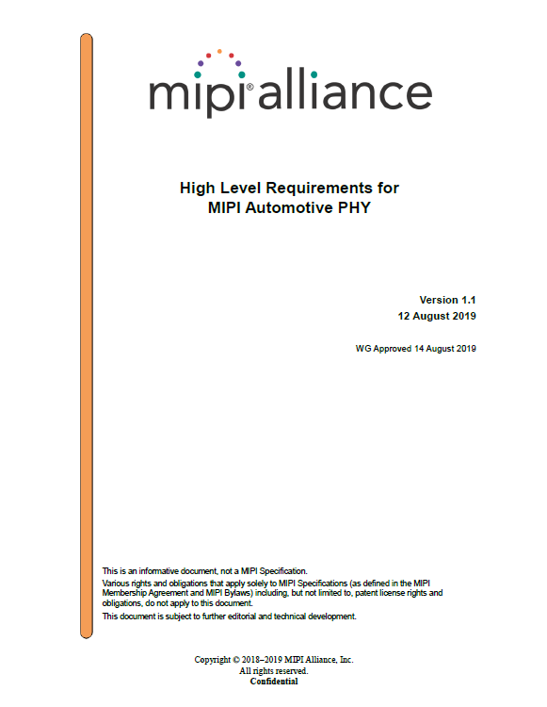

Mipi a-phy standards development timeline
Group formation
Major requirements milestones
REQUIREMENTS DOCUMENTS
A-PHY
SPECIFICATION
v0.56
v1.1

Slide 15
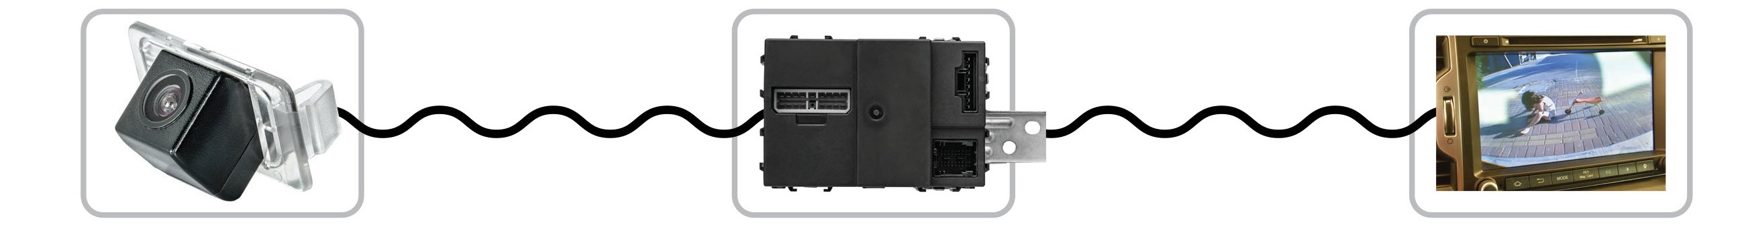

High Level Requirements
Robust Automotive Long-Reach Link
Ultra-low error rate (PER < 10⁻¹⁹: MTBF of 1 packet error in > 1 year over 10k cars*)
End-to-End Functional Safety
Integration of devices using MIPI & 3rd Party protocols over A-PHY in ASIL B / ASIL D systems
A-PHY and Protocol functional safety: Bridge-to-bridge at the PHY level, Source to sink at the higher/application layer
End-to-End Security
Authentication; prevention of tampering
Content protection for display applications (HDCP)
Heterogeneous Interfaces
Support broad range of application protocols: Ex: DSI, DisplayPort, eDP, others
High-speed downlink and aggregation to support multiple 4K cameras and displays
Asymmetric high-speed link with fixed low latency (target ~6ms @ 16 Gbps)
Agnostic to source/sink PHY configuration: C-PHY, D-PHY, DP-PHY, I2C/I3C, DP-AUX, lane counts
Application-layer encryption beyond the conventional link-based PHY-to-PHY extent
* Assuming an average of 10 links/car with an average of 10Gbps/link
PER: Packet Error Rate
MTBF: Mean-Time Between Failure

Slide 16
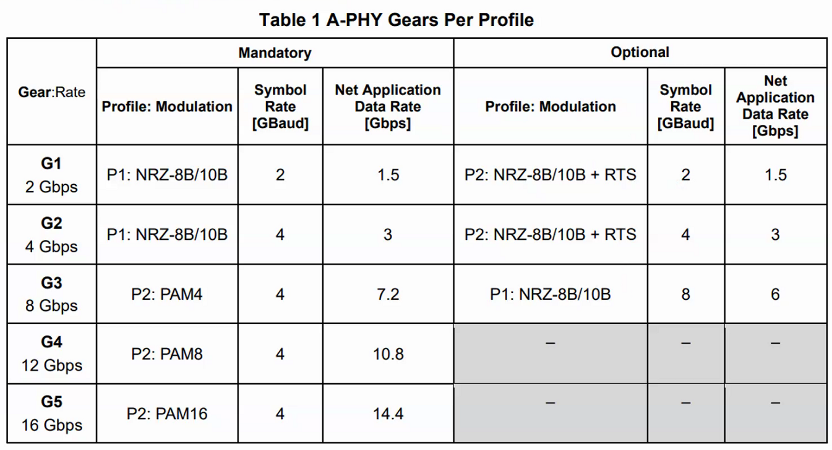
Noise Immunity
    Speed Gears
    There is a major variance in the OEM EMC requirements, from those targeting minimal noise immunity, to OEMs that apply stringent requirements to protect their system.
    A-PHY’s two profiles provide two noise immunity levels, to accommodate this variance.
        Profile P1 has lower noise immunity, similar to other SERDES solutions and is applicable for G1 and G2 (optional G3)
        Profile P2 has very high noise immunity based on MIPI Alliance analysis of expected noise level for the car life-time period.
    MIPI conducted multiple tests in independent labs evaluating noise levels and shielding effect degradation after mechanical stress and aging
        Results helped evaluate the multiple SerDes architecture/technology proposals
        Research continues as part of MIPI A-PHY SG activities.
Immunity Requirement | P1 [mVpeak] | P2 [mVpeak] | Notes
RF Ingress | 5 | 40 | Based on ALSE method ISO 11452-2, CW/AM/PM modulation scheme
Bulk Current Injection | 21 | 40 | Based on ISO 11452-4, CW/AM modulation scheme
Fast Transient | 15 | 150 | Based on ISO7637-2/3, with modifications for higher frequency pulses
  Notes:
  Noise levels are defined at the receiver pads when using the specified typical worst-case cable
  P2 limits are in line with similar results shown in IEEE research paper: https://ieeexplore.ieee.org/document/8825296 (Requires IEEE member access)
  40mVpeak corresponds to 89dBuV RMS

Slide 17
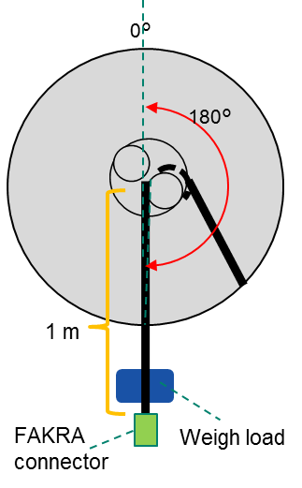
RF Ingress Testing
Test Conditions
Bending Fatigue & Temperature Cycling Test
  Cable: Two types of Dynamics Coax cables in
  lengths of 2m and 15m
  Lab Conditions:
Mechanical condition | Bending angle | 180°
 | Bending diameter | 60 mm
 | Bending Speed | 10 times/min
 | Weight load | 3 N (~0.3kgf)
Temperature condition | Temp. cycle | See below fig.
 | Temp. range | -25~25~105℃
Total number of bending |  | 36000 times
Total time |  | Roughly 72 hours
  Screening Attenuation Test Result
Dynamic Coax 1
Dynamic Coax 2

Slide 18
A-PHY Technical Overview

Slide 19
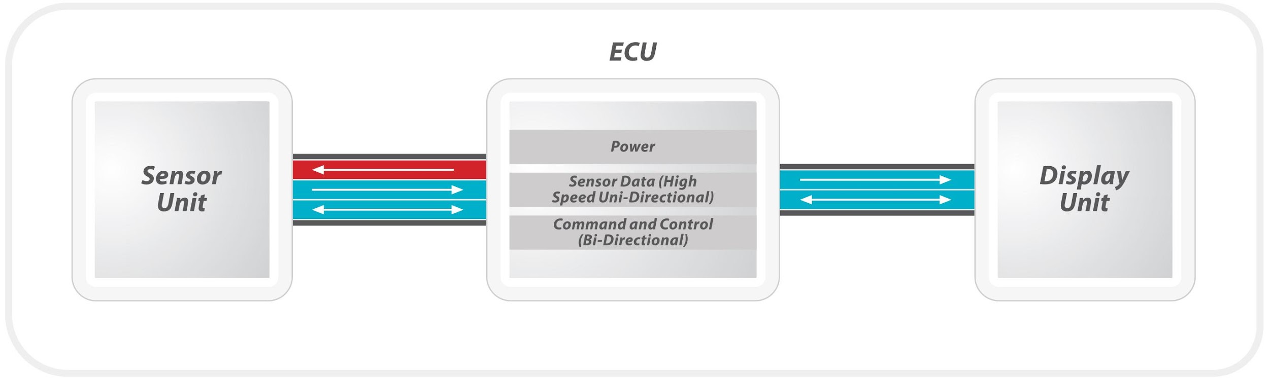
What is mipi A-PHY?
Industry-standard asymmetric SerDes physical layer specification targeted for ADAS/ADS surround sensor applications and infotainment/Digital Cockpit display applications
A-PHY v1.0 offers:
Direct coupling to MIPI and VESA protocols, supporting bridge-based & endpoint integration
High performance of 2-16 Gbps over 10-15m, with roadmap to 24-48+ Gbps
High noise immunity, ultra-low PER (< 10⁻¹⁹)
Support for automotive coax and SDP channels
Lower cost through standardization and economies of scale
Lower cost/eBOM through integration
Notes:
We identify two stages of evolution. The first is the move from current/proprietary bridges to standard/A-PHY bridges, then the integration of the A-PHY and its protocols directly into the endpoints: camera, SOC processor, and display/TCON or DDIC.
Integration in automotive may occur first in cameras, and later in the SOCs and displays, by virtue of the cost advantages in eliminating bridges for the 12+ cameras needed for ADAS/AD (autonomous driving).

Slide 20
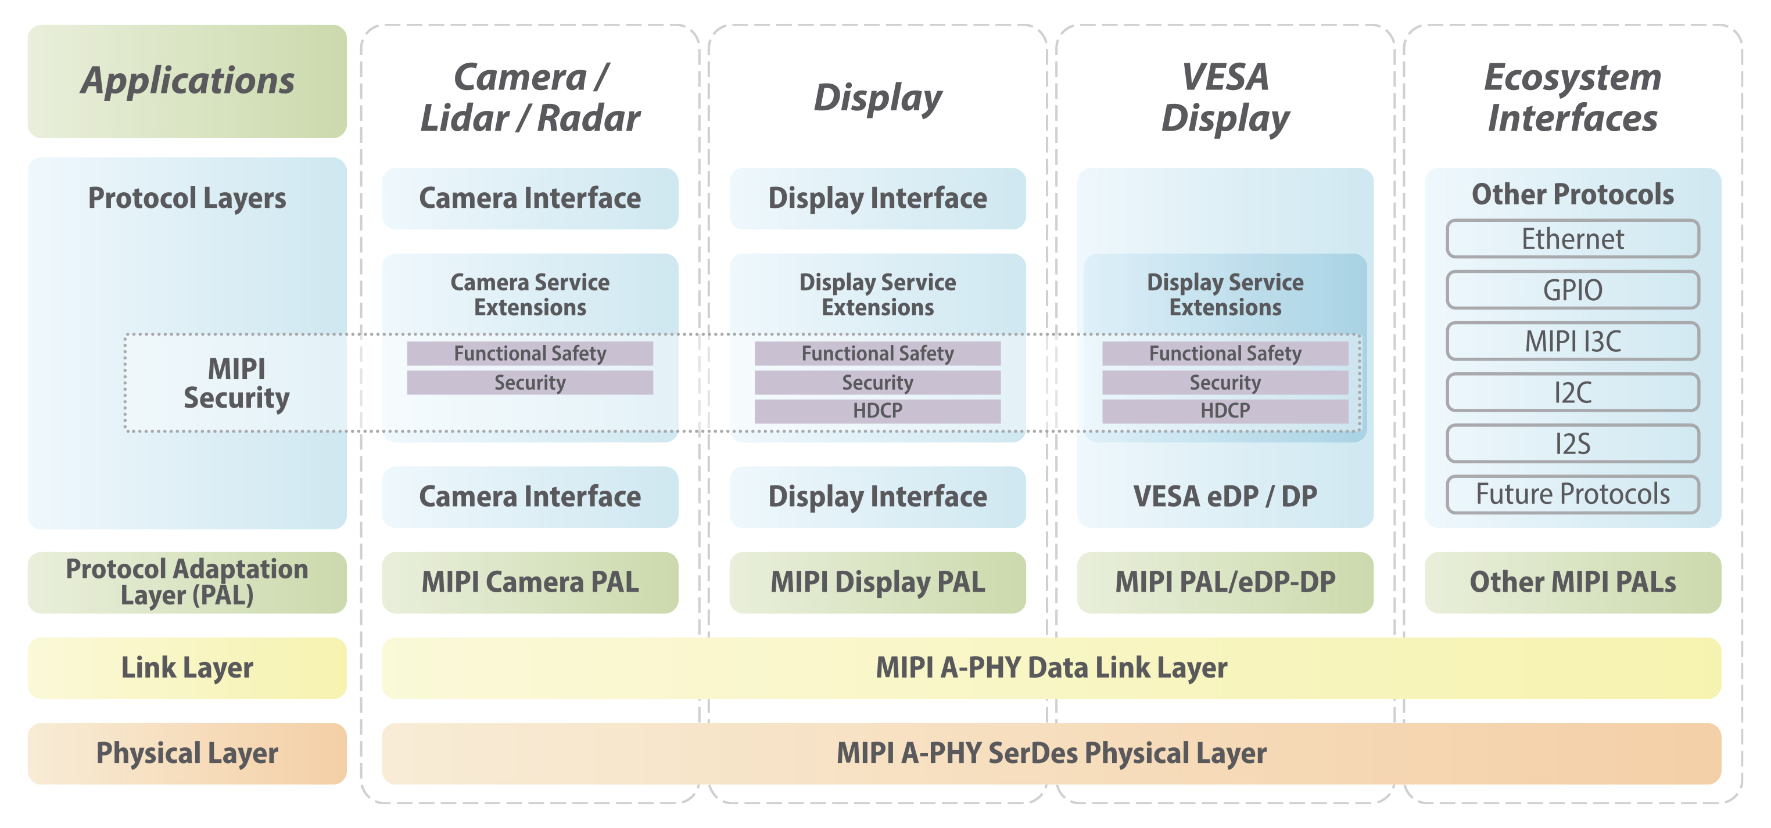
A-PHY & its Position in Automotive Connectivity Stack
A family of specifications, enabled by A-PHY

Slide 21
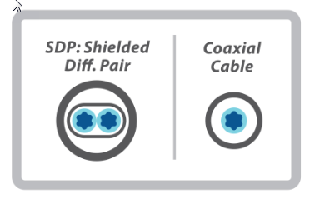
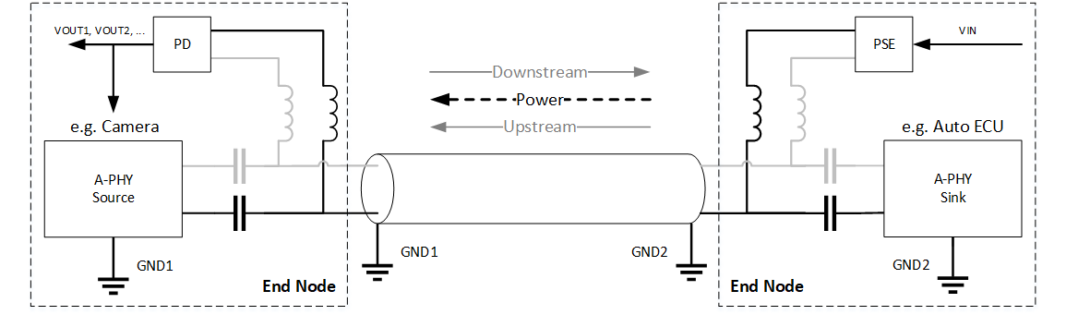
A-PHY Interconnect Channel
A-PHY is a single lane, point-to-point, serial communication technology
Support for multiple cable types - SDP/Coax
Power over cable support
Up to 15m with 4 inline connectors

Slide 22
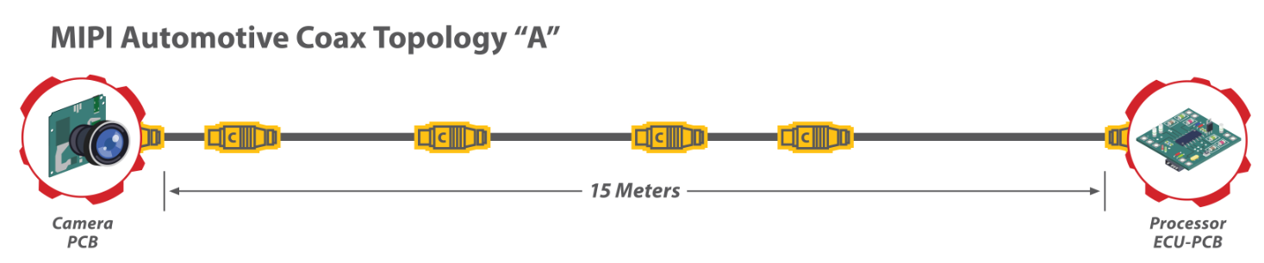
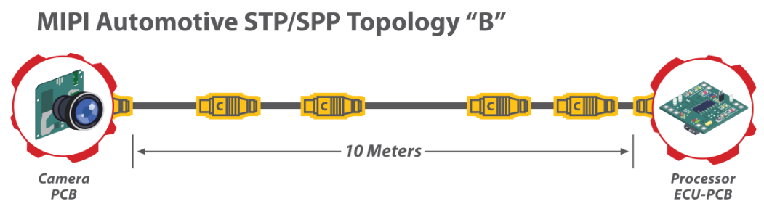
A-PHY cable type & topology
50 Ω Coax cable up to 15 m, with up to 4 inline connectors with minimum segment of 30 cm
100 Ω SDP cable up to 10 m, with up to 4 inline connectors with minimum segment of 30 cm

Slide 23
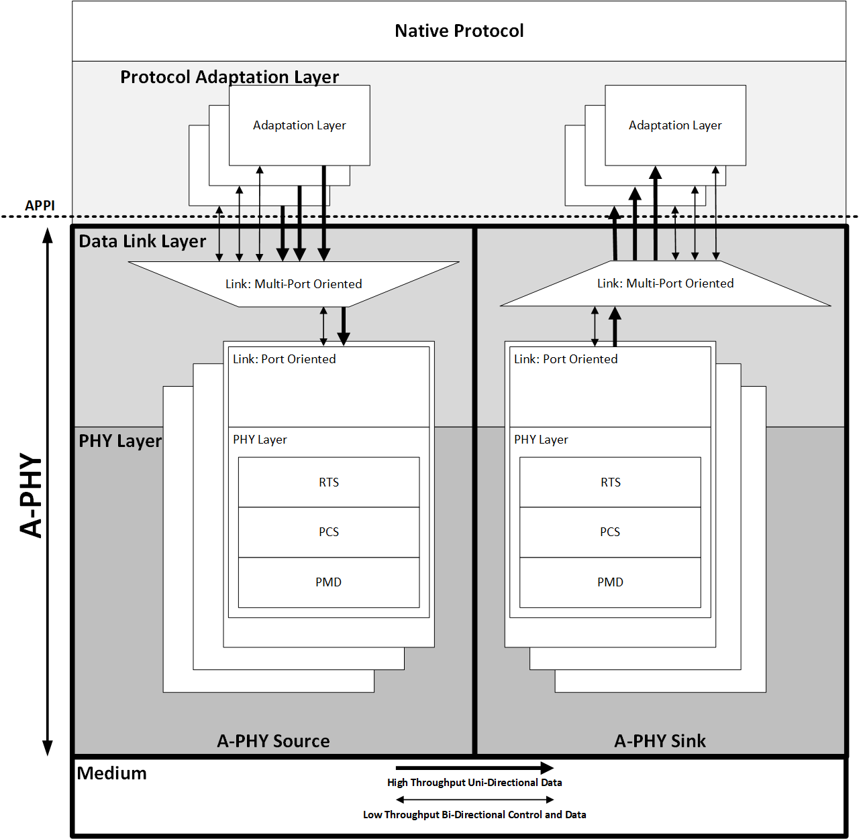
A-PHY Layers
Native Protocol
    E.g., MIPI Protocols, DP/eDP, Ethernet, I2C, GPIO
Protocol Adaptation Layer (PAL)
    Mapping to/from Native Protocol to A-Packet
Link Layer
    Scheduling, Prioritization, Duplication, Forwarding
PHY Layer
    Encodes and decodes symbols extracted from A-Packets according to the modulation scheme used per gear
    Modulated symbols are transmitted and received over the
    A-PHY interconnect according to the medium-dependent
    electrical specifications

Slide 24
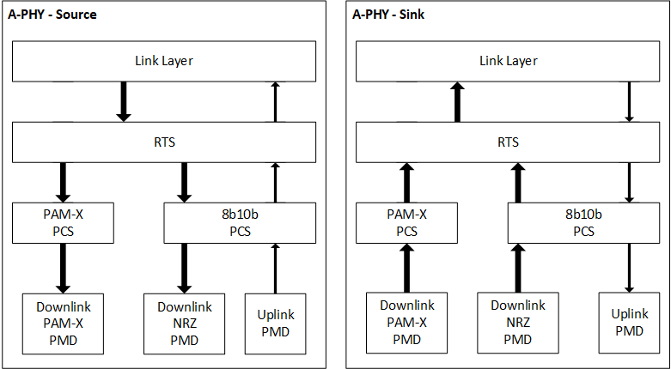
PHY Layer – Structure
    Unified structure to reduce complexity
    Shared 8B/10B PCS for G1/G2 and uplink
    RTS Sub-Layer
      Manage data pacing and buffering
      Assign Message Counter (MC) and CRC
      P2 - the retransmission process for A-Packets that are erroneous or that are not received
    PCS Sub-Layer
      Specifies the conversion of Data Link Layer
      A-Packets into PHY symbols
      In P2, PCS also handles the JITC* Re-Training
    PMD Sub-Layer
      Defines the electrical specifications and the physical medium
*JITC – Just In Time Cancelers

Slide 25
What Makes MIPI A-PHY So Robust and Efficient?
PHY-level Retransmission (RTS) & Narrow band interference cancellation (NBIC)
Time Bounded
  Retransmission is attempted only within predefined “Overall Delay” (e.g. ~6µS @G5)
Local PHY Level
  Transparent to upper layers
  Happens within a single A-PHY Hop
Dynamically Modulated
  Retransmitted packets has better error resistant data payload Sub-Constellation.
Highly Reliable
  PER (Packet Error Rate) < 10⁻¹⁹
Highly Resilient
  Overcome Thousands symbols-long Error bursts
  Multiple 10s of mVs, instantly attacking, NBI Peak.
Low Overhead
  Overall PHY + Link < 10% ➔ 90% Net Data rate
Notes:
Recover damaged packets due to large in-car electrical transients which create long bursts of errors
Recover damaged packets due to instant attack of yet un-cancelled large NBI which create long bursts of errors
Ensure steady link throughput to enable seamless higher layers operation even at extreme Phy operation points

Slide 26
A-PHY Performance and Immunity-Based Profiles
Performance requirements vary:
    8MP camera sensors might require “8 Gbps” per camera
    4K displays might require “16 Gbps” per display (uncompressed)
    These interface speeds increase with aggregation and daisy-chain use cases
Noise immunity (EMC RF Ingress) requirements vary:
    Different OEMs have different requirements
    MIPI-conducted tests in independent labs evaluated noise levels and shielding effect degradation after mechanical stress and aging
A-PHY supports two performance & immunity profiles:
    P1 (NRZ): Lower noise immunity, similar to other SerDes solutions, and applicable to the lower speed gears (G1 and G2, optional at G3)
    P2 (PAM-X): Very high noise immunity to meet the expected noise levels over 10-15m and the car lifetime period
Performance- and Immunity-based profiles:
    P1 offers the lowest cost at the lower performance needs
    P2 offers the highest performance and immunity
Notes:
The two A-PHY profiles –Performance and –Immunity based offers the automotive industry choice in the first wave of implementations (circa 2024).

Slide 27

A-PHY functional safety features
A-PHY packets are end-to-end protected as recommended in ISO-26262:2018:
    CRC-32 for each packet, providing a Hamming-Distance of more than 3
    Message Counter that is 8 bits wide
    Time out monitoring is fulfilled by Keep-Alive function
The above measures are necessary to argue a high diagnostic coverage for a communication bus, per Table D.6 in ISO 26262-5:2018
All other functional safety features necessary to fulfill the required system-level safety goal with ASIL are expected to be managed by upper layers

Slide 28
SUmmary

Slide 29
Summary
    MIPI A-PHY is an advanced long-reach asymmetric SerDes PHY standard, offering performance- and immunity-based profiles to meet a broad spectrum of requirements
      Asymmetric interfaces are key to surround sensor applications for ADAS/autonomous driving and advanced Digital Cockpit displays
      A-PHY supports PHY-level functional safety and a link to application-layer end-to-end data protection (functional safety and security) from data source to data sink
    Standardization expansion into an IEEE specification further drives visibility, economies of scale, interoperability, and ultimately reduces cost and eBOM.
Motion: To accept IEEE P2977/D1 Standards for Adoption of MIPI Alliance Specification for A-PHY Interface (A-PHY) Version 1.0 as the official Working Group Draft to authorize it to move to SA ballot.
Yes:
No:
Abstain:

Slide 30
Thank you

