Slide 1
Possible Resilience Stats
Brett Efaw
2020 IEEE JTCM – Dist Res WG
Jacksonville, FL

Slide 2
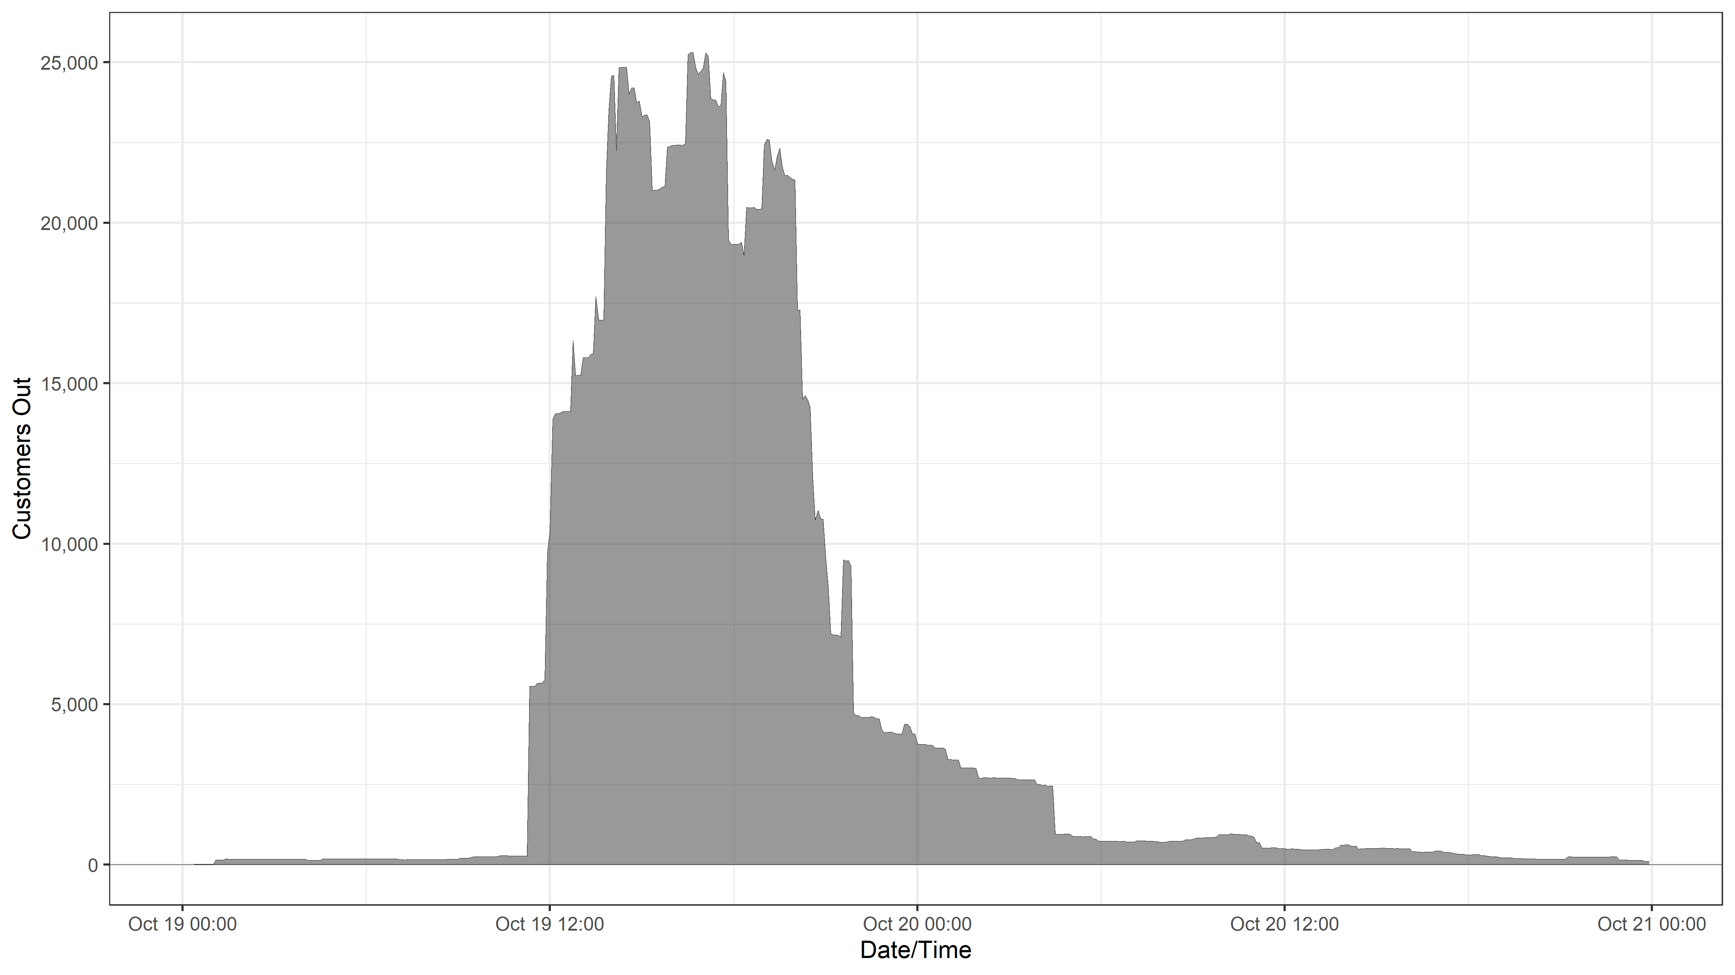
Large t-storm moved thru IPC service territory
~12 feeders LOs and 2 sub-tx line LOs plus dozens of smaller incidents

Slide 3
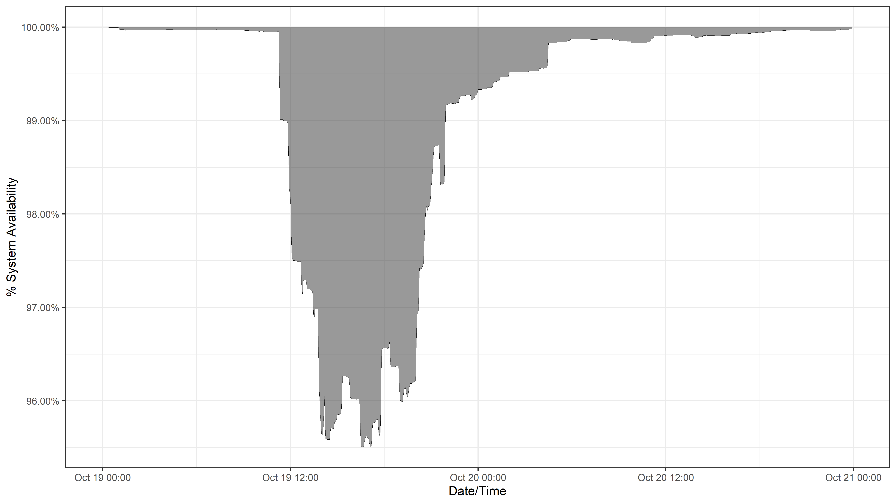
Inverting the customer-outage timeline = system availability timeline

Slide 4
T
XXX
XXX is a system availability threshold
Use 3 decimal places of precision
(i.e. 995 = 99.5%)
A
D
System Availability (%)
time

Slide 5
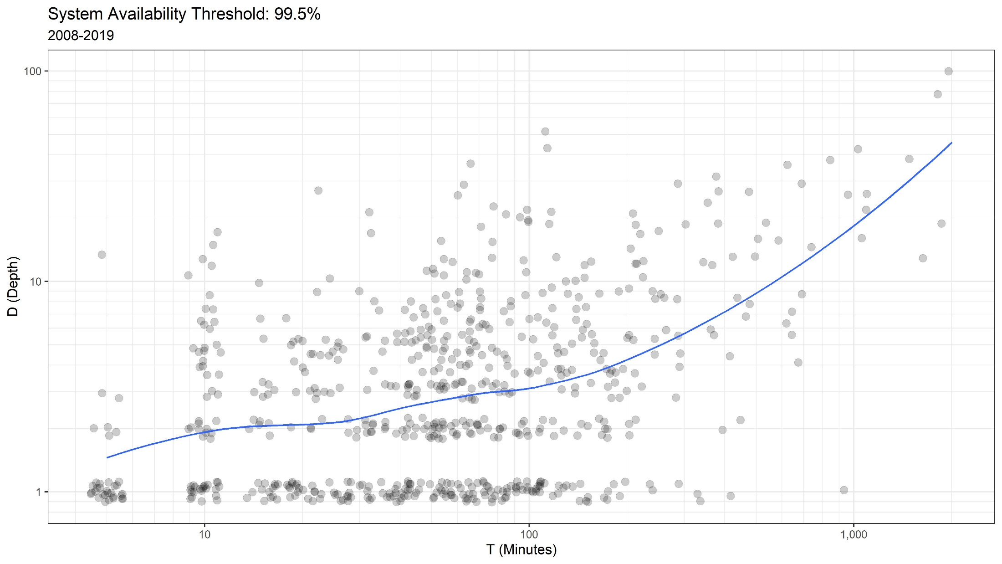
674 total occurrences in 12 years

Slide 6
XXX = 995 (i.e. 99.5%)
Year | # of Occrn | T mean/max (minutes) | D mean/max | A | 1 - % Time | SAIFI | SAIDI (minutes)
2008 | 89 | 89 / 725 | 5.0 / 32 | 558,435 | 99.89 | 1.97 | 213
2009 | 78 | 119 / 1515 | 5.4 / 39 | 1,654,525 | 99.68 | 1.90 | 249
2010 | 71 | 152 / 1900 | 5.3 / 72 | 5,087,960 | 99.03 | 1.66 | 274
2011 | 33 | 106 / 970 | 3.2 / 23 | 343,070 | 99.93 | 1.19 | 151
2012 | 51 | 140 / 2005 | 5.6 / 90 | 9,925,340 | 98.11 | 1.46 | 245
2013 | 61 | 100 / 1135 | 4.6 / 28 | 640,135 | 99.88 | 1.40 | 202
2014 | 39 | 107 / 625 | 5.5 / 35 | 382,780 | 99.93 | 1.22 | 156
2015 | 62 | 110 / 720 | 5.8 / 53 | 560,725 | 99.89 | 1.60 | 220
2016 | 49 | 79 / 325 | 4.3 / 21 | 39,150 | 99.99 | 1.19 | 162
2017 | 63 | 118 / 695 | 4.9 / 28 | 480,980 | 99.91 | 1.54 | 233
2018 | 35 | 97 / 995 | 4.1 / 22 | 36,520 | 99.99 | 1.07 | 132
2019 | 43 | 92 / 880 | 6.2 / 40 | 1,144,730 | 99.78 | 1.22 | 145

Slide 7
XXX = 990 (i.e. 99.0%)
Year | # of Occrn | T mean/max (minutes) | D mean/max | A | 1 - % Time | SAIFI | SAIDI (minutes)
2008 | 27 | 91 / 450 | 6.5 / 27 | 146,810 | 99.97 | 1.97 | 213
2009 | 26 | 150 / 1515 | 7.8 / 34 | 872,845 | 99.83 | 1.90 | 249
2010 | 19 | 221 / 1240 | 9.4 / 67 | 2,475,705 | 99.52 | 1.66 | 274
2011 | 4 | 171 / 350 | 8.0 / 18 | 48,455 | 99.99 | 1.19 | 151
2012 | 11 | 272 / 1505 | 15.5 / 85 | 6,290,005 | 98.79 | 1.46 | 245
2013 | 16 | 109 / 670 | 7.2 / 23 | 233,850 | 99.96 | 1.40 | 202
2014 | 8 | 134 / 475 | 12.4 / 30 | 118,910 | 99.98 | 1.22 | 156
2015 | 28 | 104 / 495 | 6.4 / 48 | 182,105 | 99.97 | 1.60 | 220
2016 | 13 | 40 / 115 | 4.7 / 16 | 6,625 | 99.99 | 1.19 | 162
2017 | 22 | 96 / 425 | 6.6 / 23 | 135,275 | 99.97 | 1.54 | 233
2018 | 6 | 63 / 230 | 4.8 / 12 | 5,570 | 99.99 | 1.07 | 132
2019 | 13 | 92 / 620 | 9.2 / 35 | 630,715 | 99.88 | 1.22 | 145

Slide 8
