Slide 1
Mobile Edge Computing Sensors for Grid Resilience
John L. Lauletta
Life Sr. Member, IEEE
jlauletta@exacterinc.com

Slide 2
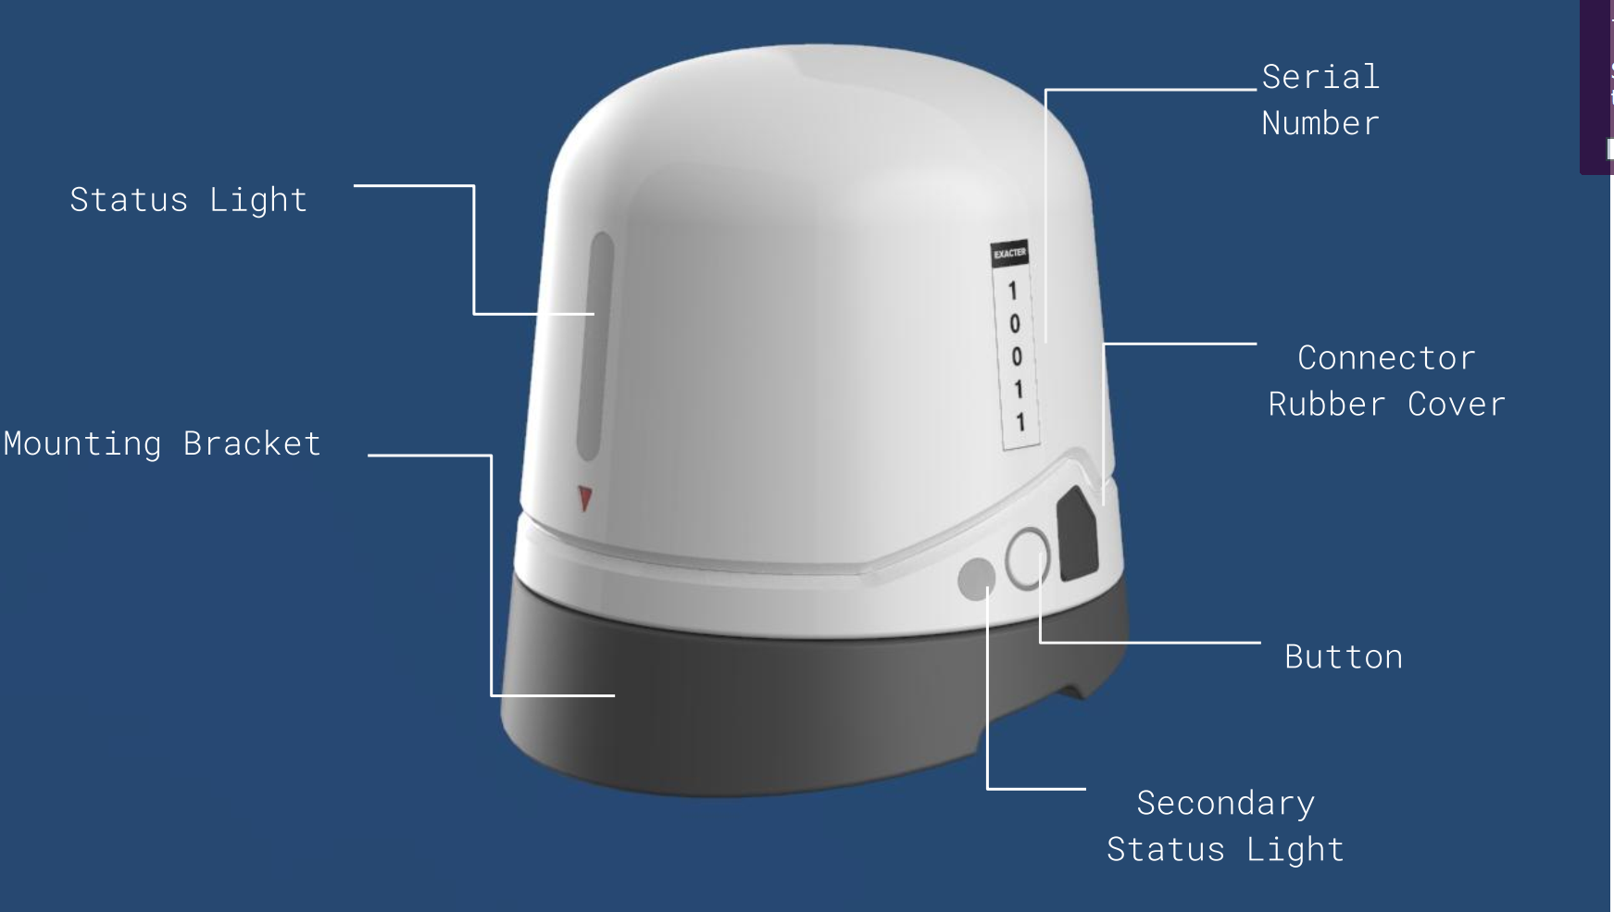
Exacter Trekker™ Bird Foundation Grant Award
U.S. and Israel Collaborate for Power Grid Predictive Analytics
Exacter, Inc., of Columbus, Ohio, and Razor Labs of Tel Aviv, Israel, were awarded a $950,000 grant to fund collaborative research and development efforts. As part of a pilot project, these sensors will be installed on garbage trucks in Ohio, for continuous grid monitoring and grid resilience analytics.

Slide 3
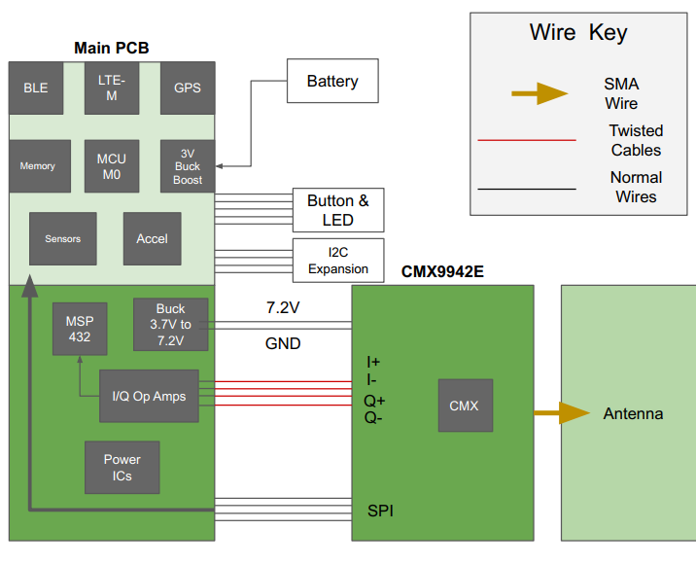
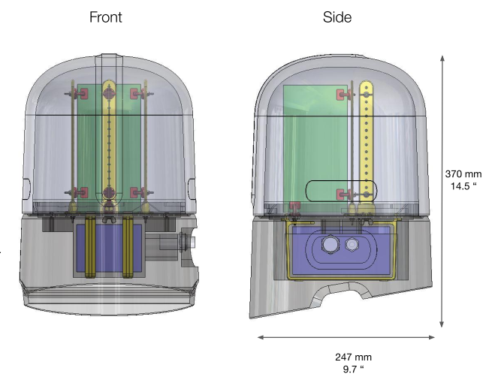
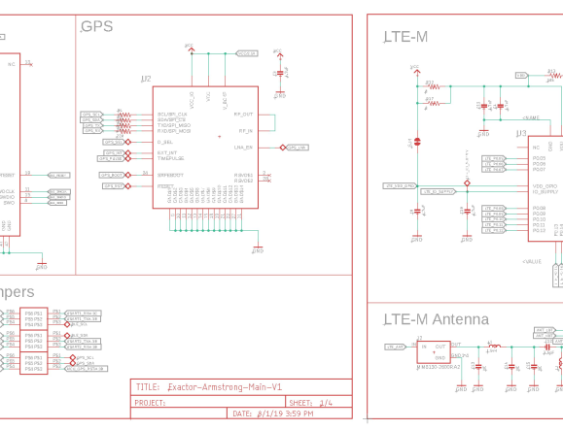
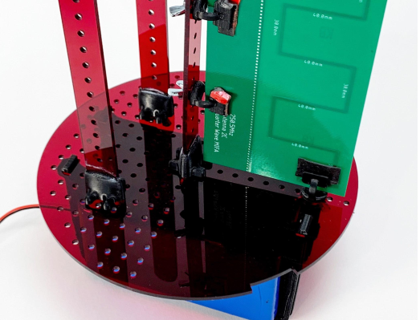
Initial Sensor Deployment: 5,000 miles of Distribution Grid
Field Trials Complete
AWS Cloud Connections Established
Data Visualization Platform Complete
Trial Field Deployment Began: June 2020

Slide 4
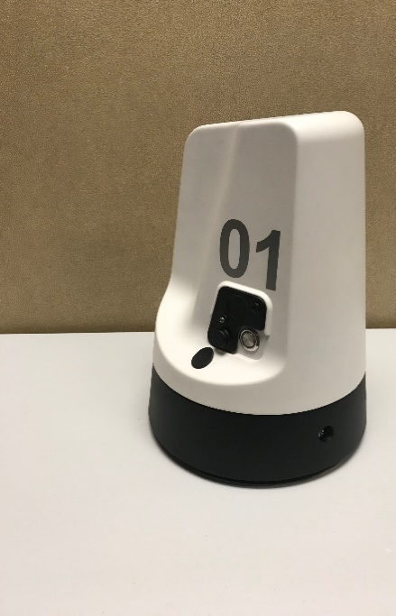
What if . . .
Grid Equipment Condition Sensors were installed on all 60,000 sanitation vehicles collecting the condition of the nation’s grid every day?
Who could use this data?
What would be the use cases?

Slide 5
Launch Timeline
First Deployment - U of Akron
14 Units – 5,000 Grid Miles
Product Prototype
In Field Test
Second Larger Scale
Deployment
Establish
Channel Partners
Data Analytics
Platform Launch
Utility Partnerships
2021
2019:Q4
Q1
Q2
Q3
Q4

Slide 6
Technical Challenges - Project Goals
Autonomous Operation
Minimal Power Requirements - Battery Operation
Edge Computing Sensor
No Vehicle Alterations

Slide 7
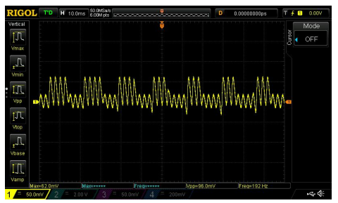
“Partial Discharge is a Key Indicator of Equipment Deterioration.” Dr. S Sebo, The Ohio State University High Voltage Laboratory
Patented Partial Discharge Analysis Algorithms
99.7% Ground Truthing Achievement
14-year Experience

Slide 8
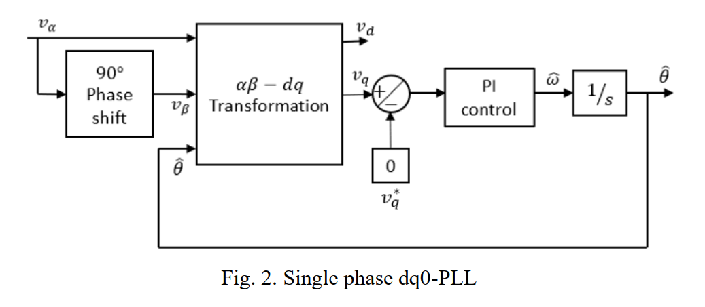
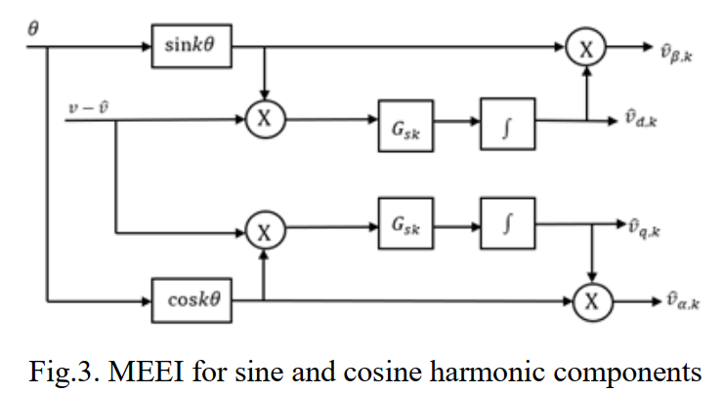
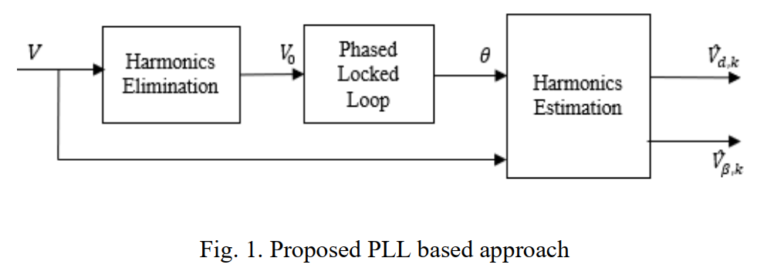
Research to Integrate APD Algorithms on Silicon
Mixed Estimation Error Integral MEEI Algorithm Model¹
Fast
Low Power
Integrated on One Mixed Mode Microcontroller
1. Dasari, R.S., Phase Locked Loop Based Signal Processing Approach for the Health Monitoring of Power Systems
through their Emissions, Master Degree Thesis, May 2019, ECE Department, University of Akron

Slide 9
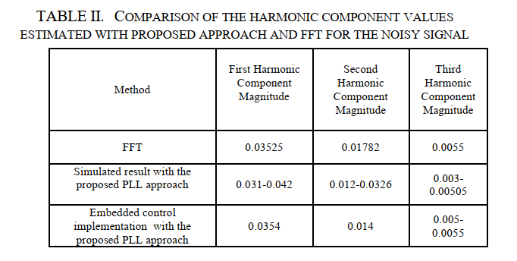
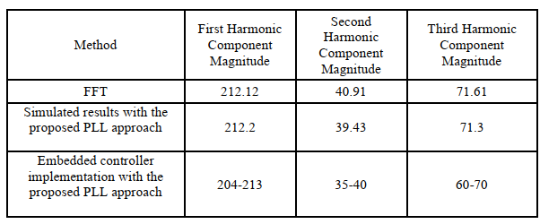
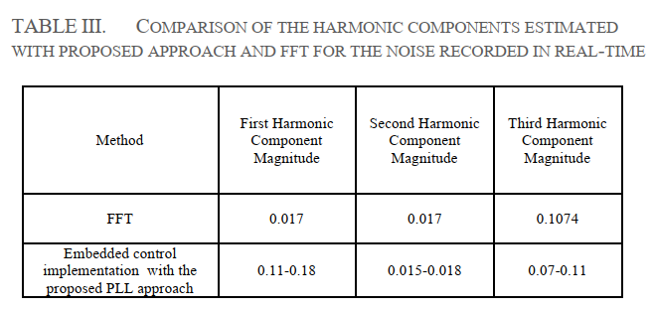
MEEI Algorithm VS. FFT
Table I. Comparison of the Harmonic Component Values
Estimated with Simulated Signals

Slide 10
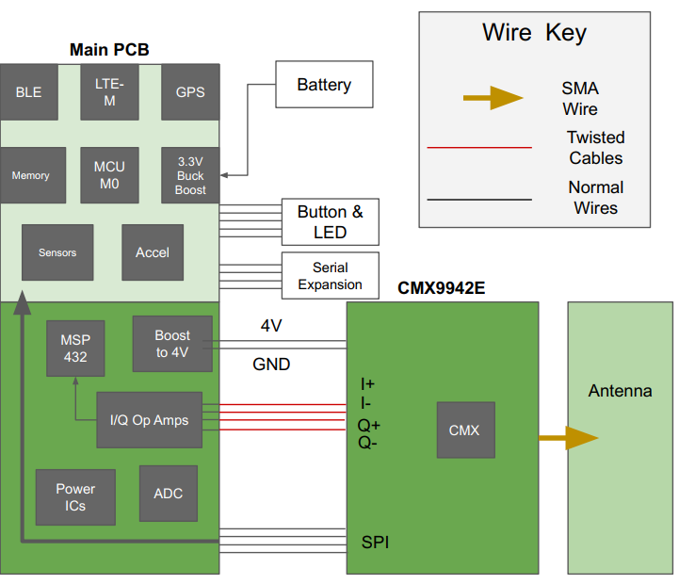
Emission Detection and Analysis
Vehicle Motion Detection
Dynamic Sleep Mode
Concealed Antenna
Centralized Maintenance Web Portal

Slide 11
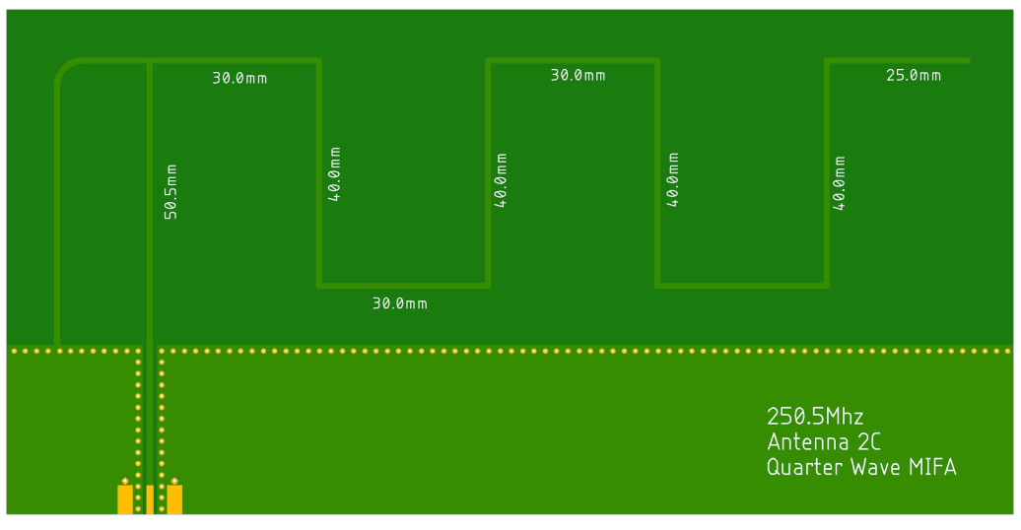
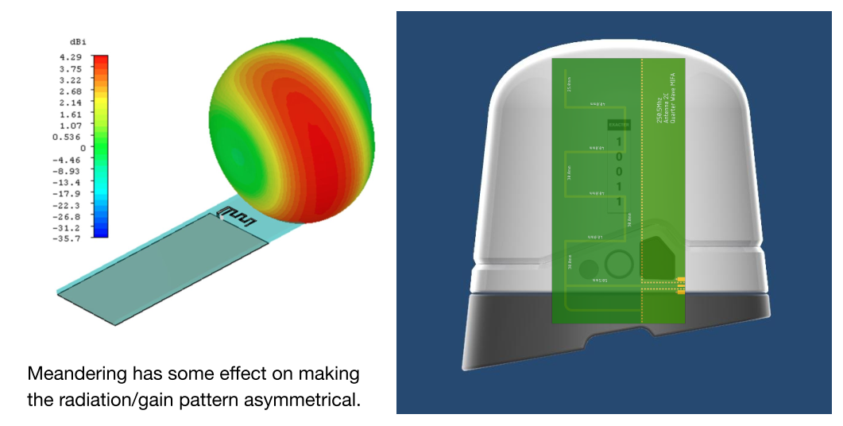
Internal VHF Antenna for PD Emission Detection
No External Wiring
No External Antennae – Meandering Inverted F-Pole Antenna (MIFA)
Simple Installation and Commissioning
No Vehicle Alterations

Slide 12
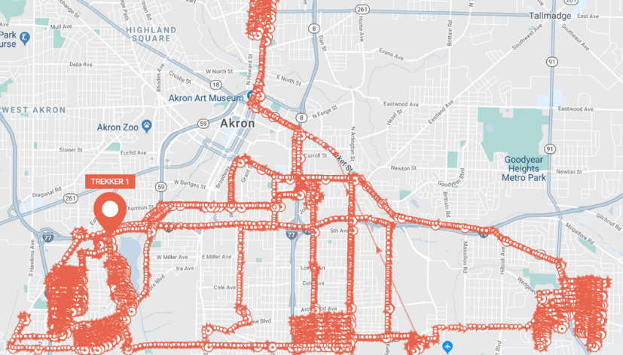
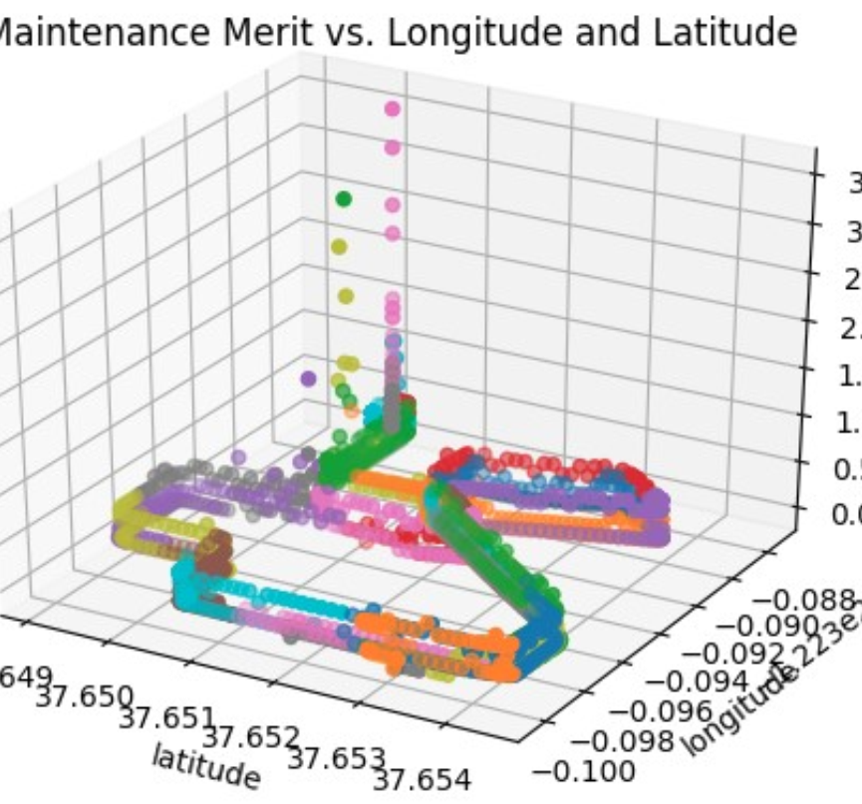
Deployment Model: 1-Second Data Acquisition
Partial Discharge Emissions
GPS Location
Date and Time
Temperature, Barometric Pressure, Relative Humidity
Air Particulate Contamination
Neural Network Correlations
Grid Load
Weather Events
Air Quality

Slide 13
Deployment Summary
I will share a 3 minute video here on the deployment. It is too large to email.
It is at this link: https://vimeo.com/440685792

Slide 14
Join the Collaboration
Join
Oak Ridge National Lab and
Lawrence Livermore National Lab
Razor Laboratories
Exacter, Inc
Become Part of the Collaboration

Slide 15
Contact: John Lauletta
jlauletta@exacterinc.com
216-496-1219

