Slide 1
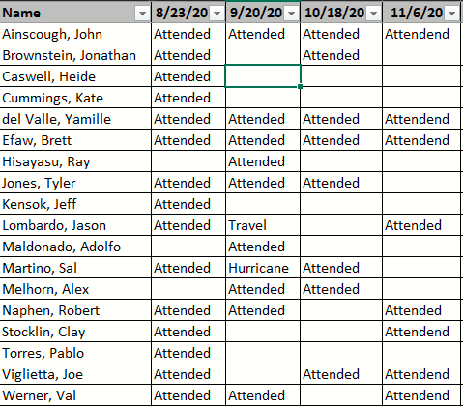
Resiliency Task Force
18 members attended at least 1 of the 4 conference calls

Slide 2
IEEE Resilience-Related Groups
Power System Operation, Planning and Economics (PSOPE)
Technologies and Innovation Subcommittee
Natural Disaster Mitigation Methods and Operational Technology Working Group
Advances in Natural Disaster Mitigation Methods Task Force
Power System Dynamic Performance (PSDP)
Power System Stability Subcommittee
Methods for Analysis and Quantification of Power System Resilience Task Force

Slide 3
PES-TR65
The Definition and Quantification of Resilience
by IEEE PES Industry Technical Support Task Force
April 2018
Definition of Resilience: “The ability to withstand and reduce the magnitude and/or duration of disruptive events, which includes the capability to anticipate, absorb, adapt to and/or rapidly recover from such an event.”

Slide 4
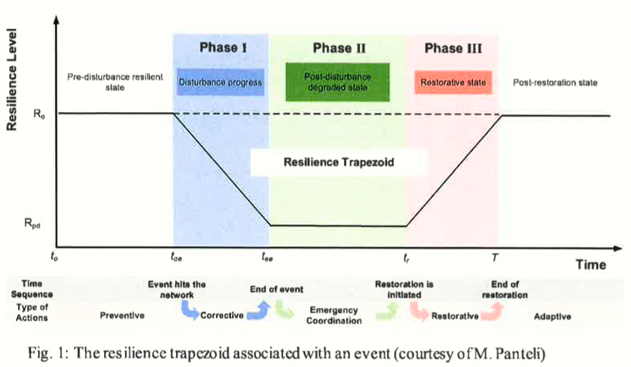
PES-TR65
See “Metrics and Quantification of Operational and Infrastructure Resilience in Power Systems”, IEEE Transactions vol 32. no. 6 by Panteli et al

Slide 5
CIGRE WG C4.41: Power System Resilience
See CIGRE slide deck.
Definition: Power system resilience is the ability to limit the extent, duration and rate of performance degradation of a power system following an extreme contingency/event. This is achieved through key actions before, during and after the extreme contingency /event, such as: anticipation, preparation, absorption, adaption, rapid recovery and sustainment of critical system operation including application of lessons learnt.

Slide 6
Resiliency TF Activities
Reviewed 11 Reports on the Topic of Resilience Relating to Electrical Infrastructure
A Framework for Establishing Critical Infrastructure Resilience Goals (2010)
What's the Difference between Reliability and Resilience? (2016)
Electric Power System Resiliency: Challenges and Opportunities (2016)
Resilience in Regulated Utilities (2013)
Factors in the resilience of electrical power distribution infrastructures (2012)
Economic Benefits of Increasing Electric Grid Resilience to Weather Outages (2013)
Resilience of the U.S. Electricity System: A Multi-Hazard Perspective (2016)
Resilience for Black Sky Days: Supplementing Reliability Metrics for Extraordinary and Hazardous Events (2014)
Resilience Metrics for the Electric Power System: A Performance-Based Approach (2017)
Conceptual Framework for Developing Resilience Metrics for Electricity, Oil, and Gas Sectors in the United States (2015)
Measuring the Resilience of Energy Distribution Systems (2015)

Slide 7
TF Adopted Definition
From “A Framework for Establishing Critical Infrastructure Resilience Goals”
Infrastructure resilience is the ability to reduce the magnitude and/or duration of disruptive events. This resilience construct, originally conceived by resilience expert Stephen Flynn, consists of four outcome-focused abilities:
(1) Robustness—the ability to absorb shocks and continue operating;
(2) Resourcefulness—the ability to skillfully manage a crisis as it unfolds;
(3) Rapid Recovery—the ability to get services back as quickly as possible; and
(4) Adaptability—the ability to incorporate lessons learned from past events to improve resilience.
Focus on these for Distribution System Only

Slide 8
Robustness
System Characteristics such as:
% OH vs. UG
Fault Rates
Customer Exposure Ratio / Exposure Zone Reduction
Asset Replacement
Pole Treatment and Inspection
Feeder Patrols / Maintenance
Feeder (Trunk) Hardening
Vegetation Management
Distribution Automation / FLISR
System Upgrading (large grade construction)
Targeted Undergrounding / Flood-proofing

Slide 9
Resourcefulness
Emergency response plans and procedures
Storm room operational procedures
Dynamic recloser settings
Pre-emptive line de-energization
High fire risk management
Storm forecasting / storm preparation

Slide 10
Rapid Recovery
Coordination between dispatch and mobile workforce (i.e. troublemen, patrolmen, crews)
Adequate feeder ties and system capacity for system re-configuration
Is the damage easily fixable (i.e. failure point)
tree contact breaks pins instead of pole
Mobile service offerings
Ties with other utilities

Slide 11
Adaptability
Outage reviews
Data gathering and analysis
Storm debrief
Regular reliability meetings
Planned future reliability improvement projects
Expanding / enforcing right-of-way

Slide 12
Metric Ideas
Reliability: outages or environmental conditions that are “common” and measured over a long period of time (i.e. 1, 3, 5 or 10 years)
Power utilities (in general) have common experiences in terms of what causes power outages
Resiliency: outages or environmental conditions that are “uncommon” and conditionally measured under those circumstances.
Extreme environmental conditions will vary greatly across the country
Reliability zoomed in on a specific time and/or place
Extend IEEE 1366
Daily SAIDI is used to identify T_{MED} (and MEDs)
Use combination of daily SAIDI (CMI), SAIFI (CI) and outage events
Calculate T_{MED} for all metrics, then any day where all 3 exceed their T_{MED} is an EMED (Extreme Major Event Day)

Slide 13
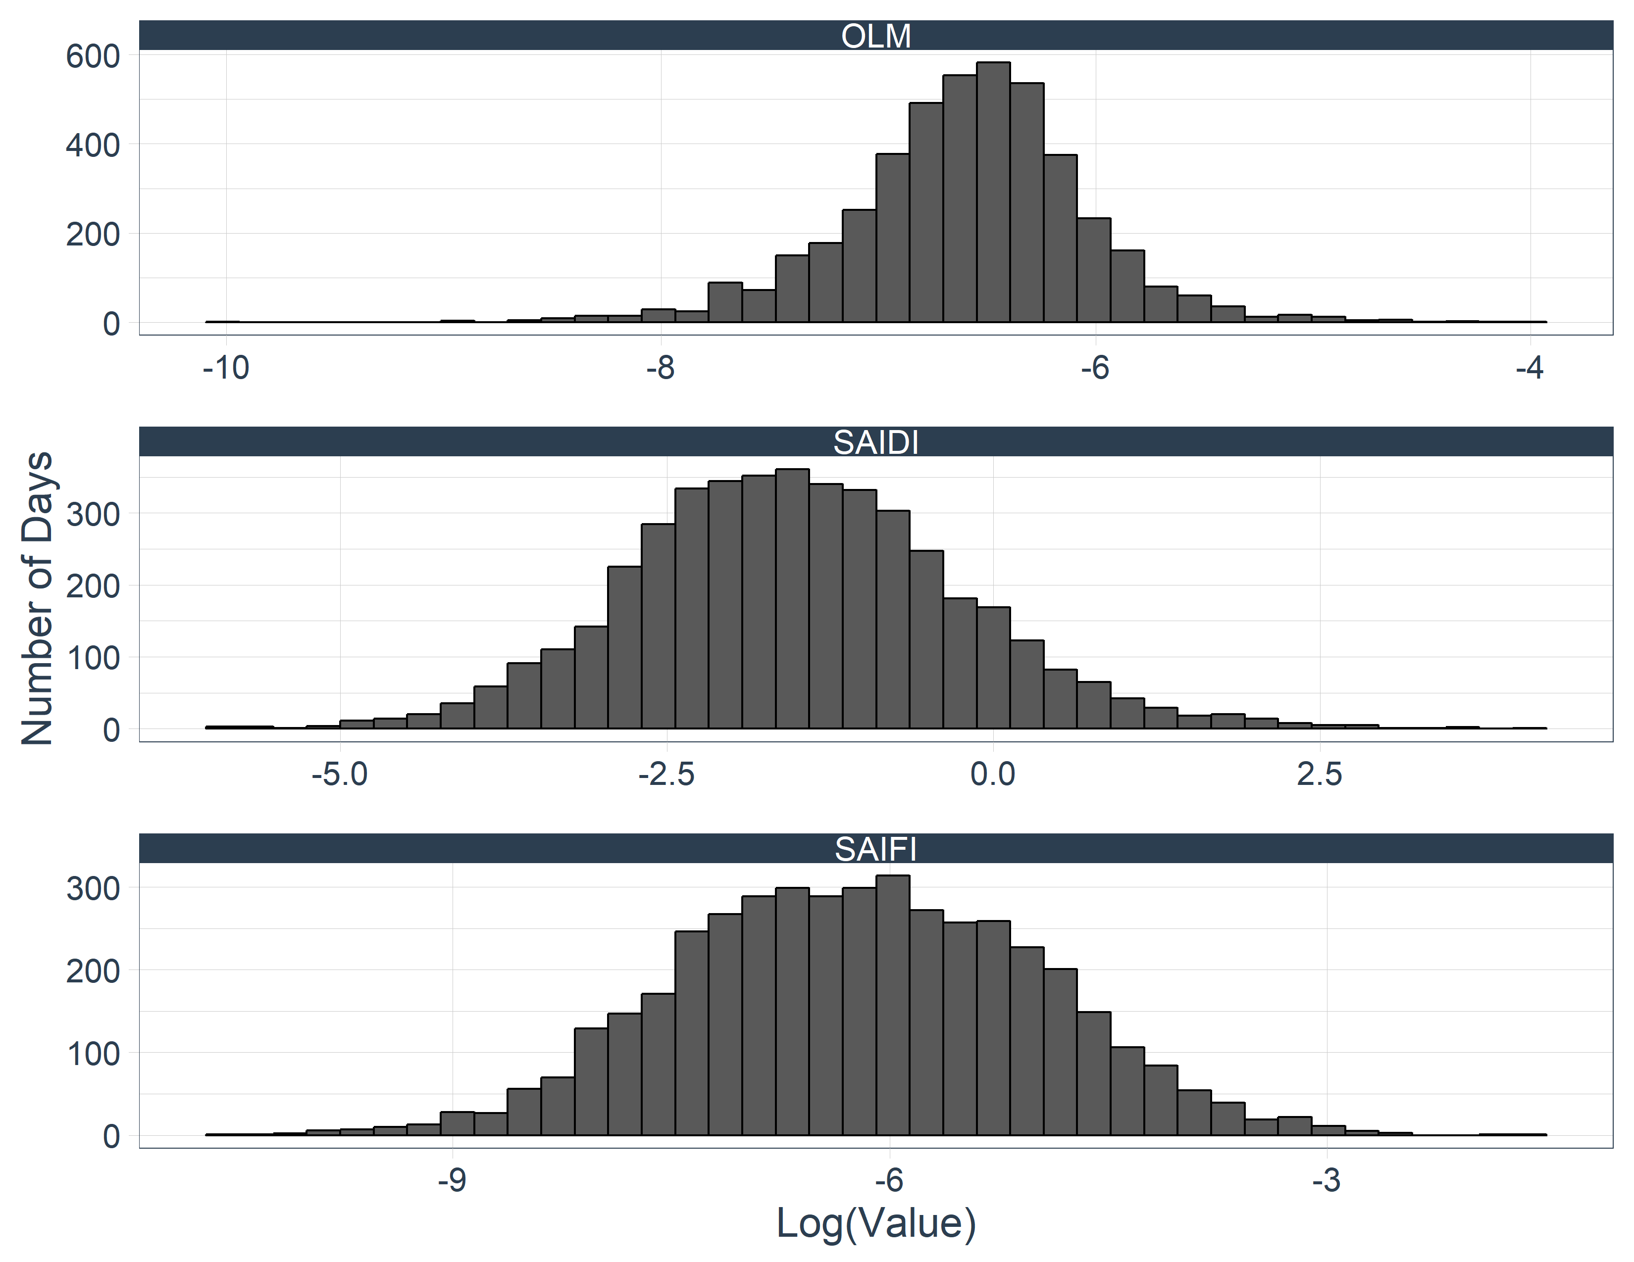

Slide 14
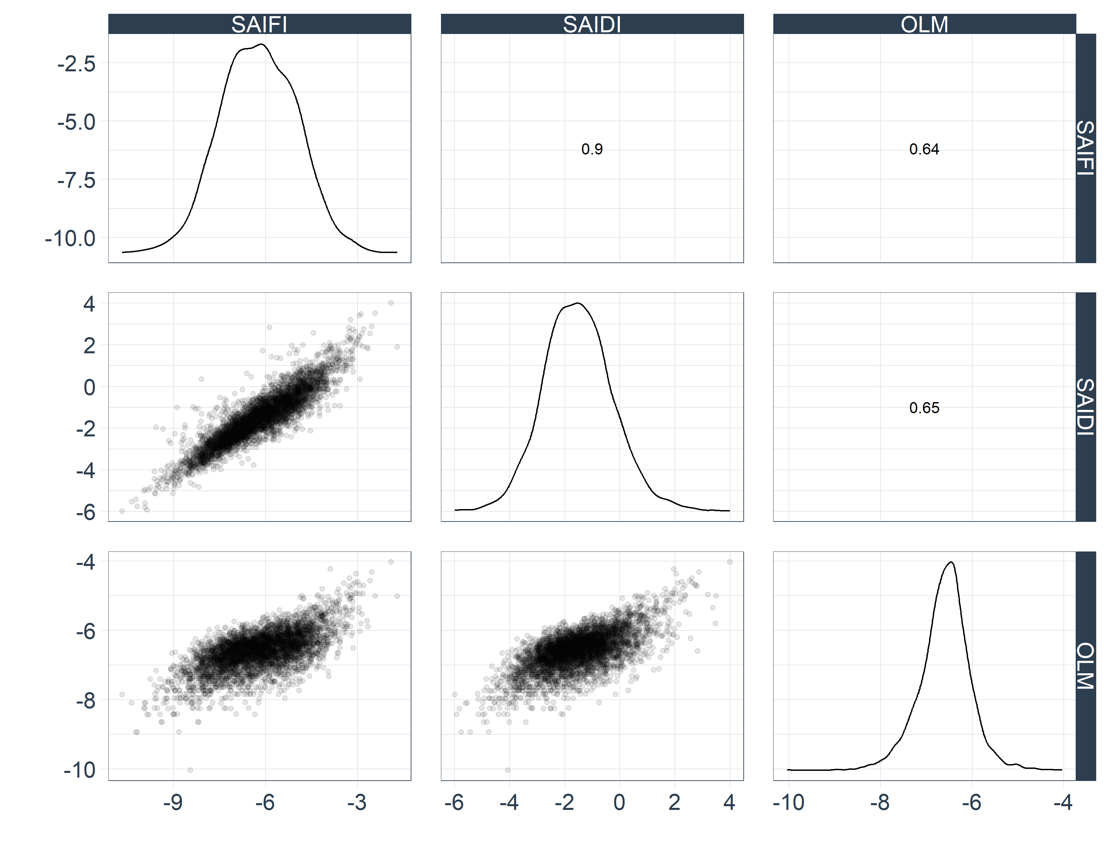

Slide 15
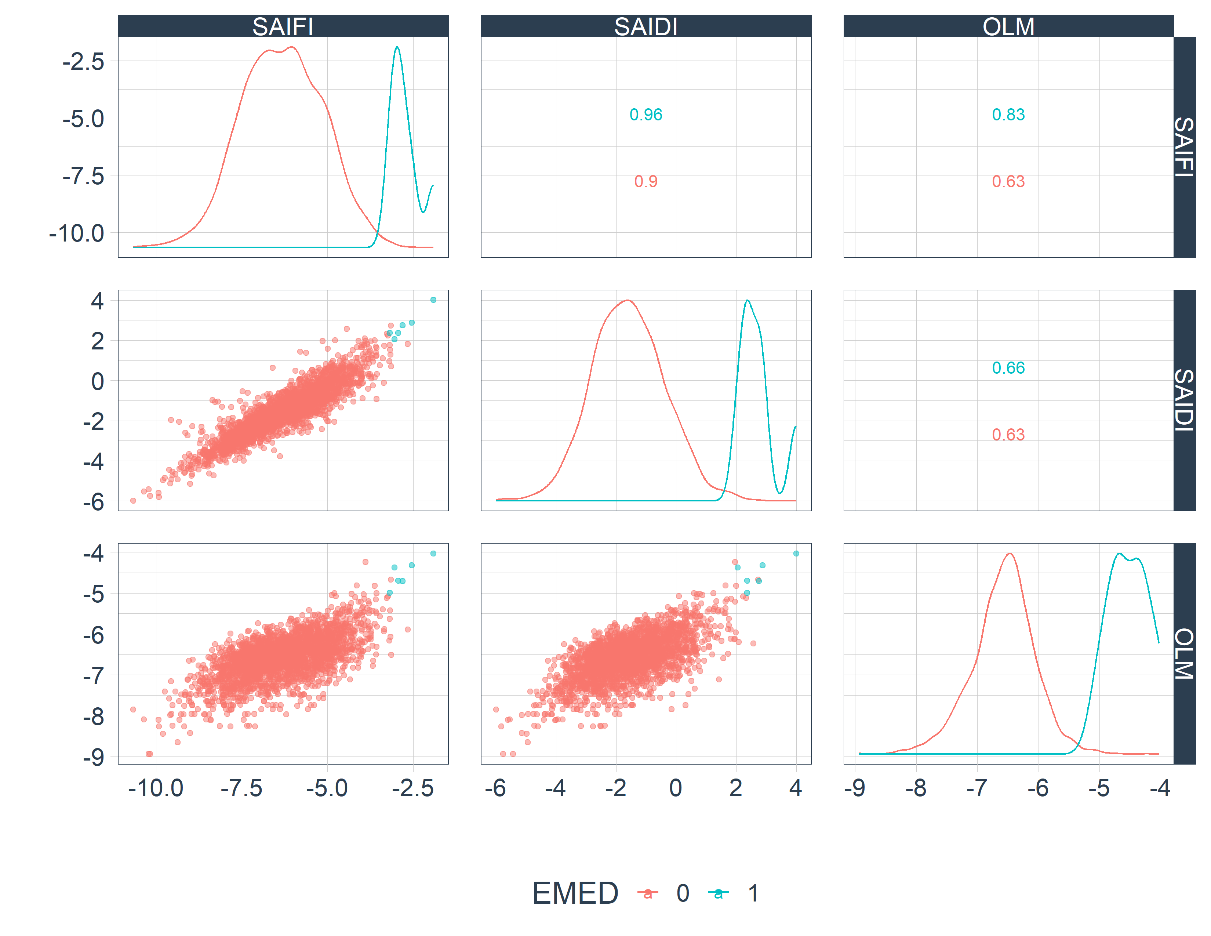
28 MEDs using SAIDI only
6 MEDs using all 3 metrics

Slide 16
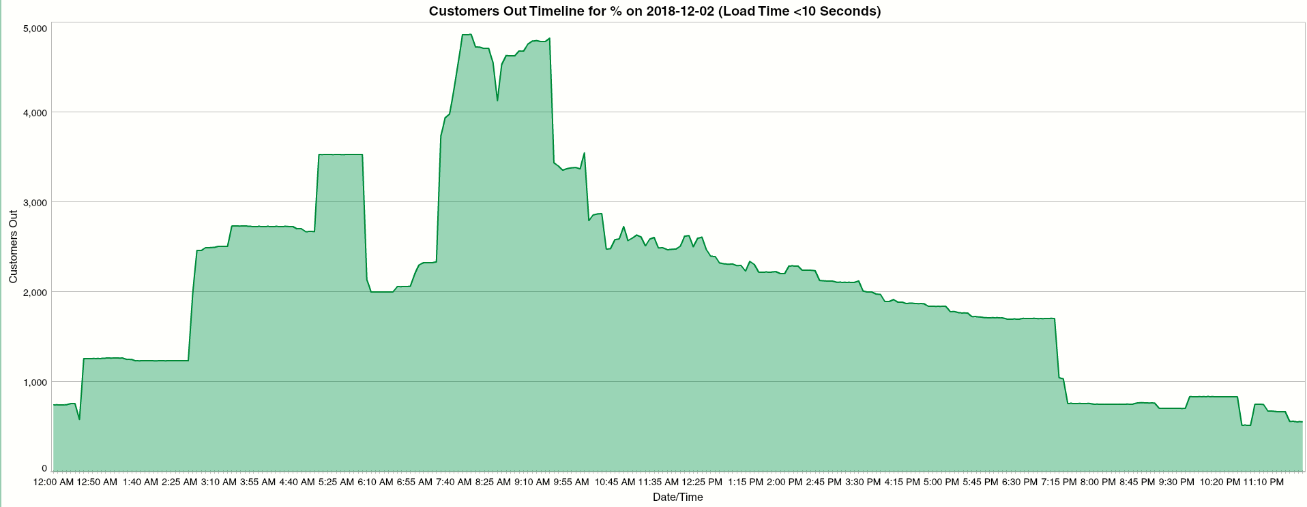
Metric Ideas
How to determine when the system is stressed?
Customers (load) out or resources dispatched at a given point in time
How to determine when the system is back to “normal”?
Customers (load) out returns to some pre-defined threshold (i.e. 99% of customers back on)
How long did it take to get the system back to “normal”?

Slide 17
Metric Ideas
Descriptive rather than quantitative might be a better approach.
Utility resiliency scorecard
Vegetation Management
Circuit Inspections
Asset Replacement Programs
Worst Performing Circuits
Distribution Automation
Disaster Preparedness
Outage Communication
Mobile Service Offerings

Slide 18
What to do with Microgrids?
Distributed Energy Resources (DER) with Energy Storage Systems (ESS) may be utilized by customers and/or utilities to maintain electric power service during an outage.
Does this topic fall under Distribution SC / DRWG, or perhaps under another IEEE Committee (i.e. ESSB)?
Microgrid TF
Distributed Resources Integration WG
Energy Storage TF

