Slide 1
Resiliency TF Agenda
Quantify Resilience – Hypothetical Example
U.S. DOE Grid Modernization Laboratory Consortium

Slide 2
Quantify Reliability
IEEE-1366
SAIFI, SAIDI, CAIDI, CEMI, CELID, etc.
Based on customer interruption records from OMS and customer count info from GIS (or OMS or CR&B or wherever)
Time-based metrics are generally annualized (i.e. calendar-year, rolling-year, average-annual)
i.e. SAIFI is generally interpreted as “sustained interruptions per customer per year”

Slide 3
OMS Customer Interruption Record
Event Key | Customer ID | Start | End | ...
654321 | 123456789 | YYYY-MM-DD HH:MM AM/PM | YYYY-MM-DD HH:MM AM/PM | ...
Other data i.e. location, device, cause, comments, etc. See IEEE-1782
From this data set, CI, CMI and other relevant reliability numbers can be derived for calculating SAIFI, SAIDI, etc.
Proposition: the quantification of resiliency *should* also be derived from this data set.

Slide 4
Reliability Hypothetical Example
BKR
Each xfrmr has 10 customers,
and there are 10 xfrmrs,
so 100 customers total.
F1
Device | Xfrmrs Down | Customers Down
BKR | 10 | 100
R1 | 4 | 40
F1 | 1 | 10
F2 | 1 | 10
F3 | 1 | 10
F4 | 2 | 20
F2
R1
F3
F4

Slide 5
Scenario 1
BKR
Date | Location | Duration | CI | CMI
Jan 1 | TX01 | 60 min | 10 | 600
Feb 1 | TX02 | 60 min | 10 | 600
... | ... | ... | ... | ...
Oct 1 | TX10 | 60 min | 10 | 600
 | 10 |  | 100 | 6,000
F1
F2
R1
SAIFI = 1.00
SAIDI = 60
CAIDI = 60
CEMI₁ = 100%
CEMI₂ = 0%
CEMI₃ = 0%
F3
F4

Slide 6
Scenario 2
BKR
Date | Location | Duration | CI | CMI
Jul 1 | BKR | 60 min | 100 | 6,000
 | 1 |  | 100 | 6,000
F1
F2
R1
SAIFI = 1.00
SAIDI = 60
CAIDI = 60
CEMI₁ = 100%
CEMI₂ = 0%
CEMI₃ = 0%
F3
F4

Slide 7
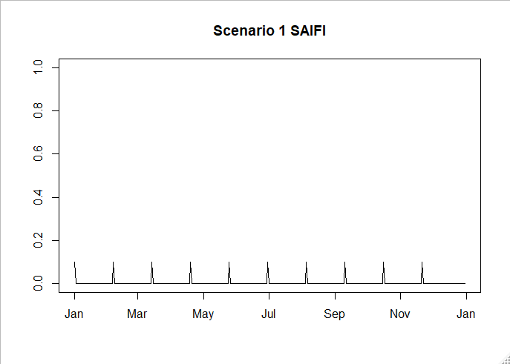
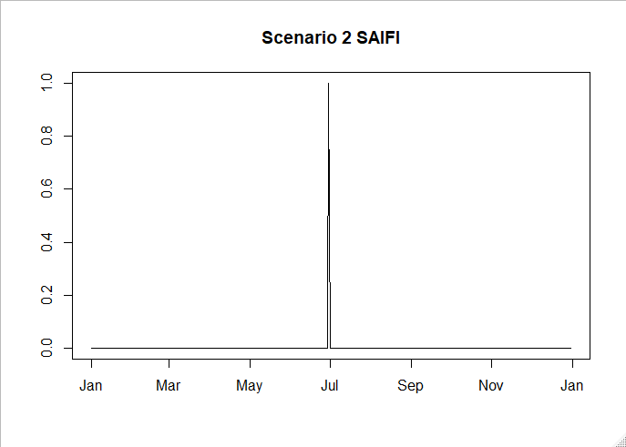
Compare Reliability
Scenario 1 and 2 are equivalent in terms of annual reliability.
However, when we temporally “zoom-in” to daily reliability, we get:
TMED using daily SAIDI is fundamentally based on this concept.

Slide 8
Customer Outage Timeline
Temporally “zoom-in” even further than daily time steps.
5, 10, or 15-minute time steps.
No longer an explicit separation between CI and CMI.
At every time step, what % of customers are not being served by the grid?
Answer questions like “Did the system dip below serving X% of customers, and if so, how long did it take to get back above X%?”

Slide 9
Closing Thoughts
Concurrent: events occurring at the same time.
Are customers out at the same time?
Proximity: how close events are to each other.
Are customers near each other out at the same time?
Customer outages that are temporally and spatially “close” to each other could be accounted for in how we choose to measure resiliency, that aren’t explicitly accounted for in reliability metrics.
Other consideration: what happens when the service point ceases to exist (i.e. extreme weather or environmental conditions impact power grid and homes/businesses/etc.)?

