Slide 1
The Resiliency Continuum
Aaron F. Snyder, Ph.D.
Director of Grid Technology Consulting
EnerNex

Slide 2
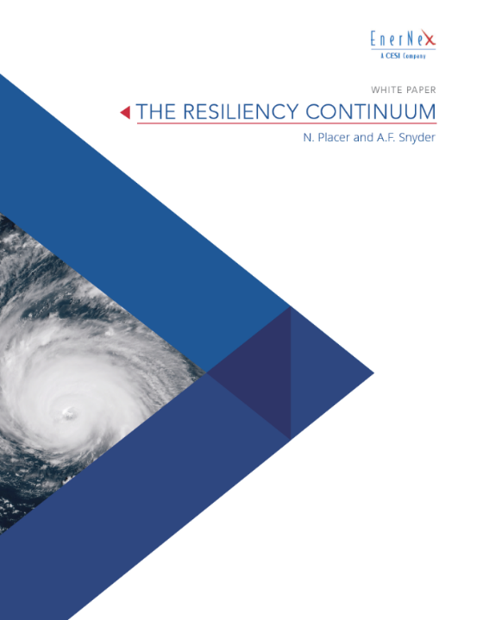
The Resiliency Continuum
Neil Placer and Aaron F. Snyder (SMIEEE)
https://www.enernex.com/whitepapers/the-resiliency-continuum/
Storm damage can wreak havoc on the electrical distribution system and instantaneously create a major impact on those who continuously depend on unfettered access to electrical energy. “Keeping the lights on” is a bedrock principle of utility operations, but is increasingly being challenged by more frequent and turbulent natural disasters. The quest for greater utility resiliency is therefore an ongoing pursuit that continuously takes shape over time—on a continuum.
This white paper serves as a useful resource for grid practitioners who are seeking a strategic resiliency framework with actionable checklist items and one that concurrently aligns with evolving grid modernization efforts. The three resiliency categories presented progressively increase from foundational topics to more forward-leaning initiatives. This time-based progression enables utilities to assess where they fall on the resiliency continuum, their resiliency maturity level, and steps they can take to advance along this resiliency pathway.

Slide 3
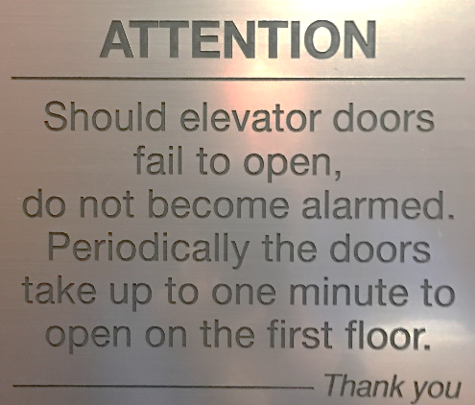
What is Resiliency
Infrastructure resilience is the ability to reduce the magnitude and/ or duration of disruptive events. (National Infrastructure Advisory Council)
  Note that resiliency measures themselves do not prevent damage.
Enable electric facilities to continue operating despite damage and/or promote a rapid return to normal operations when damages and outages occur. (Edison Electric Institute)
Notes:
National Infrastructure Advisory Council, “A Framework for Establishing Critical Infrastructure Resilience Goals,” www.dhs.gov/xlibrary/assets/niac/niac-a-framework-for- establishing-critical-infrastructure-resilience-goals-2010-10-19.pdf, October 19, 2010.
Edison Electric Institute, “Before and After the Storm—A compilation of recent studies, programs, and policies related to storm hardening and resiliency,”
www.eei.org/issuesandpolicy/electricreliability/mutualassistance/Documents/ BeforeandAftertheStorm.pdf, March 2014 updated.

Slide 4
Resiliency Context
2017
Intelligent Grid
Modern Grid
Smart Grid
Grid Modernization
  Fusing Information and Communication Technology (ICT) into every aspect of service
  Deploying additional sensors
  Enabling the mobile workforce
  Focusing on data analytics
  Information Technology/Operations Technology (IT/OT) convergence
  (2005)
  Greater RESILIENCE
  Improved RELIABILITY
  Enhanced SECURITY
  Additional AFFORDABILITY
  Superior FLEXIBILITY
  Increased SUSTAINABILITY
  Self-heals
  Motivates and Includes the consumer
  Resists attack
  Provides power quality for 21st century needs
  Accommodates all generation and storage options
  Enables markets
  Optimizes assets and operates efficiently
  (2007)
  Digital information and controls to improve reliability, security, and efficiency
  Dynamic optimization with full cyber-security.
  Deployment and integration of DER
  Development and incorporation of DR, DSR, EE
  Deployment of ‘‘smart’’ metering, communications, and DA
  Integration of ‘‘smart’’ appliances and consumer devices.
  Deployment and integration of advanced storage and peak-shaving technologies
  Deployment and integration of PEV, HEF, and thermal A/C
  Timely information and control options for Customers
  Development of standards for communication and interoperability
  ID and lower barriers to adoption of technologies, practices, and services
  (2007)
2017

Slide 5
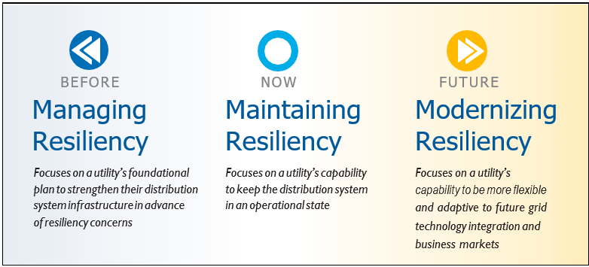
Resiliency Framework
Look back (BEFORE) to identify existing resiliency plans
Evaluate current resiliency capability (NOW) to consider success in ongoing execution of resiliency
Look forward (FUTURE) to consider how to continuously optimize resiliency as one component of a larger grid modernization strategy

Slide 6

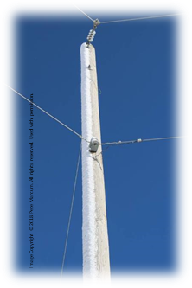
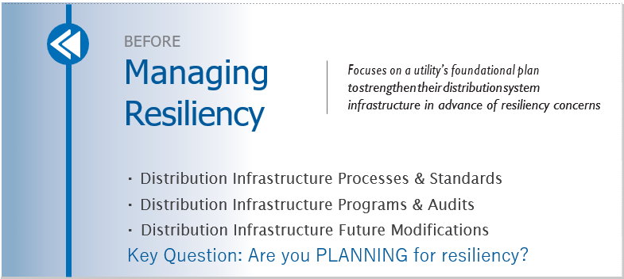
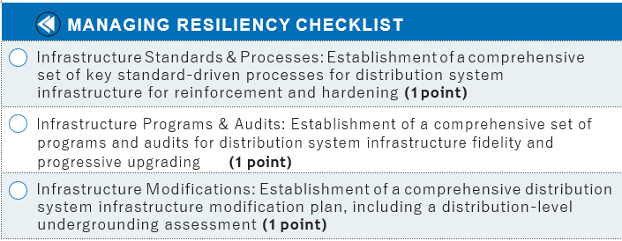
Managing Resiliency - Before
Improve design and construction standards
Reinforce overhead distribution
Reinforce structures
Harden distribution - follow best practices
Selective undergrounding
Improve relaying, segmentation, sensing, and other controls

Slide 7
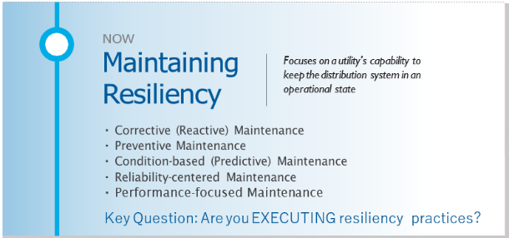
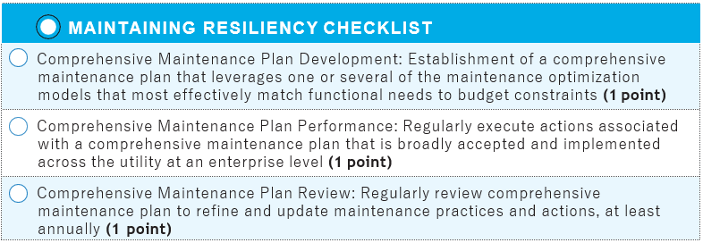
Maintaining Resiliency - Now
Corrective
Maintenance
“Reactive”
Run until broken
Design life ignored in favor of operational life
Uncertain replacement timing
Potential for higher costs – down time, secondary failures
Preventive
Maintenance
Uses intervals or criteria
Should achieve design life or beyond
Labor intensive and potential peripheral damage
Saves reactive labor costs
Condition-based
Maintenance
“Predictive”
Measurement and detection
Uses measured condition, not intervals
Can avoid catastrophic failures, extend lifetime
Extensive diagnostics and training
Reliability-centered
Maintenance
Combo approach: predictive, preventive
Adds root cause analysis
Prioritizes equipment: process or safety
Sudden failures can still happen
Can reduce repeats; adds extensive analysis
Performance-focused
Maintenance
Full spectrum approach
Includes technical, financial, business, customer, regulatory
Not a replacement, an enhancement
Match requirements with strategic goals

Slide 8

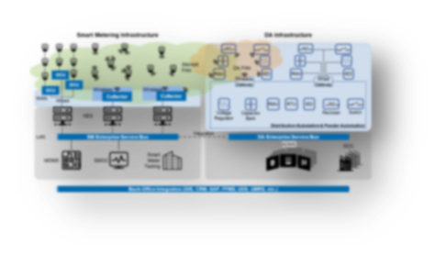
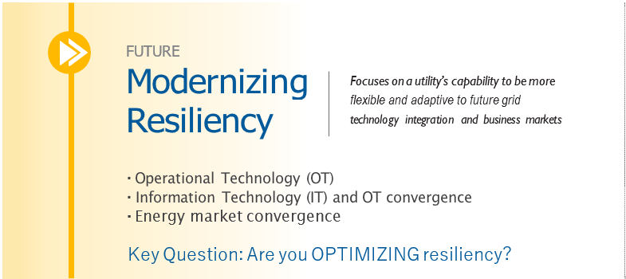
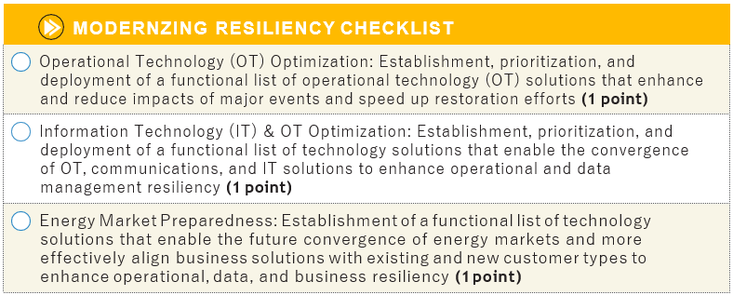
Modernizing Resiliency - Future
Operational Technology
  FLISR, IEDs, MWFM, unified FAN
OT/IT Convergence
  AMI+MDMS → OMS, ADMS
  AMI → FLISR, CVR, VVO
  OMS+DMS → ADMS
Market Convergence
  Microgrids
  DER
Notes:
Fault location, isolation, and service restoration (FLISR) systems (centralized or distributed)
Intelligent Electronic Devices (IEDs) (e.g., line sensors and smart relays)
Field Area Network (FAN)
Distribution Management Systems (DMS)
Advanced Meter Infrastructure (AMI)
Meter Data Management Systems (MDMS)
Outage management systems (OMS)
Mobile Workforce Management systems (WFM)

Slide 9
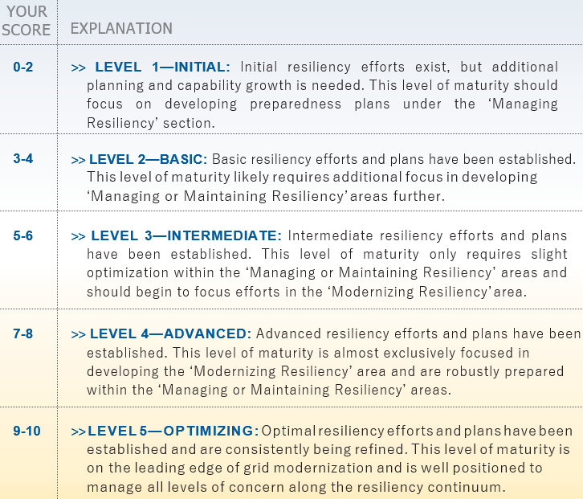
Final Self Assessment

Slide 10
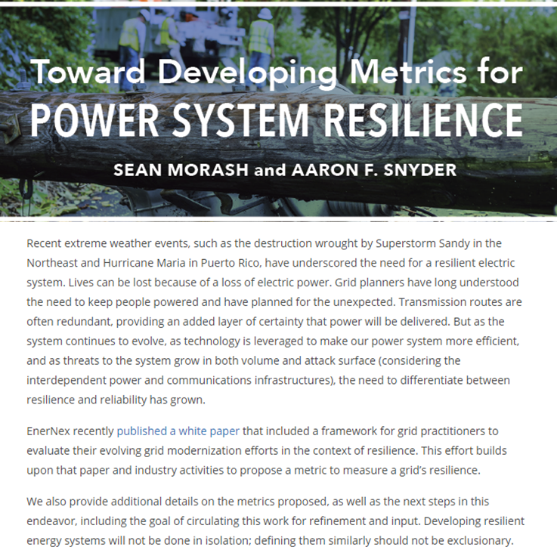
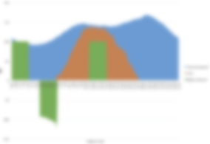
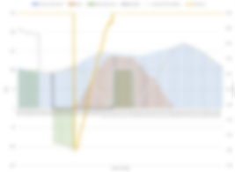
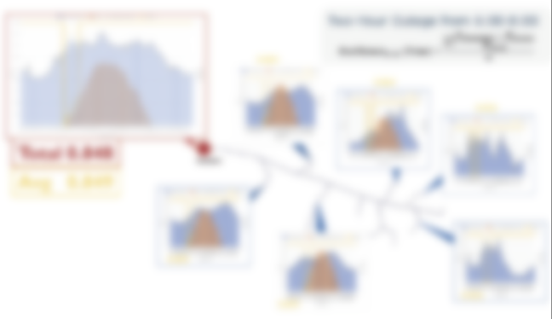
How to Invest? Need Metrics!
www.EnerNex.com aaron@enernex.com
Notes:
REFERENCES
National Infrastructure Advisory Council, “A Framework for Establishing Critical Infrastructure Resilience Goals,” www.dhs.gov/xlibrary/assets/niac/niac-a-framework-for- establishing-critical-infrastructure-resilience-goals-2010-10-19.pdf, October 19, 2010.
Edison Electric Institute, “Before and After the Storm—A compilation of recent studies, programs, and policies related to storm hardening and resiliency,”
www.eei.org/issuesandpolicy/electricreliability/mutualassistance/Documents/ BeforeandAftertheStorm.pdf, March 2014 updated.
R.E. Brown, T&D World, “Storm Hardening the Distribution System,”
www.quanta-technology.com/sites/default/files/doc-files/TDW-Storm-hardening-paper.pdf, June 2010.
Southwire, “Covered Aerial MV Systems (formerly Spacer Cable) now available,” www.southwire.com/distribution/CAMVavailable.htm.
R.J. Campbell, Congressional Research Service, “Weather-Related Power Outages and Electric System Resiliency,” www.fas.org/sgp/crs/misc/R42696.pdf, August 28, 2012.
Electric Power Research Institute, “Enhancing Distribution Resiliency: Opportunities for Applying Innovative Technologies,” www.epri.com/#/pages/product/1026889/, January 11, 2013.
J.E. Skog, Electric Light and Power, “Alphabet Soup: Making Sense of Maintenance Strategies,” https://www.elp.com/articles/powergrid_international/print/volume-13/issue-8/ features/alphabet-soup-making-sense-of-maintenance-strategies.html, August 1, 2008.
Department of Energy, DOE: Federal Energy Management Program (FEMP), “Operations & Maintenance Best Practices: A Guide to Achieving Operational Efficiency,” Release 3.0, section 5.3, https://www.energy.gov/sites/prod/files/2013/10/f3/omguide_complete.pdf, August 2010.
SAE International, “Evaluation Criteria for Reliability-Centered Maintenance (Rcm) Processes,” SAE JA1011, www.sae.org/standards/content/ja1011_199908/, September 26, 2009.
The GridWise Alliance, “Improving Electric Grid Reliability and Resilience: Lessons learned from Superstorm Sandy and Other Extreme Events,” Workshop Summary and Key Recommendations, https://www.energy.gov/sites/prod/files/2015/03/f20/GridWise%20 Improving%20Electric%20Grid%20Reliability%20and%20Resilience%20Report%20June%20 2013.pdf, June 2013.

