Slide 1
Distribution Resiliency WG Agenda Virtual – WebEx Meeting July 28, 2020
1:00PM - 2:30PM PT
2:00PM - 3:30PM MT
3:00PM - 4:30PM CT
4:00PM - 5:30PM ET
Intro / Agenda
Brett Efaw, Idaho Power
3:00 – 3:05 (5 minutes)
WG Website and Scope
Brett Efaw, Idaho Power
3:05 – 3:10 (5 minutes)
PAR 2856 and TF
Brett Efaw, Idaho Power
Brandy Gobert, ComEd
3:10 – 3:30 (20 minutes)
The Resiliency Continuum
Aaron Snyder, EnerNex
3:30 – 3:50 (20 minutes)
Grid Condition Assessment
John Lauletta, Exacter, Inc.
3:50 – 4:10 (20 minutes)
IEEE Transactions Paper
Masoud Davoudi, Quanta Technology
4:10 – 4:25 (15 minutes)
Close / Adjourn
Brett Efaw, Idaho Power
4:25 – 4:30 (5 minutes)
Note: All Agenda Times are CT

Slide 2
Outline
Introduction
Problem Statement
Resilience Orientated Reclosing
Conclusions
Next Steps

Slide 3
Introduction
Power system caused wildfires:
10 out of 20 most destructive California wildfires
90% of fatal bushfires in Australia were power-line related
51% of the total area burned by wildfires in California were power-line related
California wildfire of October 2007, Victorian wildfire in February 2009, Wildfire in Alberta in May 2016, Northern California Wildfire in October 2017, and November 2018 wildfire in California have taken lives of 323 people and have had a physical property damage of around $33.6 billion
A recent survey of 63 North American utilities, 546 pole fires were studied: Only 19% of utilities surveyed have a specific pole fire mitigation program or strategy in place

Slide 4
Problem Statement
Resilience:
The ability to withstand and reduce the magnitude and/or duration of disruptive events, which includes the capability to anticipate, absorb, adapt to, and/or rapidly recover from such an event.
Difference between Resilience and Reliability:
Resilience covers unexpected, high-impact, low frequency events
Resilience looks long term
Resilience also considers personnel and equipment
How can we target wildfire resilience?
What are the impact on customer experience?
What are the trade-offs?

Slide 5
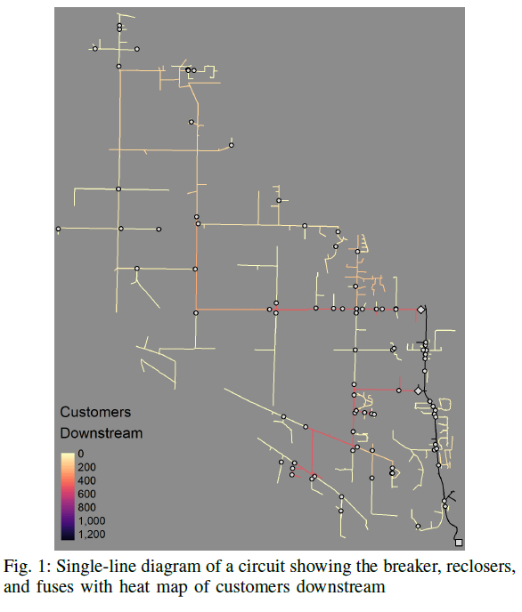
Resilience Orientated Reclosing
Targeting fuses and reclosers (1 of 2)

Slide 6
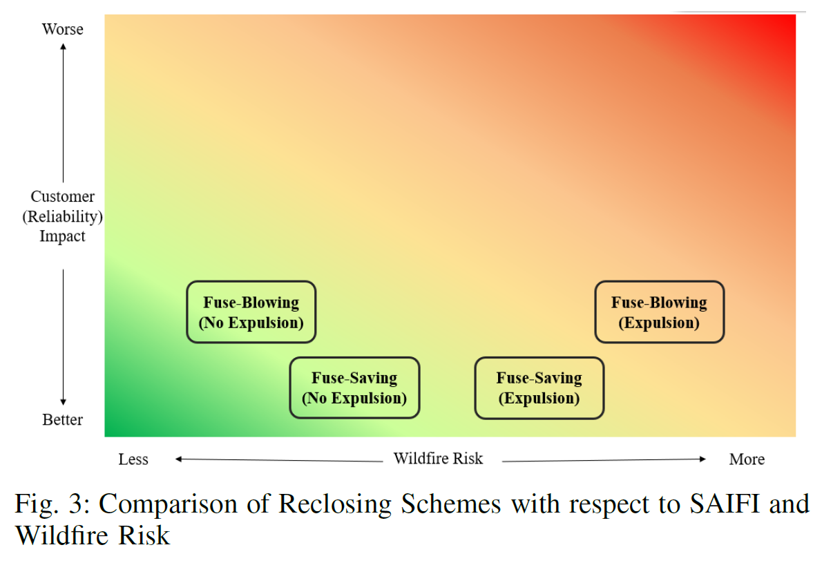
Resilience Orientated Reclosing
Targeting fuses and reclosers (2 of 2)

Slide 7
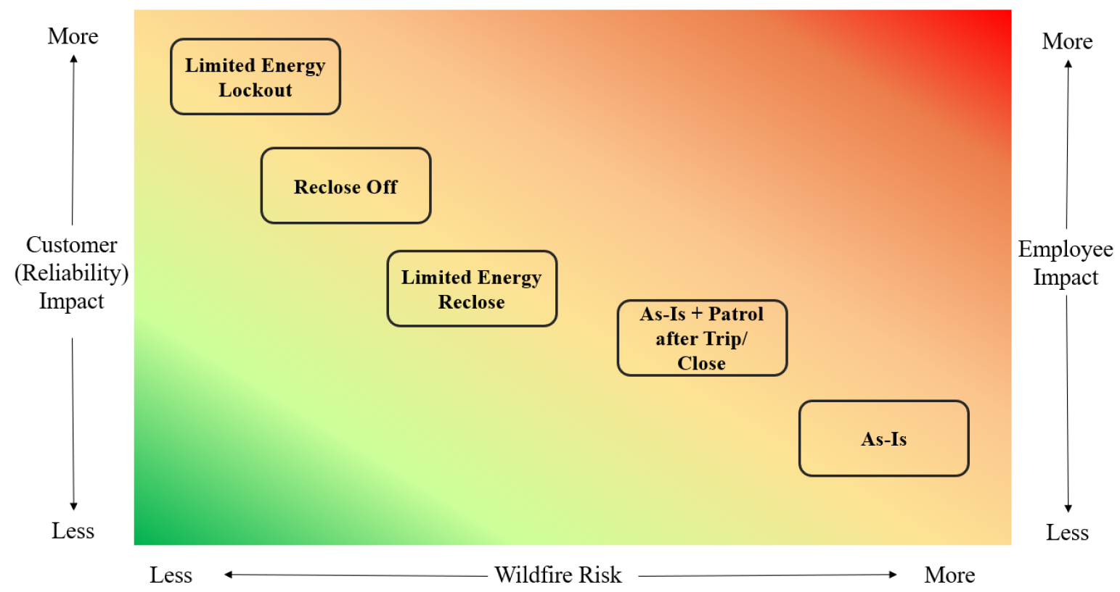
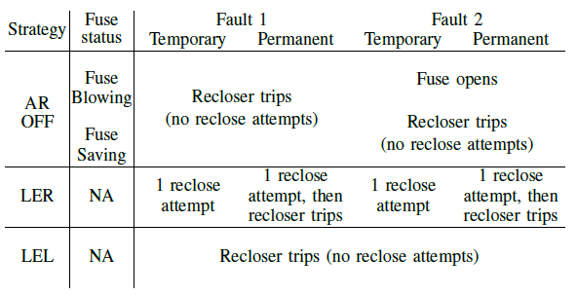
Resilience Orientated Reclosing
Targeting Reclosing Schemes

Slide 8
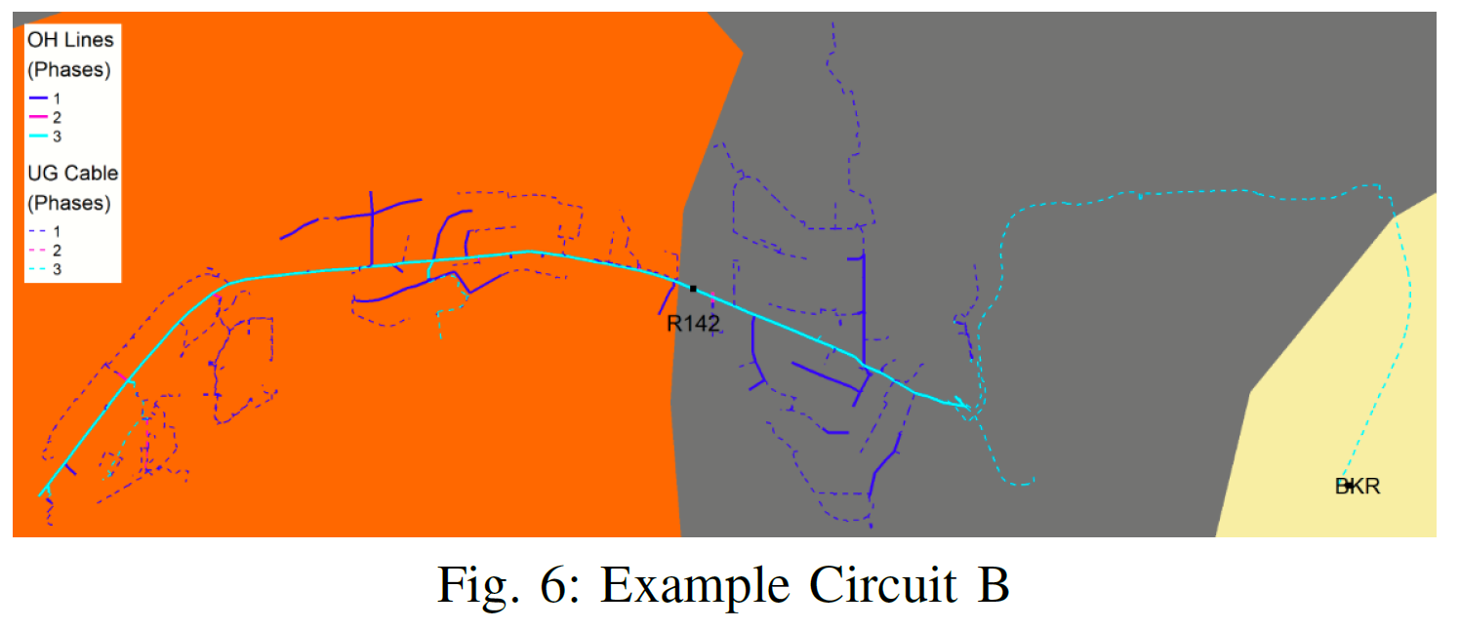
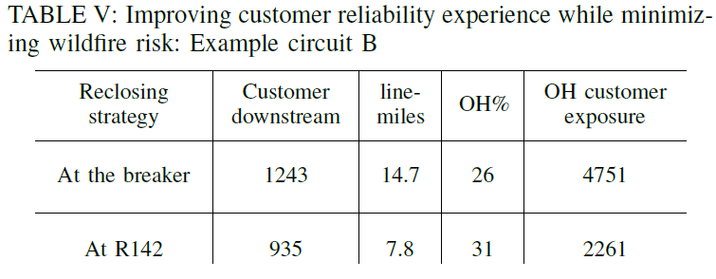
Resilience Orientated Reclosing
Adding line reclosers to reduce customer exposure

Slide 9
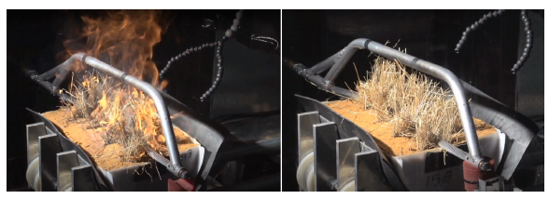
Resilience Orientated Reclosing
Rapid Earth Fault Current Limiter (REFCL)
A protection technology for accurate detection of line-to-ground faults
Reclosing strategies discussed previously: intent was using the existing technologies for the novel goal of wildfire risk mitigation
REFCL has emerged primarily for wildfire mitigation and requires its own infrastructural changes

Slide 10
Conclusion
Trade-off between customer experience, employee impact, and wildfire risk mitigation
How can the grid’s current infrastructure be utilized for wildfire risk reduction
Different reclosing strategies were compared with respect to wildfire risk reduction
Need for emerging technologies such as REFCL

Slide 11
Next steps
More quantification of the results in the draft
Utilizing more data-centric approaches such as mobile-edge computing
Other novel methodologies for High Impedance Fault detection, aimed at wildfire mitigation

