Slide 1
National Grid NY Resiliency Overview
IEEE Resiliency Working Group

Slide 2
Resiliency Definition
To determine how to measure resiliency, a good working definition is required. Several national organizations have proposed definitions, converging closer to an industry consensus.
IEEE- Anticipate the impact, resist discontinuity of service, and restore service with rapidity, to critical loads in the system.
EPRI- Damage Prevention, System Recovery, and Survivability
FERC 2018 and CIGRE- Withstand and reduce the magnitude and/or duration of disruptive events, which includes the capability to anticipate, absorb, adapt to, and/or rapidly recover from such an event.
Sandia- The ability to prepare for and adapt to changing conditions and withstand and recover rapidly from disruptions

Slide 3
Resiliency Definition
National Grid has proposed to align our definition with EPRI, which breaks resiliency into three core concepts - Damage Prevention, System Recovery and Survivability.
Damage Prevention refers to the application of engineering designs and advanced technologies that harden the distribution system to limit damage.
System Recovery refers to the use of tools and techniques to quickly restore service to as many affected customers as practical.
Survivability refers to enhanced system planning or use of innovative technologies to aid consumers, communities, and institutions in continuing some level of normal function without complete access to the grid.
Improving system resiliency requires advances in all three

Slide 4
Climate Change Impacts
The impacts of climate change are expected to lead to more frequent and severe weather events, increasing the probability of power outages
A resiliency plan driven by climate change must include both mitigation factors to reduce the impact of climate change, and adaptation factors to adjust to the impacts too late to change.
While the clean energy transition will spearhead National Grid’s mitigation efforts, we have also developed adaptation plans to better protect our networks from severe weather.
Every employee knows that their top priority is to keep the lights on for our customers.
Adaptation plans require a holistic approach that incorporates investments in resilient assets and work practices that maximize operation of the system.
A resilient grid requires investments in an array of assets that focus on Damage Prevention, System Recovery and Survivability.

Slide 5
Damage Prevention
National Grid’s Damage Prevention programs have been highlighted by robust investments in the Inspections & Maintenance and Vegetation Management programs, spending over $1B over the last decade.
The Company continuously reviews and refines Construction Standards, including a new series of standards for Storm Hardening.
Addressing Asset Condition issues for aging infrastructure also provides reliability benefits, as newer assets built to modern construction standards are typically stronger than assets installed in earlier eras. In addition to planned work, the Company prioritizes restoring abnormal conditions logged in the Release Report.
Additional Damage Prevention efforts focus on Side Tap Fusing, CSP Transformers, SubT Insulators, Flood Mitigation, and Substation Perimeter Fences.

Slide 6
System Recovery
System Recovery starts with keeping a fleet of trained line and forestry crews on standby when inclement weather is forecasted.
Strict adherence to a comprehensive Emergency Response Plan allows for clear lines of communication and decision-making at the lowest appropriate level. Mutual Aid Agreements allow staffing to scale according to the event.
The Company has invested heavily in automated devices that can create a self-healing grid that can isolate damage and reduce outages to momentary events. Programs include FLISR (Fault Location, Isolation, and Restoration), SubT Automation, three-phase Reclosers, and single-phase Cutout Mounted Reclosers.
Storm Hardening projects include creation of Feeder Ties, which allow crews to isolate outages and restore customers faster. Mobile Transformer Fleets and critical spare inventory bypass supply chain delays to allow for recovery during major events.
Transmission resiliency programs include Remote Control Line Switches, Additional Sources, and Line Split Breakers.

Slide 7
Survivability
Survivability refers to enhanced system planning or use of innovative technologies to aid consumers, communities, and institutions in continuing some level of normal function without complete access to the grid.
During a severe event, the Damage Appraisal team uses iPads to assess damage, including automated abilities to log GPS coordinates of damage, along with the ability to take pictures of damage and upload to a centralized database.
Various monitoring devices, ranging from RTUs to feeder monitors to line sensors, provide operations and planning with data to better restore outages in real-time (and to inform how to avoid them in the future)
New Energy Storage products enhance resiliency and may pave the way for Microgrids, whether through company-owned assets or third-party Non-Wires Alternatives.

Slide 8
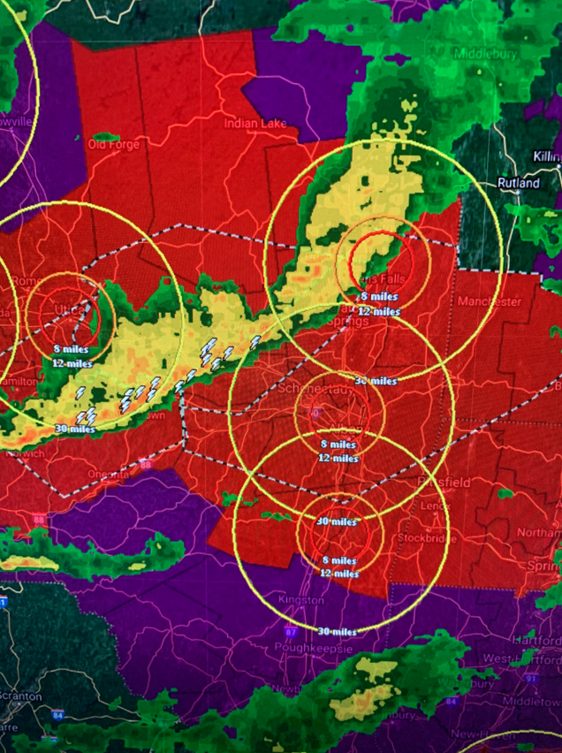
Resiliency Timeline / History
Reliability / Targeted Storm Hardening / I&M Part of Base CIP Plan
2017 Storm Hardening Information Request from PSC via Rate Case
2018 Report on Hardening & Resiliency Internal to NG
2018 Climate Change & Adaptation Plan NE
01/2019 Resiliency Presentation to the NYPSC
05/2019 Policy Board Brief Internal to NG
06/2019 Filing on Hardening & Resilience to the PSC filing
10/2019 Resiliency Spending Rationale Presentation to PSC
2020 Rate Case Resiliency & Associated Presentations
03/2021 System Impact Compared to Texas outages Talking Points

Slide 9
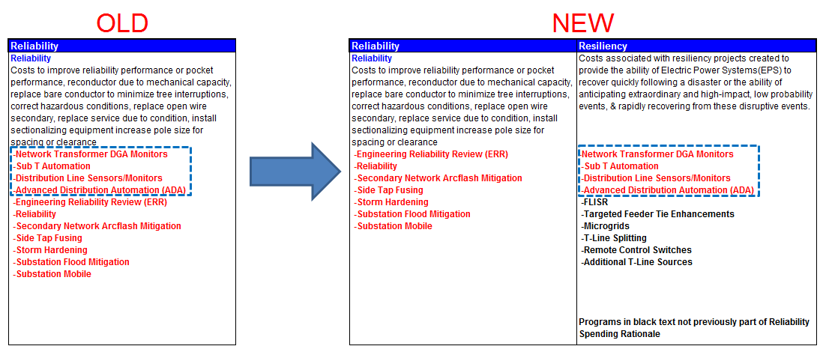
Resiliency Spending Rationale

Slide 10
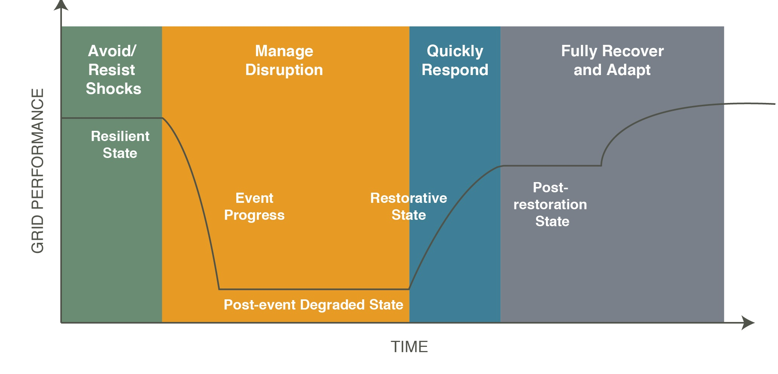
Phases of Electric System Reliability/ Resilience
Reliability
Resilience
Asset Management / BMS
Advanced Planning Process
Vegetation Management & EAB Focused Tree Trimming
Distribution Standards Including Storm Hardening
Inspection & Maintenance Program
Targeted Minor Storm Hardening
Flood Mitigation
Side Tap Fusing
Substation Perimeter Fence
Intrusion Detection
Cyber Security
Steel poles
Sub-Transmission Automation
FLISR
Recloser Loops Scheme Programs
Remote Terminal Units
Line Sensors/ Feeder Monitors
Targeted Feeder Tie Enhancements
Microgrids
T-Line Splitting
Remote control switches
Additional T-line sources
Distance to Fault relays
Mobile Transformer Fleet
Critical Spares
Damage Appraisal & iPads
Emergency Response Plan
Outage Management System
Mutual Aid agreements
Reliability and Emerging Risk Assessments
Event Analysis
Event Forensics
Reliability Guidelines and technical reference documents
System Operator Certification and Credential Maintenance
System Operator Training
Periodic Review
Adapted from: Mathaios Panteli & P Mancarella, The Grid: Stronger, Bigger, Smarter?, IEEE Power Energy Mag., 59 (2015)

Slide 11
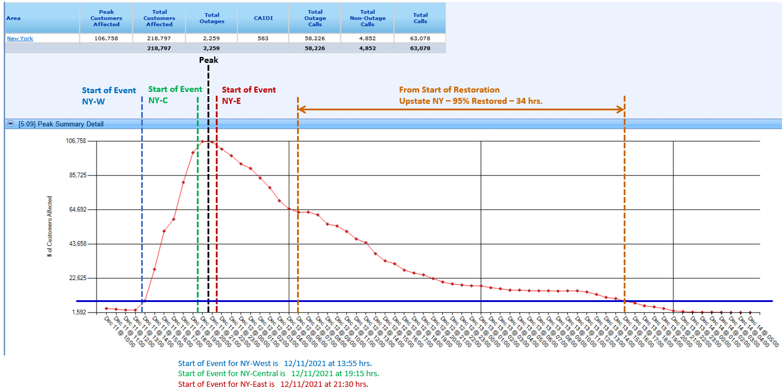
Restoration Curve Example
Notes:
-Advantages and disadvantages of the Restoration Curve as a resiliency KPI

Slide 12
Transmission Resiliency
National Grid is bolstering the Transmission system’s ability to survive and recover from outages through Resiliency projects
Historically, very little has been spent on Transmission system resiliency
Transmission resilience would supplement primary spending rationales for Transmission, such as asset condition, system capacity, and damage failure
Proposed twelve (12) projects under the new Resiliency spending rational for Transmission that fall into three (3) categories:
Remote Control Line Switches: Reduces outage durations for approx. 5-12K customers per project - 5 projects
Additional Sources: Reduces the total number of customers lost due the loss of a single line by as much as 31K -1 project
Line Split Breakers: Reduces the total number of customers lost due the loss of a single line/structure for approx. 5-15K per project - 6 project

Slide 13
Distribution Resiliency
National Grid is committed to targeting resiliency improvements on the Distribution System
169 projects were reclassified from Reliability to the new Resiliency spending rationale
Projects generally fall into these categories:
Targeted Feeder Ties: New connections between feeders that allow for operational field ties that can better isolate outages and restore customers quicker
FLISR: Fault Location, Isolation, and Restoration provides an intelligent way for the grid to “self-heal” with reclosers at the distribution and sub-transmission levels
Feeder monitors/line sensors: Additional metering to provide operations and planning with data to better restore outages in real-time (and to inform how to avoid them in the future)
~40% of the Reliability budget has been reclassified as Resiliency projects

