Slide 1
Resilience/Reliability Working Group Collaboration
Leveraging experiences from DRWG
July 20, 2022

Slide 2
DRWG History
Or how 1366/1782 came to be

Slide 3
History of IEEE 1366 and 1782
Definition/Metrics (1366)
Creation of Dataset
Application of metrics (1782)
Utility Engineers
SAIDI, SAIFI, CAIDI
Benchmarks Performed
Analysis and Results Shared
Usage of Metrics
By companies, regulators, scientists
Major Event Threshold
“Source”, Planned, etc.

Slide 4
Resilience Working Group
Suggested collaboration between DRWG & DRESWG
Lean on the DRWG work, namely
  IEEE DRWG has explored and developed reliability concepts and metrics that may be valuable to the scope that IEEE DResWG is pursuing
  DRWG’s starting assumption is that – from the standpoint of continuity of electric service - there is an overlap between “resilience events” and “reliability events”
  Namely, “resilience events” constitute what DRWG has, in the past described as either “major” or “extreme” events
  (DRWG also recognizes that there may also be dimensions or aspects of resilience events –which may be within the scope of DResWG – that go beyond concepts related to the continuity of electric service – these aspects are not the focus of this discussion)
  A leading example of DRWG’s relevant past work is development of statistically-based methods to organize and segment reliability data so that Major and Extreme events can be identified consistently using numerical criteria (Standard 1366)
  Another example of DRWG’s relevant past work is development of methods for systematically categorizing the causes of power interruptions and discussing methods for characterizing aspects of the service restoration process (Standard 1782) – these efforts focus on (but are not limited to) efforts directed at Major and Extreme events

Slide 5
What DRWG can share
The approach used to create and develop 1366 & 1782, which have gained industry acceptance
How did that happen?
Founded on the KISS principle
  Example: 1366 provides a good illustration of how simple approaches can be readily realized to provide insights and enable decision-making
Make sure the approach is utility-agnostic; resiliency guidelines should be adoptable by IOUs, RECs, MUNIs, Gov’t utilities without favoring size, capability, etc.
Ensure that it provides meaningful information to all stakeholders
Consider input from all sectors; industry, regulators, scientists
Do not specify resilience goals; build a framework for measuring as is and enabling performance goals as appropriate
Be vendor and technology agnostic; resiliency goals should enable flexing of various methods to achieve the desired outcome
While improved resiliency is a target, what is good for one system may not be appropriate for another; not plug and play for how to solve!
Provide benchmarking structure, possibly done independently

Slide 6
Suggested Principles
Should leverage prior work performed by the DRWG
    Weather normalization
    Catastrophic event
    Benchmarking
Should extend datasets previously developed
There may be different “flavors” of resilience, informed by external data sources such as weather, lightning or other and should consider the routine and severe including;
    Blue sky
    Catastrophic
    Black start
Let’s use our existing knowledge of 1366 and 1782 and begin mining specific events to gain insights and leverage how each of the metrics can inform decisions made
Leverage work done by EEI, DOE and others regarding specific recovery measures
Distribution, substation and transmission equipment may need to be considered separately in terms of measuring and developing characteristic curves for resilience
Recovery is part of resilience and will potentially be measurable using more granular analysis of the “flavors” of resilience
Recovery curves may be different based upon the damage function from external data sources such as FEMA classifications or insurance claims and may establish targets such by evaluating shapes of customers out over time for various beta levels 1.75, 2.5, 3, 4.15, more?
If possible, provide for impact of resource allocation to influence recovery scenarios

Slide 7
Industry Input
Many resources exist to help guide our work

Slide 8
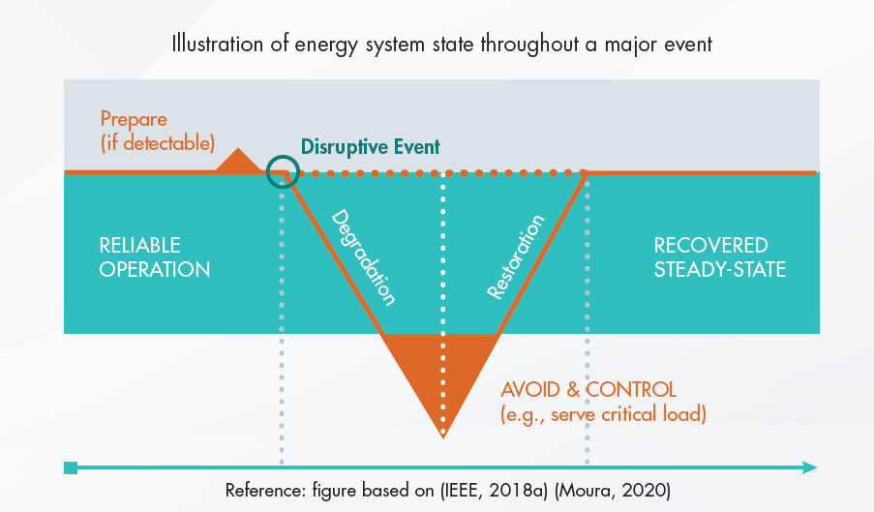
EPRI has provided this context
Threat Landscape
Recovery Timeline

Slide 9
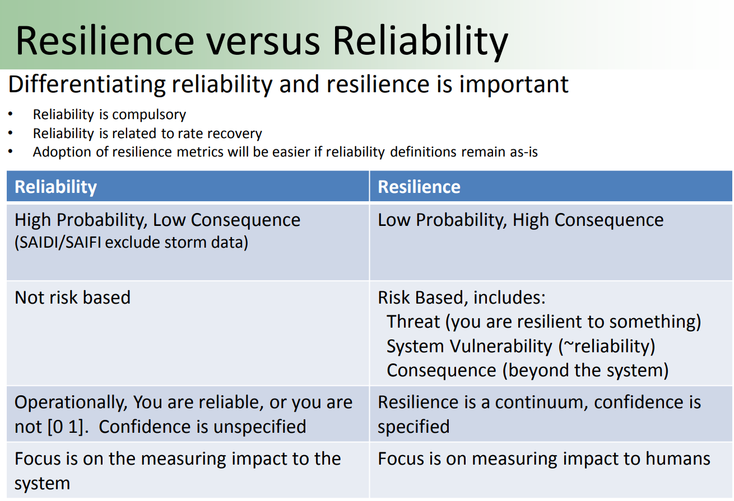
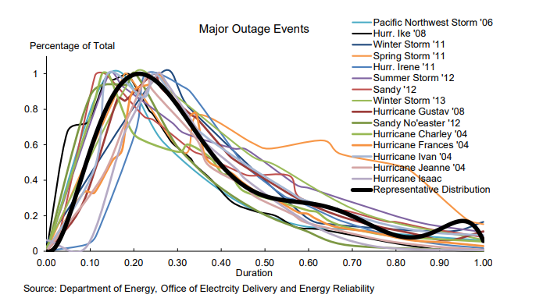
DOE-Sandia reference (1/2)
Resilience or Reliability
Recovery Timeline
https://www.osti.gov/servlets/purl/1340625
https://www.energy.gov/sites/default/files/2013/08/f2/Grid%20Resiliency%20Report_FINAL.pdf

Slide 10
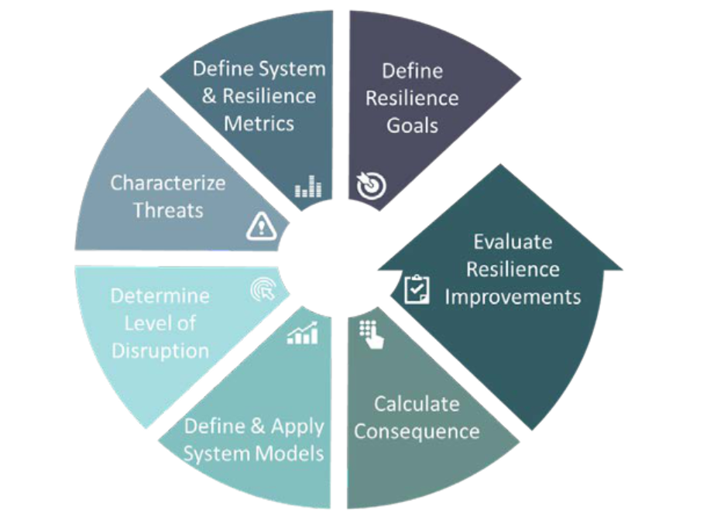
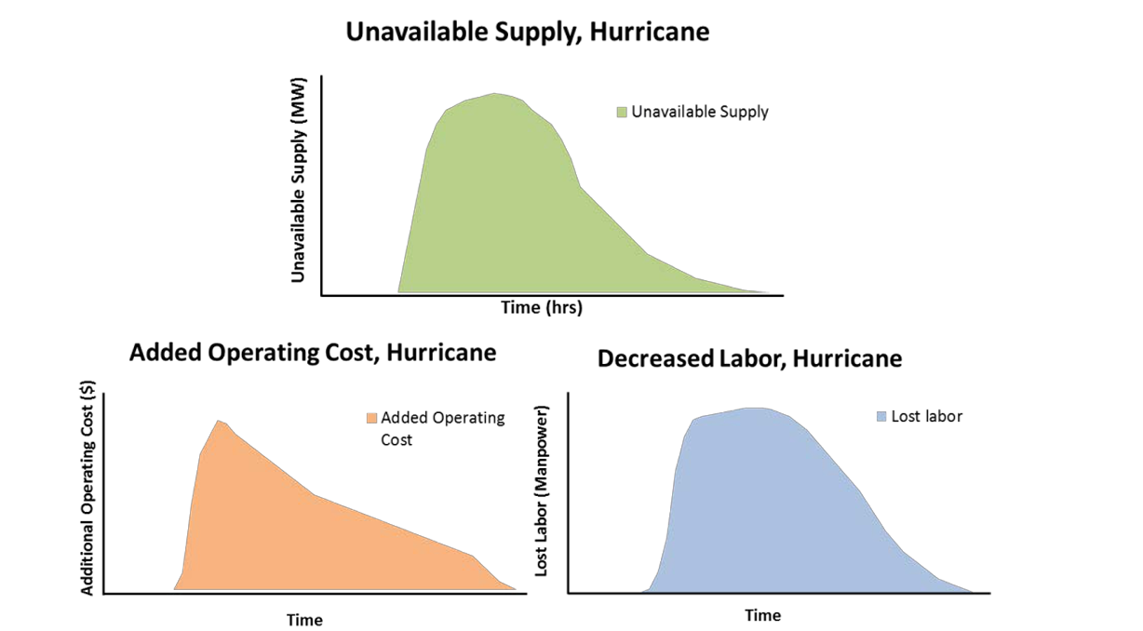
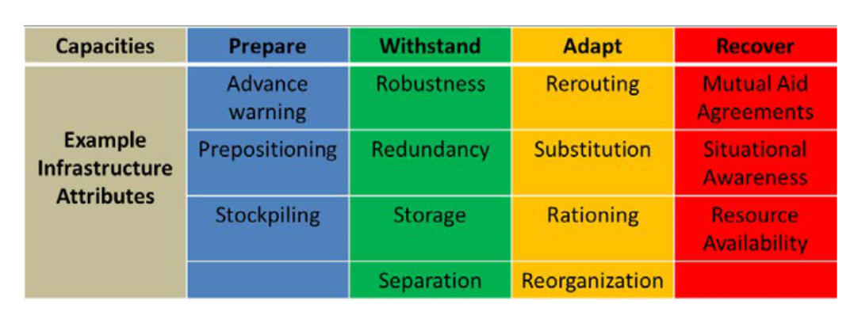
DOE-Sandia reference (1/2)
Resilience Analysis Process (counterclockwise)
Alternative Performance incorporating cost
Resilience Tactics
https://www.osti.gov/servlets/purl/1340625

Slide 11
Practical Examples from DRWG Data
Major Event Info that might inform Resiliency Metrics

Slide 12
Reliability and its Overlap with Resilience
Normal Distribution & Log Daily SAIDI Values

Slide 13
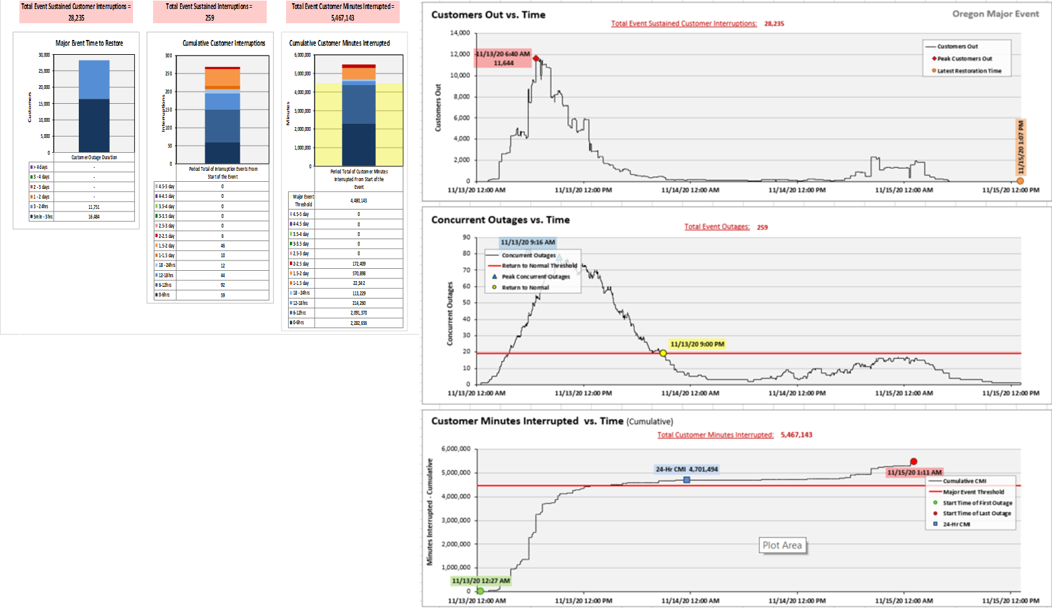
Resilience through Major Events
Example Resilience Metrics for x beta major event
Peak Customers Out
What’s not here? Cost, magnitude and what ifs for alternate outcomes (i.e. different response methods, system hardening)
Area under curve = number of outages (proxy for number of crew visits required)
Customer restoration information
Duration of Event

Slide 14
Summary
Questions?

