Slide 1
IEEE Distribution Resiliency Taskforce Update
Shikhar Pandey
Sr. Manager- DER Planning & Engineering
ComEd

Slide 2
IEEE DRES Chapter Outline
Electric distribution grid reliability and resiliency
Literature review
Grid resilience goals and objectives
System resilience assessment Methods: modeling, simulation and analysis
Resilience metric
Resilience improvement – infrastructure, operations and technology solutions
Case studies
Executive summary
The chapters aim to provide an understanding of resiliency, offer tools for utilities to study threats, quantify resilience metrics, and discuss system enhancements. It also includes case studies from five utilities across North America.

Slide 3
Resilience Guide Outline
Seven chapters, sub-sections for each chapters
Link T&D_DSC_DResWGTF_Guide_Outline - Google Sheets
Sub-groups for each chapters
CHAPTER | LEAD
CHAPTER 1: Literature Review | Masoud Davoudi
CHAPTER 2: Resilience Goal / Objectives | John Lauletta
CHAPTER 3: High Impact Weather / Storm Event Risk Identification | Ali Bidram
CHAPTER 4: Quantification of Resiliency | Shikhar Pandey
CHAPTER 5: System Modeling and Storm Simulation | Sarmad Hanif
CHAPTER 6: Infrastructure and Operational Improvements for Resilience | Julio Romero
CHAPTER 7: Case Study and Resiliency Study | Gary Huffman

Slide 4
Discussion guidance
All comments welcome today or later:
Please provide constructive feedbacks
Look to improve the metrics and content of the guide with ideas

Slide 5
What is Resiliency?
What is Resiliency?
FERC has proposed that resilience means the “ability to withstand and reduce the magnitude and/or duration of disruptive events, which includes the capability to anticipate, absorb, adapt to, and/or rapidly recover from such an event.”
Credit: Utility Dive Feb 2, 2018 by Kate Konschnik and Brian Murray
Proposed IEEE Definition
The capability of electric power distribution systems to deliver electric energy to end-use customers by avoiding interruptions and/or recovering this capability following exposure to naturally occurring high impact low frequency events.
IEEE Distribution Resiliency Focus
Out of scope: BES, Cyber/Physical Security, Operational Events
Primary Focus: Extreme Weather Events, Natural Phenomenon

Slide 6
A Comprehensive Suite of Metrics
Resiliency Metrics
Societal Impact
System Performance
Operational Performance
Comparative Metrics
Statistical Benchmark
Asset Risk Assessment
Emergency Storm Response
Automation Performance
Restoration Effectiveness
Under Development for Rev 1 of D-Resiliency Guide
Used by some Utilities – Case Study Available
Note: These metrics are designed by the IEEE Distribution Resiliency Taskforce. They are currently in draft and will be refined.
6

Slide 7
Comparative Metrics
Metric | Attributes | Historical Benchmark | Current Event Records | Performance Assessment
Storm Strength Comparison | Wind Speed | 70 mph | 80 mph | Increased wind speed, correlates with longer outages
 | Precipitation | 2 inches | 3 inches | Higher precipitation, potential cause for disruptions
Flood Comparison – Substations/Underground Equipment | Substation Outages due to Flood | 5 incidents | 3 incidents | Improved resilience, fewer outages
 | Underground Equipment Outages due to Flood | 10 incidents | 12 incidents | Slight increase, review flood mitigation strategies
Square Miles Impacted/Customer Density | Square Miles Impacted | 50 sq miles | 60 sq miles | Larger area impacted, reassess preparedness
 | Customer Density | 1,000 customers/sq mile | 1,200 customers/sq mile | Higher density, more significant impact
Pole Damage Comparison | Pole Damage Incidents | 15 incidents | 20 incidents | Increased incidents, consider reinforcement strategies
Equipment Damage Comparisons | Equipment Damage Incidents | 30 incidents | 52 incidents | Increased incidents, proactive maintenance strategy
Construction Man Hours to Restore Hardened vs. Non-Hardened | Construction Man Hours - Hardened | 500 hours | 450 hours | Improved efficiency, hardening measures effective
 | Construction Man Hours - Non-Hardened | 1,200 hours | 1,400 hours | Increased time, need for further hardening measures
Smart Grid Performance | Smart Grid - Interruptions Avoided | 300 incidents | 350 incidents | Improvement, smart grid enhancing resilience
Equipment Comparison (Transmission/Substation /Distribution) | Hardened Transmission (Outages) | 40,000 | 60,000 | Slight increase, still within acceptable limits
 | Non-Hardened Transmission (Outages) | 20,000 | 60,000 | Significant increase, highlights areas for improvement
 | Hardened Substation (Outages) | 80,000 | 60,000 | Improved performance, effective hardening measures
 | Non-Hardened Substation (Outages) | 86,667 | 125,333 | Increased, monitor for further hardening
 | Hardened Distribution (Outages) | 106,667 | 155,333 | Big increase, analysis needed
 | Non-Hardened Distribution (Outages) | 126,667 | 185,333 | Increased vulnerability, consider reinforcement
Restoration Comparison to Prior Events | Restoration - 24 hrs | 60% restored | 55% restored | Slight delay, assess resource allocation
 | Restoration - 48 hrs | 85% restored | 80% restored | Similar delay, possible need for more resources
 | Restoration - 72 hrs | 95% restored | 92% restored | Minor delay, review efficiency
 | Total Restoration Days | 5 days | 5.5 days | Slight increase, investigate specific challenges

Slide 8
Assets Risk Assessment
Climate Vulnerability Studies: Utilities are assessing risks from climate hazards to understand the impact on their assets.
Description | Temperature, Heat and Humidity | Flooding | Wind and Ice | Wildfire
Exposed Assets-At-Risk Properties | Thermal rating reduction, Accelerated asset degradation | Water-related equipment sensitivity, Corrosion, Soil Weakening | Wind and Ice Loading Tolerance, Vegetation Proximity | Fire-related equipment damage, Smoke on conductors, Soot accumulation over insulators, damaged insulators exhibiting high leakage currents, Vegetation Proximity
2. Asset-Risk Assessment Metric: Utilizes two matrices:
Exposure Properties to Risk Matrix: Identifies asset properties affected by climate change.
Assets-to-Exposure Matrix: Prioritizes asset strengthening based on risk levels (medium, high, low) against climate change variables.
Equipment vs Threat | Temperature, Heat and Humidity | Flooding | Wind and Ice | Wildfire
Substation | High Risk | High Risk | Low Risk | Low Risk
Overhead Equipment | Medium Risk | Low Risk | High Risk | High Risk
Underground Equipment | High Risk | Medium Risk | Low Risk | Low Risk

Slide 9
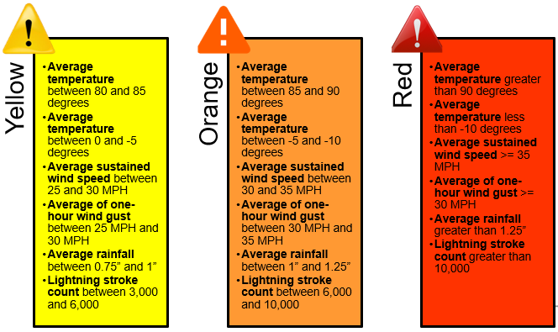
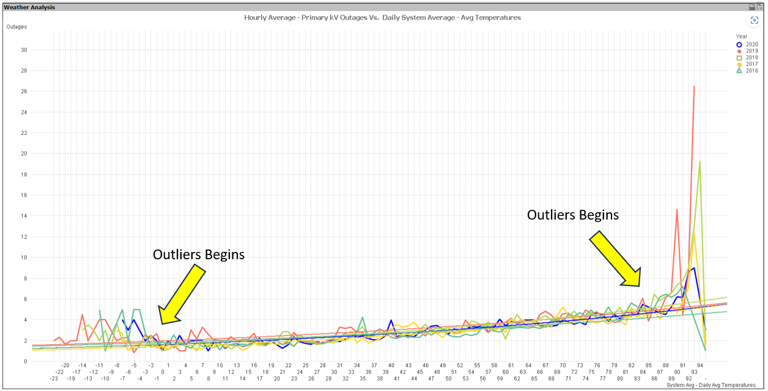
System Performance: Outages on Gray Sky days
Gray Sky Day: Focuses on robustness and the ability to withstand most weather events
We established a statistical benchmark based on weather parameters and historical outages
This benchmark tracks the system performance (of outages) during gray sky days
Temperature vs Outage

Slide 10
Automation Performance
Automation Performance Ratio (APR) = $\frac{Outages Avoided by Automation}{Outages Avoided by Automation + Sustained Outages}$
Aspect | Key Points
Perfect Resilience Scenario | Automation Performance Ratio of 1 signifies perfect resilience, ensuring uninterrupted service and high customer satisfaction.
Factors Influencing the Ratio | Automation Mechanisms: Impact on outage prevention. Sustained Outages: Causes like equipment failure or external disruptions.
Real-World Implications | Case Studies: Successful automation in outage prevention. Challenges: Areas where automation needs improvement.
Trends Over Time | Historical Analysis: Trends in Automation Performance Ratio and automation strategies. Continuous Improvement: Informing ongoing efforts.
Comparisons with Other Metrics | Comprehensive Resilience: Alignment with other metrics. Interconnected Nature: Holistic understanding of grid resilience.
Operational Considerations | Response Times: Speed of detection, decision-making, and execution. Adaptability: Handling different disturbances.
Scalability and Adaptability | Scalability Challenges: For larger grid systems. Technological Advances: Enhancing automation systems.
Practical Applications | Decision-Making Support: Helps in prioritizing investments. Customer Impact: Improved service reliability through outage prevention.

Slide 11
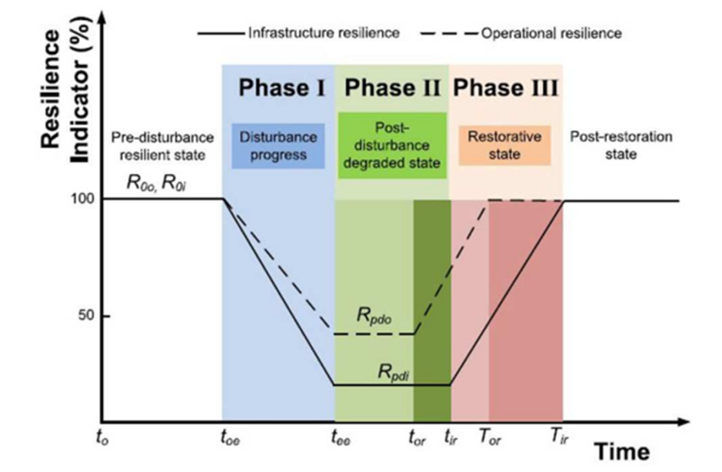
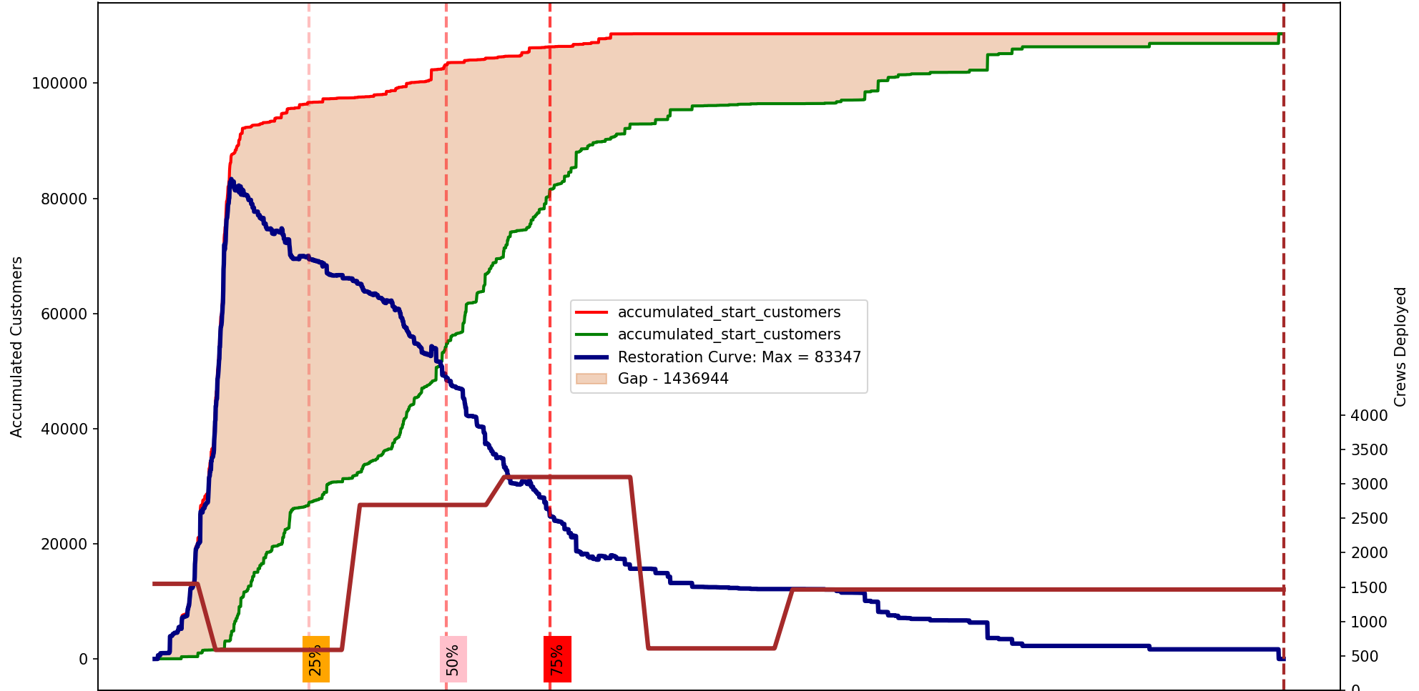
Emergency response effectiveness
Factors:
Total Outages – Intensity of the storm [Non-controllable]
Max Customer Interruptions – Indicator of crew efforts in curbing maximum degradation
Semi-Controllable – better human performance, lower CI.
But for severe events where all outages happen at the head end of the chart, there will be significant lag in start of restoration by crews
Area under the Restoration Curve – Indicator tracking restoration efforts vs emerging outages. Smaller the area under the curve better restoration performance [Controllable – Better human performance, lower AURC]
Crew Hours – Total hours spent on the field by crew [Controllable – Better human performance, lower crews needed for 100% restoration]
Storm duration
Full restore time – Controllable but already captured by AURC
If Customer Interruptions is the resilience indicator in this figure, then the operational resilience is enabled by restoration efforts, both automated and by crew work
Max Customer Interruptions
Area under the Restoration Curve
DRAFT IMAGE
Crew Hours

Slide 12
Sample Calculations for 9 storms
Wide range – compression required. Use Log scale
ERF = $log(\frac{AURC}{CI}.\frac{CrewHours}{Outages})$
Insights:
Lower crew
Lower max customer Interruptions
Lower AURC
Customers Interruptions | AUC | Outages | CREWS | ERF
96,570 | 2,765,000 | 1,513 | 227,257 | 3.63
61,021 | 3,590,000 | 921 | 82,764 | 3.72
49,107 | 4,164,000 | 966 | 58,118 | 3.71
4,424 | 4,204,136 | 195 | 65,030 | 5.5
112,134 | 8,160,396 | 2,184 | 190,774 | 3.8
65,920 | 9,717,651 | 723 | 150,944 | 4.49
11,983 | 9,910,036 | 411 | 52,344 | 5.02
18,502 | 10,145,170 | 291 | 48,933 | 4.96
83,347 | 11,582,114 | 930 | 81,456 | 4.09

Slide 13
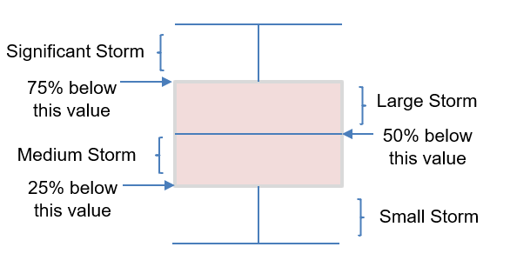
Restoration Effectiveness
Max Outage
Z
Threshold “Y” is calculated based on data analytics of small, medium, large, and significant size storm with 5 year moving average data. Details are explained in IEEE distribution resiliency guide.

Slide 14
Takeaways and Next Steps
ComEd has been utilizing two metrics, restoration effectiveness and Gray Sky day, since 2020.
These metrics have allowed ComEd to concentrate on system enhancements and improvements in resiliency.
Through the IEEE Distribution Resiliency Working Group, three other utilities have adopted the restoration effectiveness and Gray Sky day metrics for their systems.
Additional metrics are being developed to be included alongside case studies in the guide.
Support Utilities to finalize case study and include in the guide.
The first draft of the guide available for review by IEEE DRES Taskforce meeting at the PESGM conference.
Regulators and stakeholders continue to use the IEEE 1366 metrics (the SAIDI sisters) to assess the impact of resilience events.

Slide 15
Thank you

