Slide 1
IEEE SAR Metadata Stds Meeting
September 24, 2020

Slide 2
Today's Agenda
1. Call to Order
2. Approval of the agenda
3. Approval of minutes of previous meeting
4. IEEE Patent Policy
5. Discussion of Draft Standard
6. Other business
7. Future meeting
8. Adjourn

Slide 3
2. Approval of Agenda
1. Is there a motion for approval of the agenda?
2. Is there a second?
3. Is there discussion?
4. Is there any opposition?
5. Vote if needed

Slide 4
3. Approval of Minutes of previous mtg
see: https://sagroups.ieee.org/sar/
1. Is there a motion for approval of the minutes?
2. Is there a second?
3. Is there discussion?
4. Is there any opposition?
5. Vote if needed

Slide 5
4. IEEE Patent and Copyright Policy

Slide 6
PATENT POLICY INFORMATION
Participants have a duty to inform the IEEE
Participants shall inform the IEEE (or cause the IEEE to be informed) of the identity of each holder of any potential Essential Patent Claims of which they are personally aware if the claims are owned or controlled by the participant or the entity the participant is from, employed by, or otherwise represents.
Participants should inform the IEEE (or cause the IEEE to be informed) of the identity of any other holders of potential Essential Patent Claims.
Early identification of holders of potential Essential Patent Claims is encouraged.

Slide 7
PATENT POLICY INFORMATION
Ways to inform the IEEE
Cause an LOA to be submitted to the IEEE SA (patcom@ieee.org); or
Provide the chair of this group with the identity of the holder(s) of any and all such claims as soon as possible; or
Speak up now and respond to this Call for Potentially Essential Patents
If anyone in this meeting is personally aware of the holder of any patent claims that are potentially essential to implementation of the proposed standard(s) under consideration by this group and that are not already the subject of an Accepted Letter of Assurance, please respond at this time by providing relevant information to the WG Chair.

Slide 8
IEEE SA COPYRIGHT POLICY
By participating in this activity, you agree to comply with the IEEE Code of Ethics, all applicable laws, and all IEEE policies and procedures including, but not limited to, the IEEE SA Copyright Policy.
Previously Published material (copyright assertion indicated) shall not be presented/submitted to the Working Group nor incorporated into a Working Group draft unless permission is granted.
Prior to presentation or submission, you shall notify the Working Group Chair of previously Published material and should assist the Chair in obtaining copyright permission acceptable to IEEE SA.
For material that is not previously Published, IEEE is automatically granted a license to use any material that is presented or submitted.

Slide 9
IEEE SA COPYRIGHT POLICY
The IEEE SA Copyright Policy is described in the IEEE SA Standards Board Bylaws and IEEE SA Standards Board Operations Manual
IEEE SA Copyright Policy, see Clause 7 of the IEEE SA Standards Board Bylaws https://standards.ieee.org/about/policies/bylaws/sect6-7.html#7 Clause 6.1 of the IEEE SA Standards Board Operations Manual https://standards.ieee.org/about/policies/opman/sect6.html
IEEE SA Copyright Permission
https://standards.ieee.org/content/dam/ieee-standards/standards/web/documents/other/permissionltrs.zip
IEEE SA Copyright FAQs
http://standards.ieee.org/faqs/copyrights.html/
Distribution of Draft Standards (see 6.1.3 of the SASB Operations Manual)
https://standards.ieee.org/about/policies/opman/sect6.html

Slide 10
5. Discussion of Draft Standard
Wade: Polynomials vs. Grids

Slide 11
Polynomial in SICD
SICD currently uses polynomial to describe 1- and 2-dimension functions
IPPPoly (1D; valid over collection time; frequently order 1)
ARPPoly (3 1D; valid over collection time)
PFA polar angle polynomials (1D; valid over collection time)
TimeCAPoly (1D; valid over image space; nearly always linear)
Center of aperture time (2D; valid over image space)
NoisePoly/Radiometric (2D; valid over image space)
DeltaKCOAPoly (2D; valid over image space)
Doppler centroid/rate (2D; valid over image space; related to col.DeltaKCOAPoly)
Antenna polynomials (many polynomials, some not explicitly defined over what extent they are valid)

Slide 12
Alternatives
Provide a set of samples AND specify a method for interpolating between those samples
Natural cubic splines is one frequently used option
Sometimes better behaved than polynomials with regard to oscillations
Discontinuities, endpoints, high order fit
Splines moderately more difficult to work with than polynomials (particularly for 2D surfaces), but a number of libraries support them
Differentiable/integrable which is an important operation for some of the polynomials such as DeltaKCOAPoly and polar angle polynomials
Differentiable/continuous/smooth is a requirement. Would this ever be a problem (antenna patterns past mainlobe?)
Uniquely determined for any set of sample points
A polynomial is a spline of one segment.

Slide 13
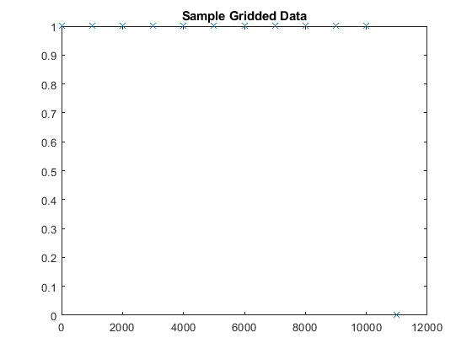
Toy Problem
Flat function across most of its domain with dropoff near end
Following slides will show various interpolations
None are really “right”, since we’ve only provided a set of points with not truth of what should fall between them.
Just illustration of different ways

Slide 14
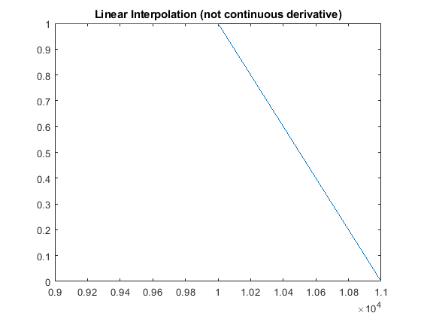
Toy Problem: Linear Interpolation
Flat function with dropoff near end
Zoomed in at right end

Slide 15
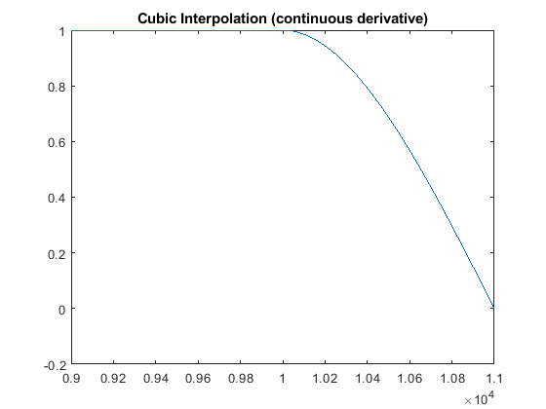
Toy Problem: Cubic Interpolation
Flat function with dropoff near end
Zoomed in at right end

Slide 16
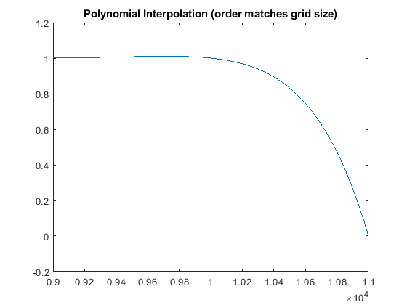
Toy Problem: Polynomial Interpolation
Flat function with dropoff near end
Zoomed in at right end

Slide 17
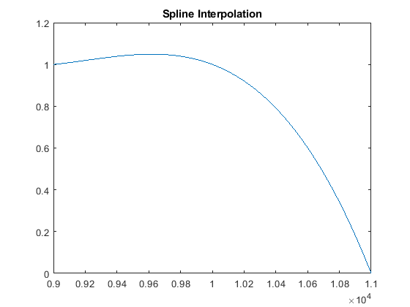
Toy Problem: Spline Interpolation
Flat function with dropoff near end
Zoomed in at right end

Slide 18
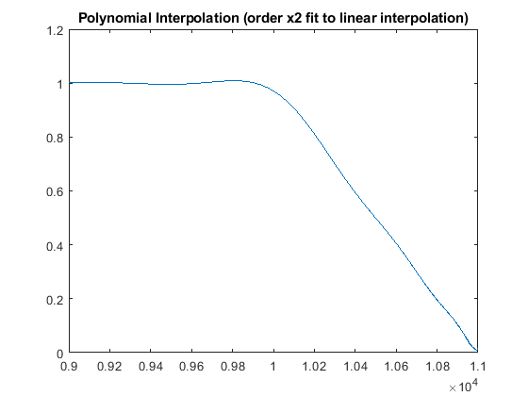
Toy Problem: Polynomial oversampled
Flat function with dropoff near end
Zoomed in at right end

Slide 19
Fields where it likely doesn’t matter
IPPPoly
Frequently linear. All data I am aware of is well described by polynomial.
TimeCAPoly
Linear in all cases I am aware of

Slide 20
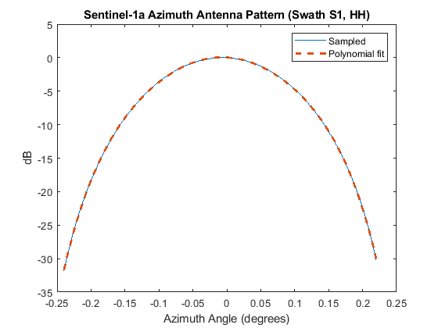
Antenna Pattern
Sentinel-1 provides 401-point sampled azimuth antenna pattern out to several sidelobes (about 100 samples of which cover mainlobes)
6th order least-squares polynomial fit describes Sentinel-1a mainlobe down to -30dB with RMS error of <0.1dB (max deviation of 0.2dB)
6 segment cubic spline provides nearly identical fit (difference of RMS and max errors on the order of hundredths of dB)
Both behave reasonable for relatively low orders. Polynomial degenerates for very high orders.
Necessary to define extent of validity for polynomial

Slide 21
Sensor Position
Orbital system position defined to high fidelity with polynomials
JPL orbital interpolation study
Study performed to determine required sampling rates for state vectors and suggested interpolation methods. Various types of polynomial fit were examined.
Some solutions to polynomial representation were shown to have accuracy on the order of hundredths of a millimeter, even with 10-second sampling rate.
That said, JPL still has chosen to release state vectors for NISAR.
State vectors with suggested method for polynomial fit vs direct polynomial coefficients are equivalent. Different representations of exactly the same thing.
Airborne systems
Polynomial certainly will not capture deviations from ideal flight path due to turbulence
These deviations probably not necessary for SLC exploitation though.
Many airborne data formats only provide a single position/velocity (maybe more if circular flight)

Slide 22
Doppler Centroid/Rate
Generally follows polynomial behavior
Is provide as a polynomial by the following providers
Cosmo Skymed
ICEYE
PALSAR2
RADARSAT-2/RCM
Sentinel-1
TerraSAR-X (Doppler rate only)
DeltaKCOAPoly is derived from these, so we will group it in there as well

Slide 23
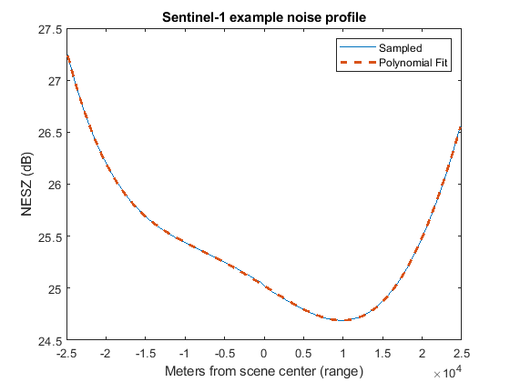
Radiometric
Example Sentinel-1 noise profile (vs range)
534 samples in this example
Polynomial 6th order fit
Max error between sampled data and polynomial fit of around 0.01 dB
Spline (6 segments)
Max error also around 0.01 dB

Slide 24
Conclusions
Not aware of a counter-example for SAR metadata where a polynomial representation does not suffice for SLC processing.
Spline representations may have some theoretical benefit.
Optimize vs “If it ain’t broke, don’t fit it”
Antenna field still of questionable utility for SLC to this reviewer

Slide 25
6. Other Business
Anyone can bring up another topic...

Slide 26
7. Future Meetings
Our next meeting will be in 2 weeks:
Thursday, October 1, 2020, 11AM Eastern Time.

Slide 27
8. Adjourn
1. Is there a motion to Adjourn?
2. Is there a second?
3. Is there discussion?
4. Is there any opposition?
5. Vote if needed

